Slide 2
Stay Informed
The Department of Procurement Services is committed to Communications and Outreach, which is key to keeping citizens informed of bid opportunities, new programs, and innovations.
We encourage you to follow us social media to stay informed. You can find us on LinkedIn, Facebook, Twitter, and YouTube.

Slide 3
We encourage you to visit the DPS table for additional resources and to ask any questions about doing business with the City.
You can also contact us anytime via email at DPS.Feedback@CityOfChicago.Org

Slide 4
Ciere Boatright Commissioner

Slide 5
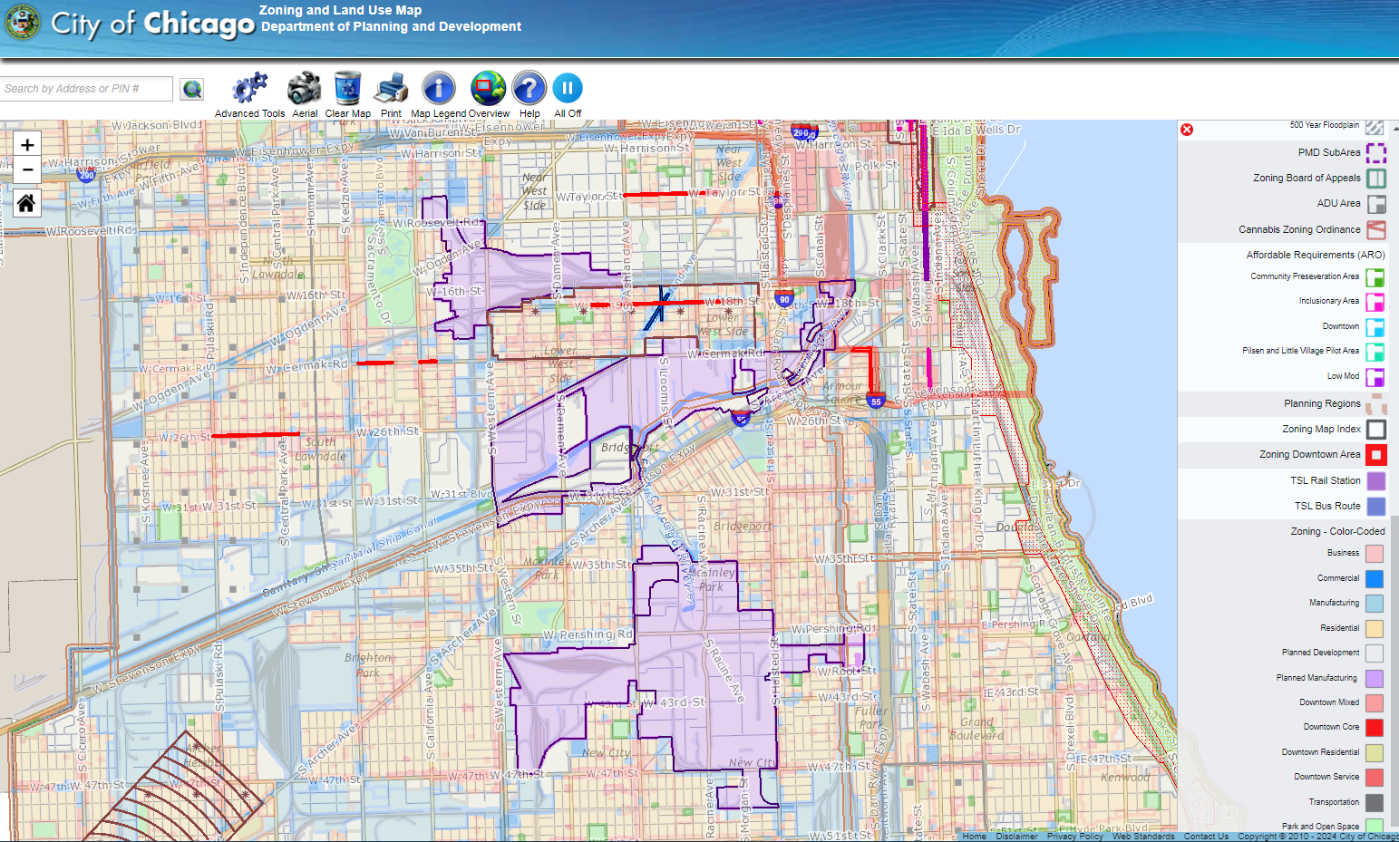
Chicago.gov/ZoningMap

Slide 6
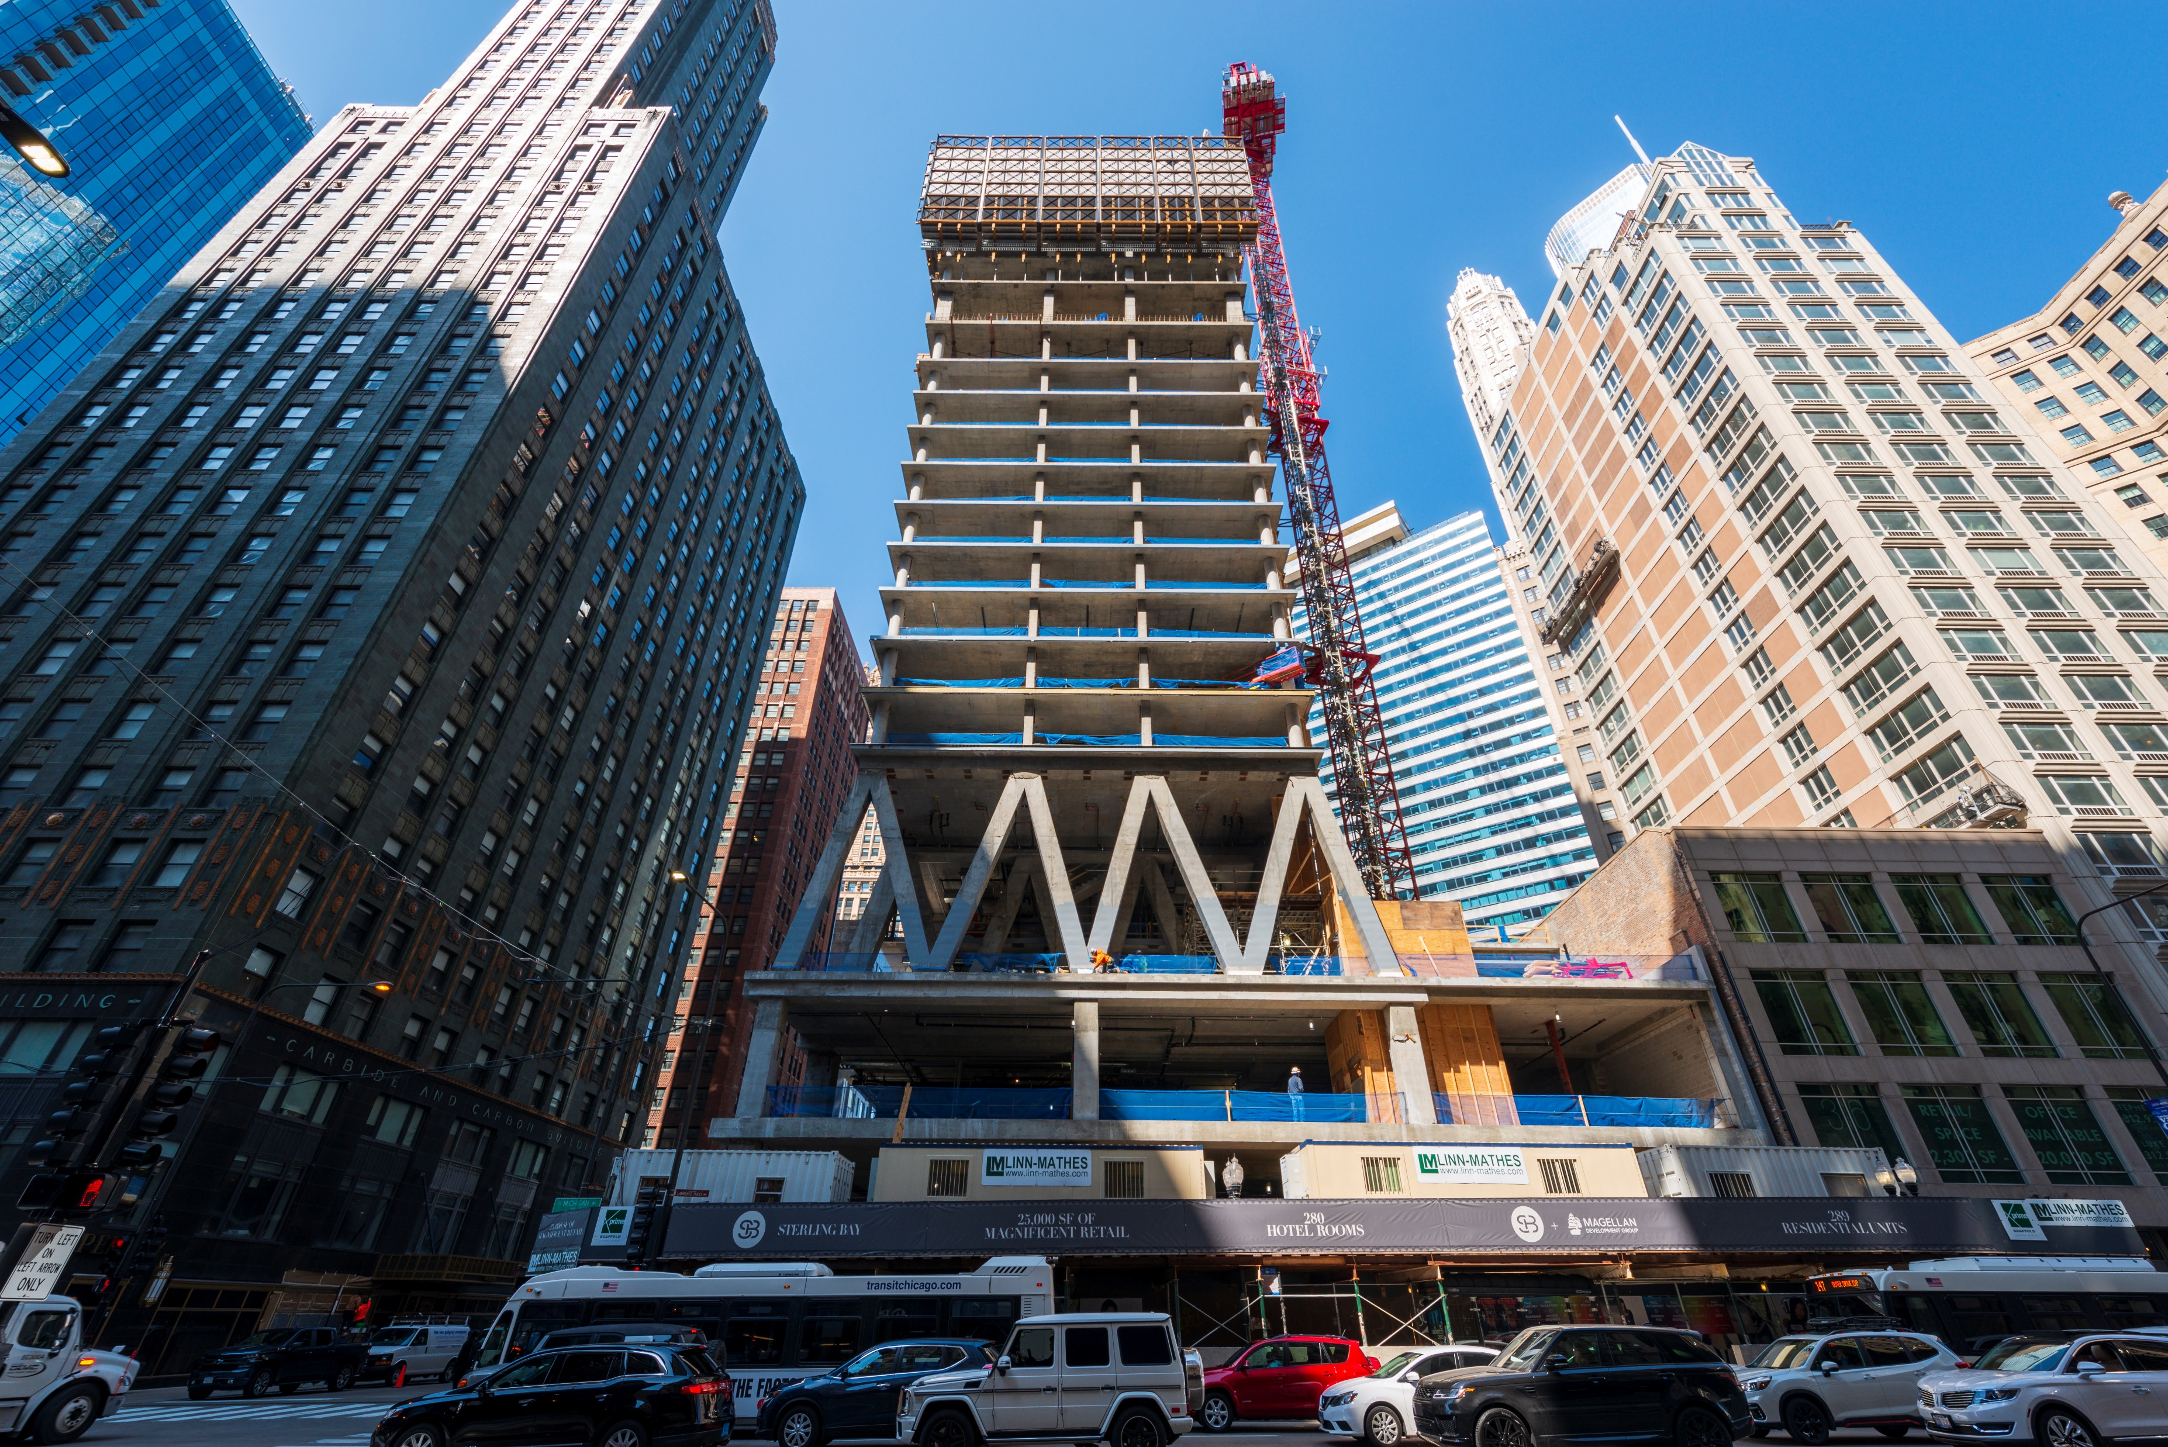

Slide 8
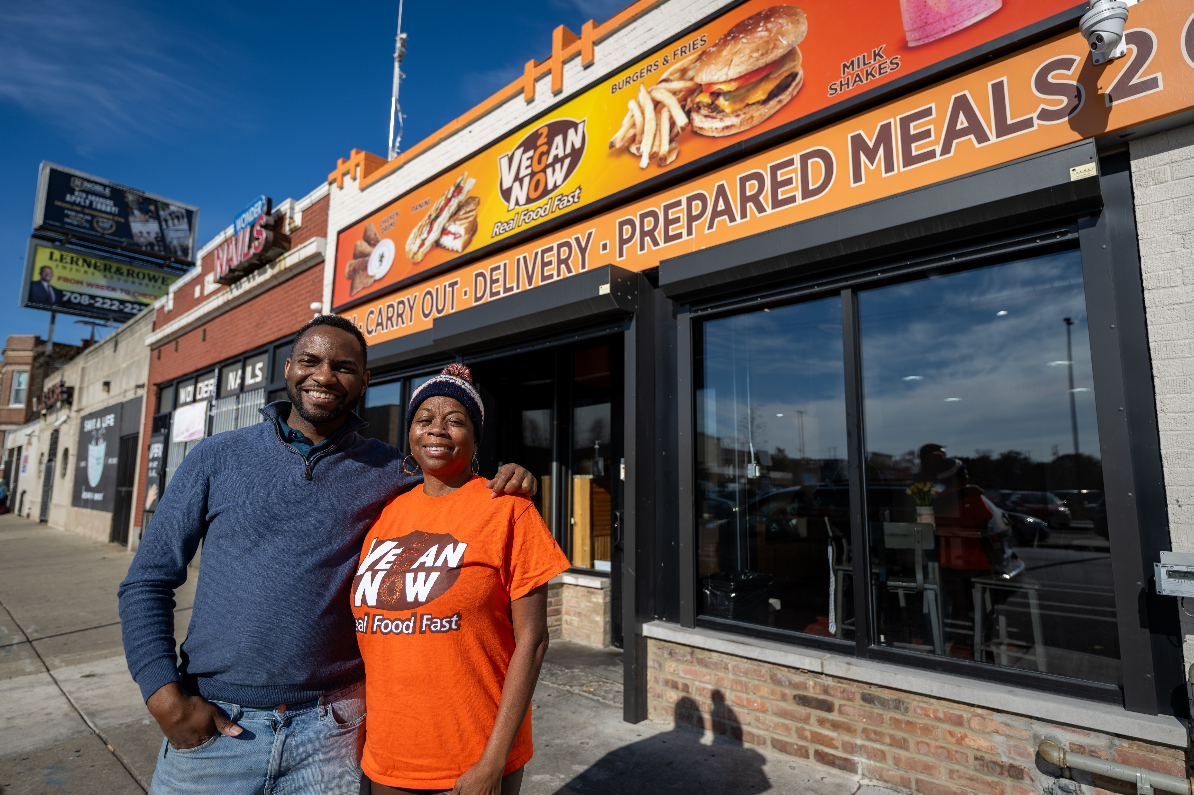

Slide 9
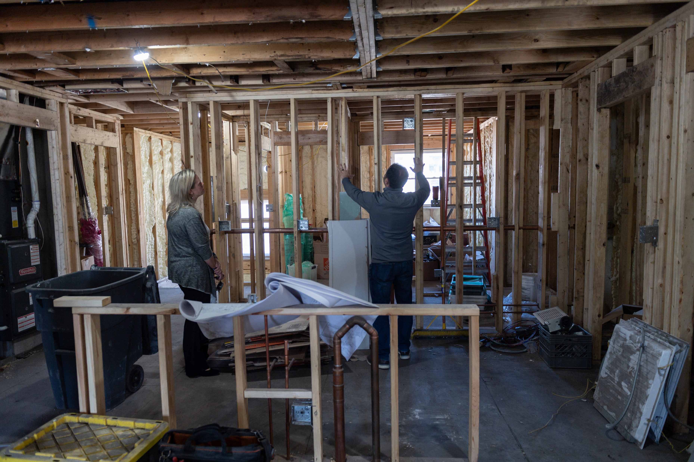

Slide 10
