Slide 2
Stay Informed
The Department of Procurement Services is committed to Communications and Outreach, which is key to keeping citizens informed of bid opportunities, new programs, and innovations.
We encourage you to follow us social media to stay informed. You can find us on LinkedIn, Facebook, Twitter, and YouTube.

Slide 3
We encourage you to visit the DPS table for additional resources and to ask any questions about doing business with the City.
You can also contact us anytime via email at DPS.Feedback@CityOfChicago.Org

Slide 4
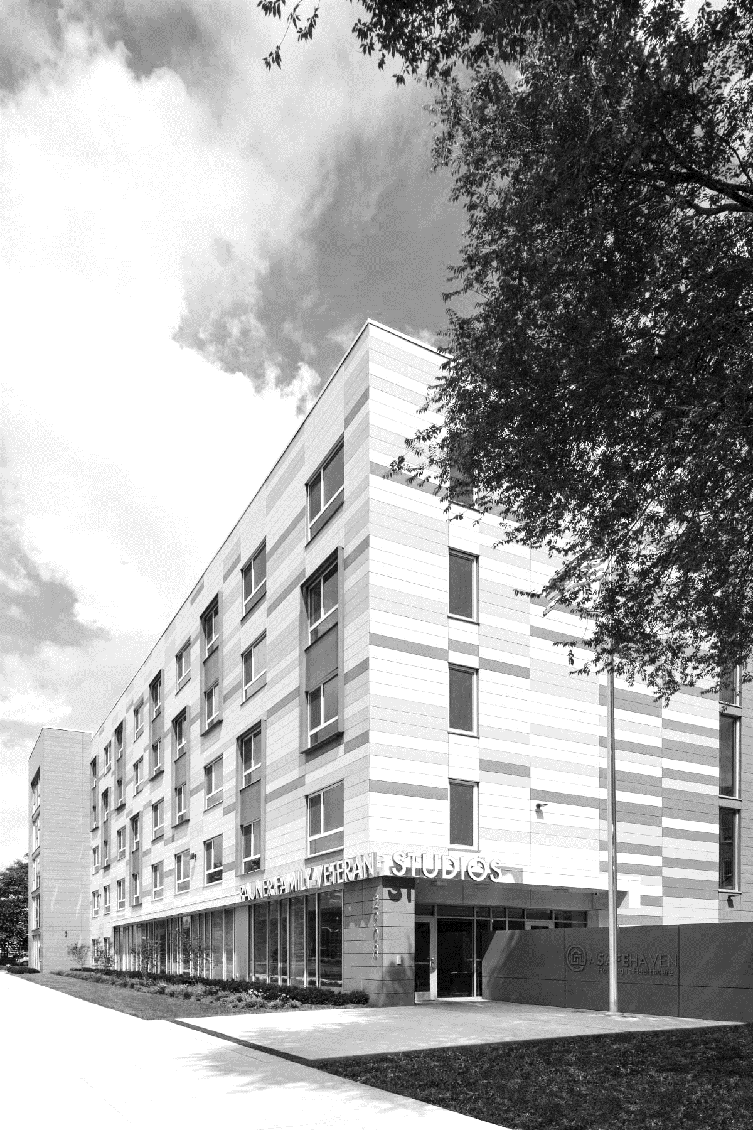
Chicago Department of Housing
Commissioner Lissette Castañeda
Notes:
Good morning,
It is with great pleasure that I welcome you today’s Construction Summit hosted by our colleagues in the Department of Procurement Services. Today, we come together to promote construction opportunities in our respective departments and DOH is excited to share what we have to offer.
Generally, the Department of Housing has made remarkable strides toward building better, stronger, and safer neighborhoods across the City.
Our efforts are aligned with the vision of Mayor Brandon Johnson, who envisions a Chicago that stands as a testament to resilience, community, and prosperity. His commitment to the well-being of our neighborhoods has been an unwavering force, and we are grateful for his leadership.

Slide 5
Racial Equity Lens DOH is committed to understanding how systemic and structural racism have shaped policies and decision-making in housing and strives to create more equitable outcomes by applying a racial justice lens to DOH’s work
Mission
Chicago’s Department of Housing expands access and choice for residents and protects their right to quality homes that are affordable, safe and healthy.​​​
Vision The equitable distribution of resources across all 77 communities so that every Chicagoan can choose and remain in quality housing that’s affordable, safe and healthy. ​​​
Notes:
A pillar of DOH's mission is the unwavering dedication to increasing homeownership. We understand that thriving communities are built on the foundation of secure and stable homes. This year, we have intensified our commitment to preserving existing homeownership, keeping families in their homes, and breathing life back into vacant and abandoned houses that have long stained our blocks.

Slide 6
2,800
Multi-family affordable units created or preserved in 2023
2,893
1,543
Affordable units created by ARO
Tenants served with rental subsidies in 2023
25,462
Affordable rental units in inventory
325
Single family homes created or preserved in 2023
368
Homeowners served in 2023

Slide 7
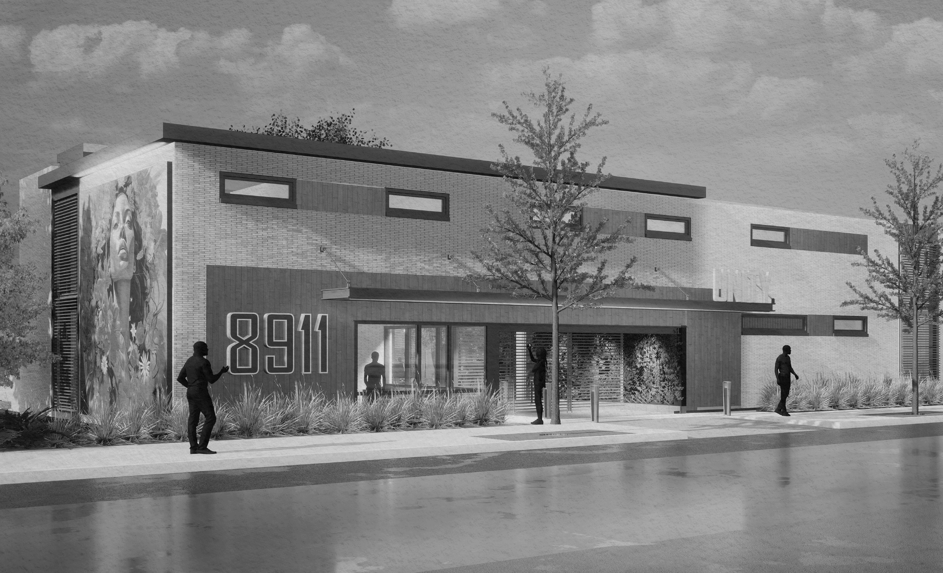
What does DOH do?
Affordable Rental (30-80% AMI)
Homeownership
(60-150% AMI)
Homelessness​
(0-30% AMI)
Policy Development
Community Engagement & Racial Equity

Slide 8
Preventing Homelessness
Build and Preserve Permanent Supportive Housing (PSH)
Monitor, preserve, and rehab Single-Room Occupancy buildings (SROs)
Provide rental subsidies to low-income tenants
Provide right-to-counsel program to tenants facing eviction
Transition emergency shelters to Non-Congregate Housing
Notes:
Non-Congregate Shelter Acquisition Program
In partnership with the Department of Family and Support Services (DFSS) DOH released a RFP to fund the acquisition and possible rehabilitation of buildings and/or other properties within the City of Chicago to be used as Non-Congregate Shelter (NCS) for people experiencing homelessness.
There will be construction opportunities to rehab the acquired properties.

Slide 9
2024 Goals
Mission Critical:
SRO Preservation Loan Fund 2023 Outcomes:
Complete preservation of 400+ units
Secure $15M per year of additional funds to expand the SROPLF
101 Units in pipeline
Add 500+ units to pipeline
413 Units preserved
312 Units renovated or under construction
Preserve and rehabilitate existing SROs by providing grants for major property renovations.
Notes:
Add 500+ units to pipeline ** with more money

Slide 10
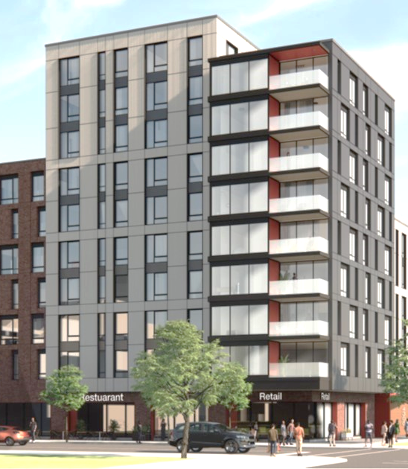
Affordable Rental
Create and preserve multi-family affordable rental housing
Implement the ARO, Chicago’s inclusionary zoning policy
Rescue troubled buildings and transfer them to responsible owners
Monitor and enforce building standards and income limits on 25,000+ units
Encourage housing development through policy and ordinance (e.g., ADUs, eTODs)

Slide 11
2024 Goals
Mission Critical:
Building Multi-Family Rental Housing
2023 Outcomes:
Construction starts on 2,000+ additional units (28 dvlpmts)
1345 Units closed Q1 - Q3 2023
Select and add 15 dvlpmts (1460 units) to pipeline
Increased BIPOC developer and GC participation
2,015 Units created this year
Racial Equity Goals
670 Units closed Q4 2023
Consultant-led REIA of 2021 QAP to be conducted in 2024
Create a pipeline of rental construction and preservation by programming LIHTC, HOME, CDBG, TIF, and other funding resources
Notes:
Multi-family affordable housing
The Department of Housing invites housing developers to apply for public funds and other subsidies to build and rehabilitate affordable rental properties in the City of Chicago.
Once funded, Developers are encouraged to actively seek MBE General Contractors for their multimillion-dollar projects. Additionally, construction opportunities are available for mid to large companies through the developers’ general contractor as subcontractors.

Slide 12
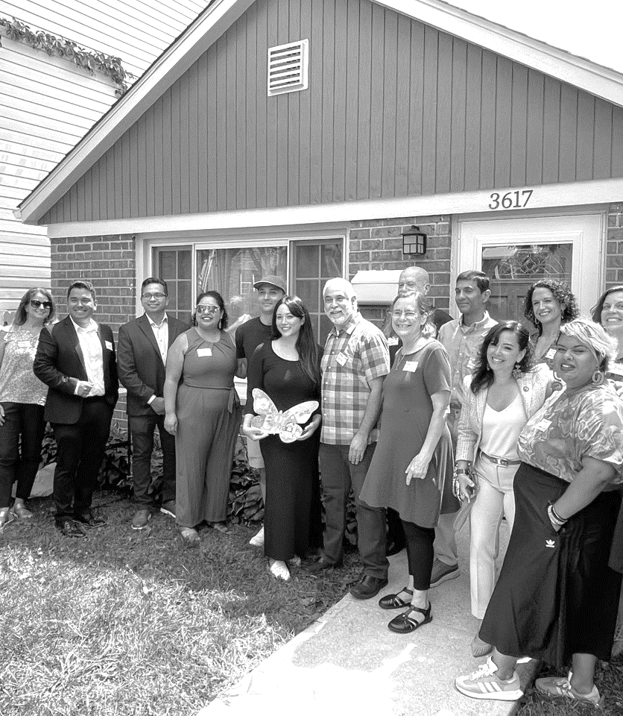
Homeownership
Administer home repair programs for low-income homeowners
Build new affordable homes on vacant land
Provide purchase price assistance grants to low-income buyers
Support coops and shared-equity models of homeownership
Decarbonize existing homes to decrease utility bills and address climate change
Notes:
Creating affordable housing in target neighborhoods
The Chicago Neighborhood Rebuild pilot program aims to rehabilitate vacant homes and place at-risk youth in jobs. In turn generational wealth us increased and low-income families can buy rehabbed homes for lower prices.​
The initiative uses trained BIPOC developers to work on city construction projects to develop and rehabs the ‘bad houses’ on a block to enhance the look of the community.
Residential Housing Decarbonization and Retrofits
The Department of Housing (DOH) has selected grantees to equitably decarbonize one-to-four-unit residential buildings in Chicago by providing low- and moderate-income homeowners with home upgrades including new insulation and heat pump heating and cooling systems. Retrofits may also include induction stoves, heat pump water heaters, heat pump clothes dryers, air sealing around doors and windows, smart thermostats, and other interventions.
The Grantees are committed to using BIPOC firms in this rapidly growing industry.

Slide 13
2024 Goals
Mission Critical:
Building Single-Family Homes on Vacant Land
2023 Outcomes:
Build 83 homes (54 affordable, 29 market)
182
389
100
Provide 25 down payment grants for new homes
90 Vacant lots approved for home construction
ChiBlockBuilder Applications for vacant land received and reviewed
Vacant parcels across 19 developers selected to advance towards home construction
Lots approved for development in North Lawndale (14 lots have development in process)
Access of city-owned land by small developers to create quality homes for working families
Notes:
Affordable Homeownership:
Developers can access opportunities to build single family homes by applying through the Chi Block Builder Platform during open rounds.
There must be evidence of a developer’s financial capacity and ability to obtain project financing. They must also show proven depth and quality of experience in successfully developing residential buildings in the community where the selected development is located, or in a community with similar market characteristics.
Construction opportunities are available with the development teams once selected.

Slide 14
2024 Goals
Mission Critical:
Home Repair Program
2023 Outcomes:
New RFP to increase contractor pool
7
342
Serve 500+ homeowners
6 of 7 new contractors are BIPOC firms
Racial Equity Goals
Small and emerging contractors hired to directly perform home repairs
Repairs provided in 2023
Double the number of BIPOC contractors providing services
Preserve homeownership through critical home repairs that keep low-income homeowners stably housed
Notes:
Home repair program
Formerly known as the Roof and Porch Repair Program, the Home Repair Program (HRP) provides grants to income-eligible homeowners for improvements to their roof or porch. By providing this necessary support, the City helps Chicagoans maintain safe and comfortable living conditions and avoid displacement.
Additionally, the repairs are completed by contractors hired by DOH and/or its delegate agencies. We switched our sourcing strategy a few years ago to specifically increase the for small, historically under-utilized businesses to align with the department's racial equity goals and to provide an additional vehicle for stimulating generational wealth. Last year we awarded HRP work to two additional delegate agencies and five general contractors that are Black, Indigenous, and People of Color (BIPOC).

Slide 15
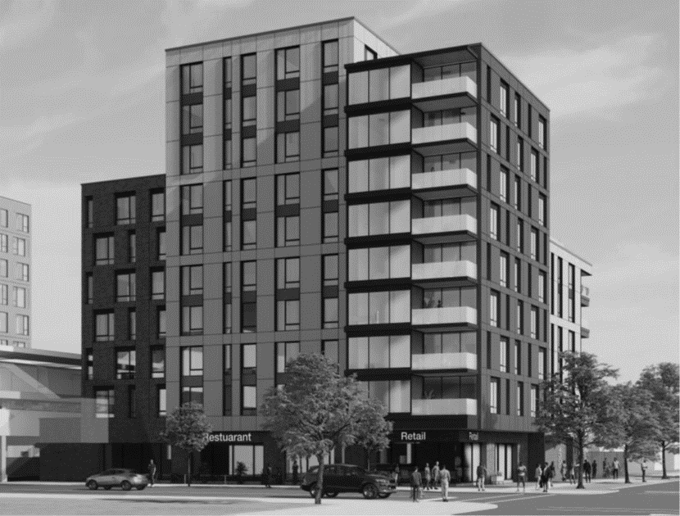
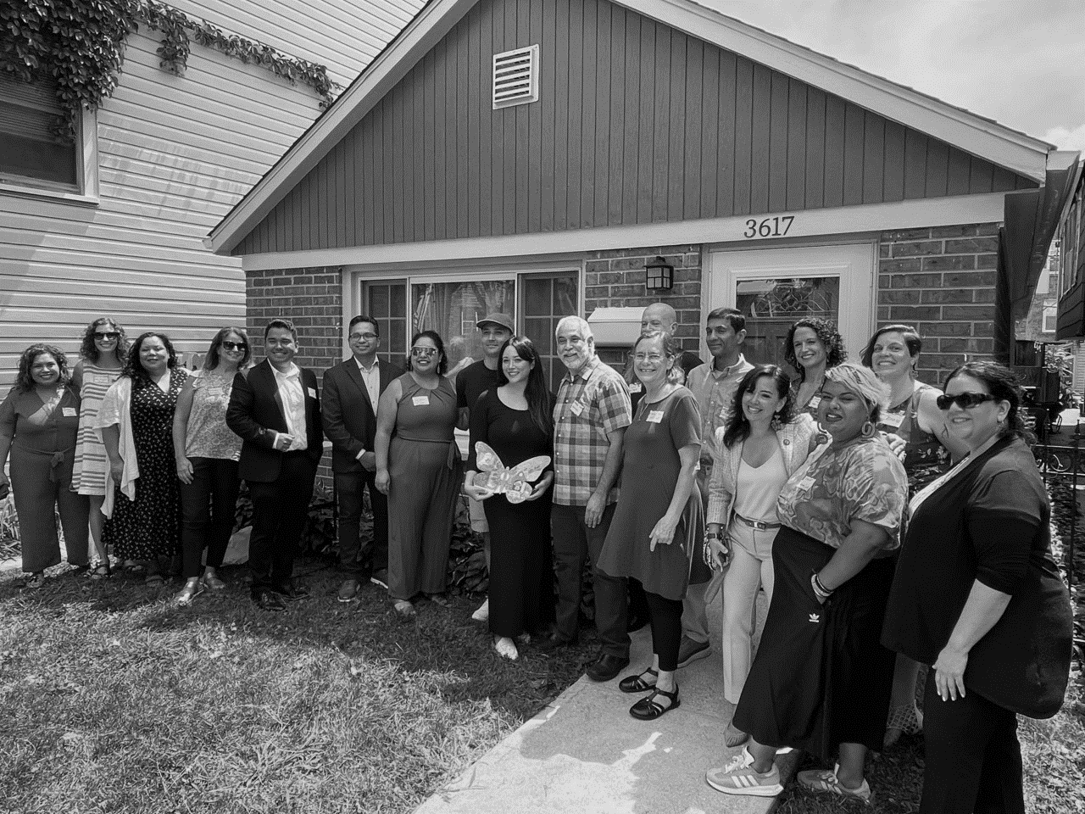
Looking Ahead to 2024
Fund SRO Preservation Loan
Transition to non-congregate shelters
Announce 2023 affordable rental projects
Stand up the Mayor’s Green Social Housing
Launch Chi-Mortgage
Expand Rebuild
“Cut The Tape” initiative to lower costs and shorten development timelines
Provide capacity building and training to scale contractors​
Notes:
1. Secure funds to continue and expand the SRO Preservation Loan Fund Pilot Program
2. Transition over 300 congregate shelter beds via the Non-Congregate Shelter program
3. Select and announce next round of affordable rental projects
4. Stand up the Mayor’s Green Social Housing revolving loan fund
5. Launch Chi-Mortgage, a new mortgage assistance grant
6. Expand Rebuild with $20M of state funding

Slide 16
Please visit the DOH Exhibitor table and scan the QR code to express your interest in working on DOH funded projects.

