Slide 2
Stay Informed
The Department of Procurement Services is committed to Communications and Outreach, which is key to keeping citizens informed of bid opportunities, new programs, and innovations.
We encourage you to follow us social media to stay informed. You can find us on LinkedIn, Facebook, Twitter, and YouTube.

Slide 3
We encourage you to visit the DPS table for additional resources and to ask any questions about doing business with the City.
You can also contact us anytime via email at DPS.Feedback@CityOfChicago.Org

Slide 4
City of Chicago Fleet and Facility Management (2FM)
Julie Hernandez-Tomlin Commissioner
Glen Cross
Managing Deputy

Slide 5
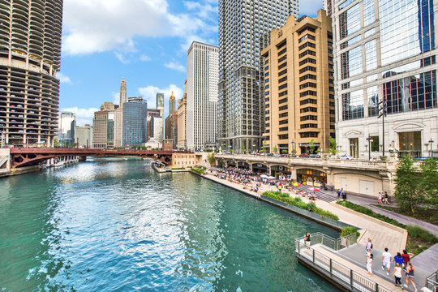
Fleet and Facility Management (2FM)
2FM Supports the operations of other City Departments by providing high-quality and cost-effective services.
The Mission of the Department of Fleet and Facility Management (2FM) is to support the operations of other City of Chicago departments and agencies by providing high-quality and cost-effective asset management and services.
2FM ensures the safe and efficient use of the City of Chicago’s assets through effectively managing the maintenance and repair of vehicles, equipment, and properties occupied by the City.
In addition, the department is responsible for space planning, advancing energy efficiency, brownfield development, procuring utilities, coordinating document retention services, providing graphic and mail services.
2FM strives to meet or exceed industry standards, best practices, and the expectations of our user departments.

Slide 6
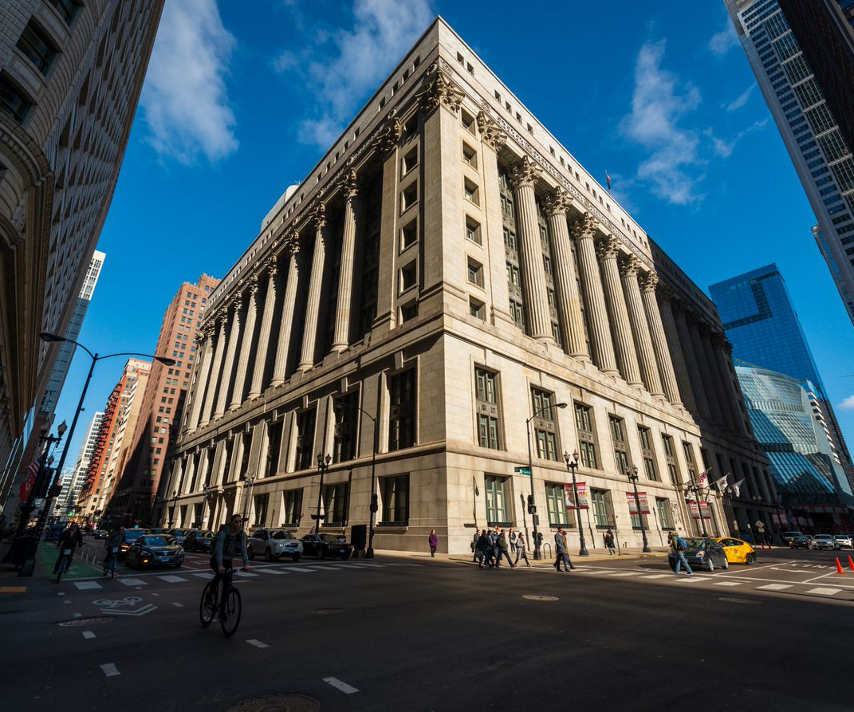
Fleet and Facility Management (2FM)
451 City Owned Buildings
Over 22,000,000 Square Feet
81 Libraries, 26 Police Stations, 92 Fire Houses
12 City garages & 12 City fuel sites
Over 13,000 owned and leased vehicles
City Pool Vehicles and Flex Fleet
Manage Millennium Park, Riverwalk, Leases
Environmental compliance and policy implications
Manage brownfield redevelopment and contaminated site remediation for city-owned parcels and underground storage tanks

Slide 7
Fleet and Facility Management (2FM)
Bureau Function Overview
Finance & Administration | Human Resources | Asset Management | Environmental Health & Safety Management | Architecture, Engineering & Construction Management | Facility Operations | Fleet Operations
Budgeting Grants Administration Accounts Payable Accounts Receivable Contracts Administration Information Technology & Process Optimization | Personnel Services & Hiring Oversight Payroll Administration Labor Relations Training Injured-on-Duty & Return-to-Work | Graphics & Reproduction Services Real Estate Leasing Management Document Retention Services Franchise Oversight Riverwalk/Millennium Park Management Energy Procurement Management | EH&S Compliance Program Sustainability Planning/LEED EBOM Brownfield Management Environmental Health & Safety Consultations NEPA Reviews | Capital Planning Design & Renovation of City Buildings Project Management & Planning Space Planning & Relocation Services Energy Efficiency & Retrofitting Projects | Building Maintenance & Repair Building Engineering Oversight Custodial Services Landscaping Services Security Services Waste/Recycling Services Snow Removal Mail Logistics | Repair & Maintenance of Vehicles Fuel Distribution for Vehicles Procurement of all Vehicles & Rental Vehicle Accidents, Cost Recovery & Outside Shop Repairs Vehicle Sharing & Flex Fleet Oversight Dispatch for Emergency Road Services

Slide 8
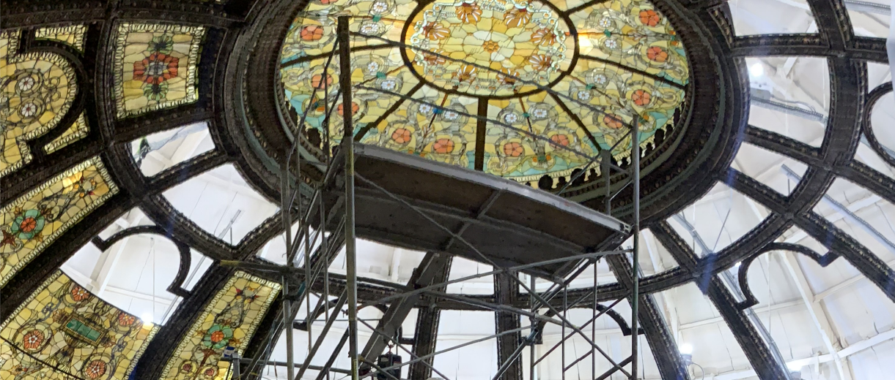
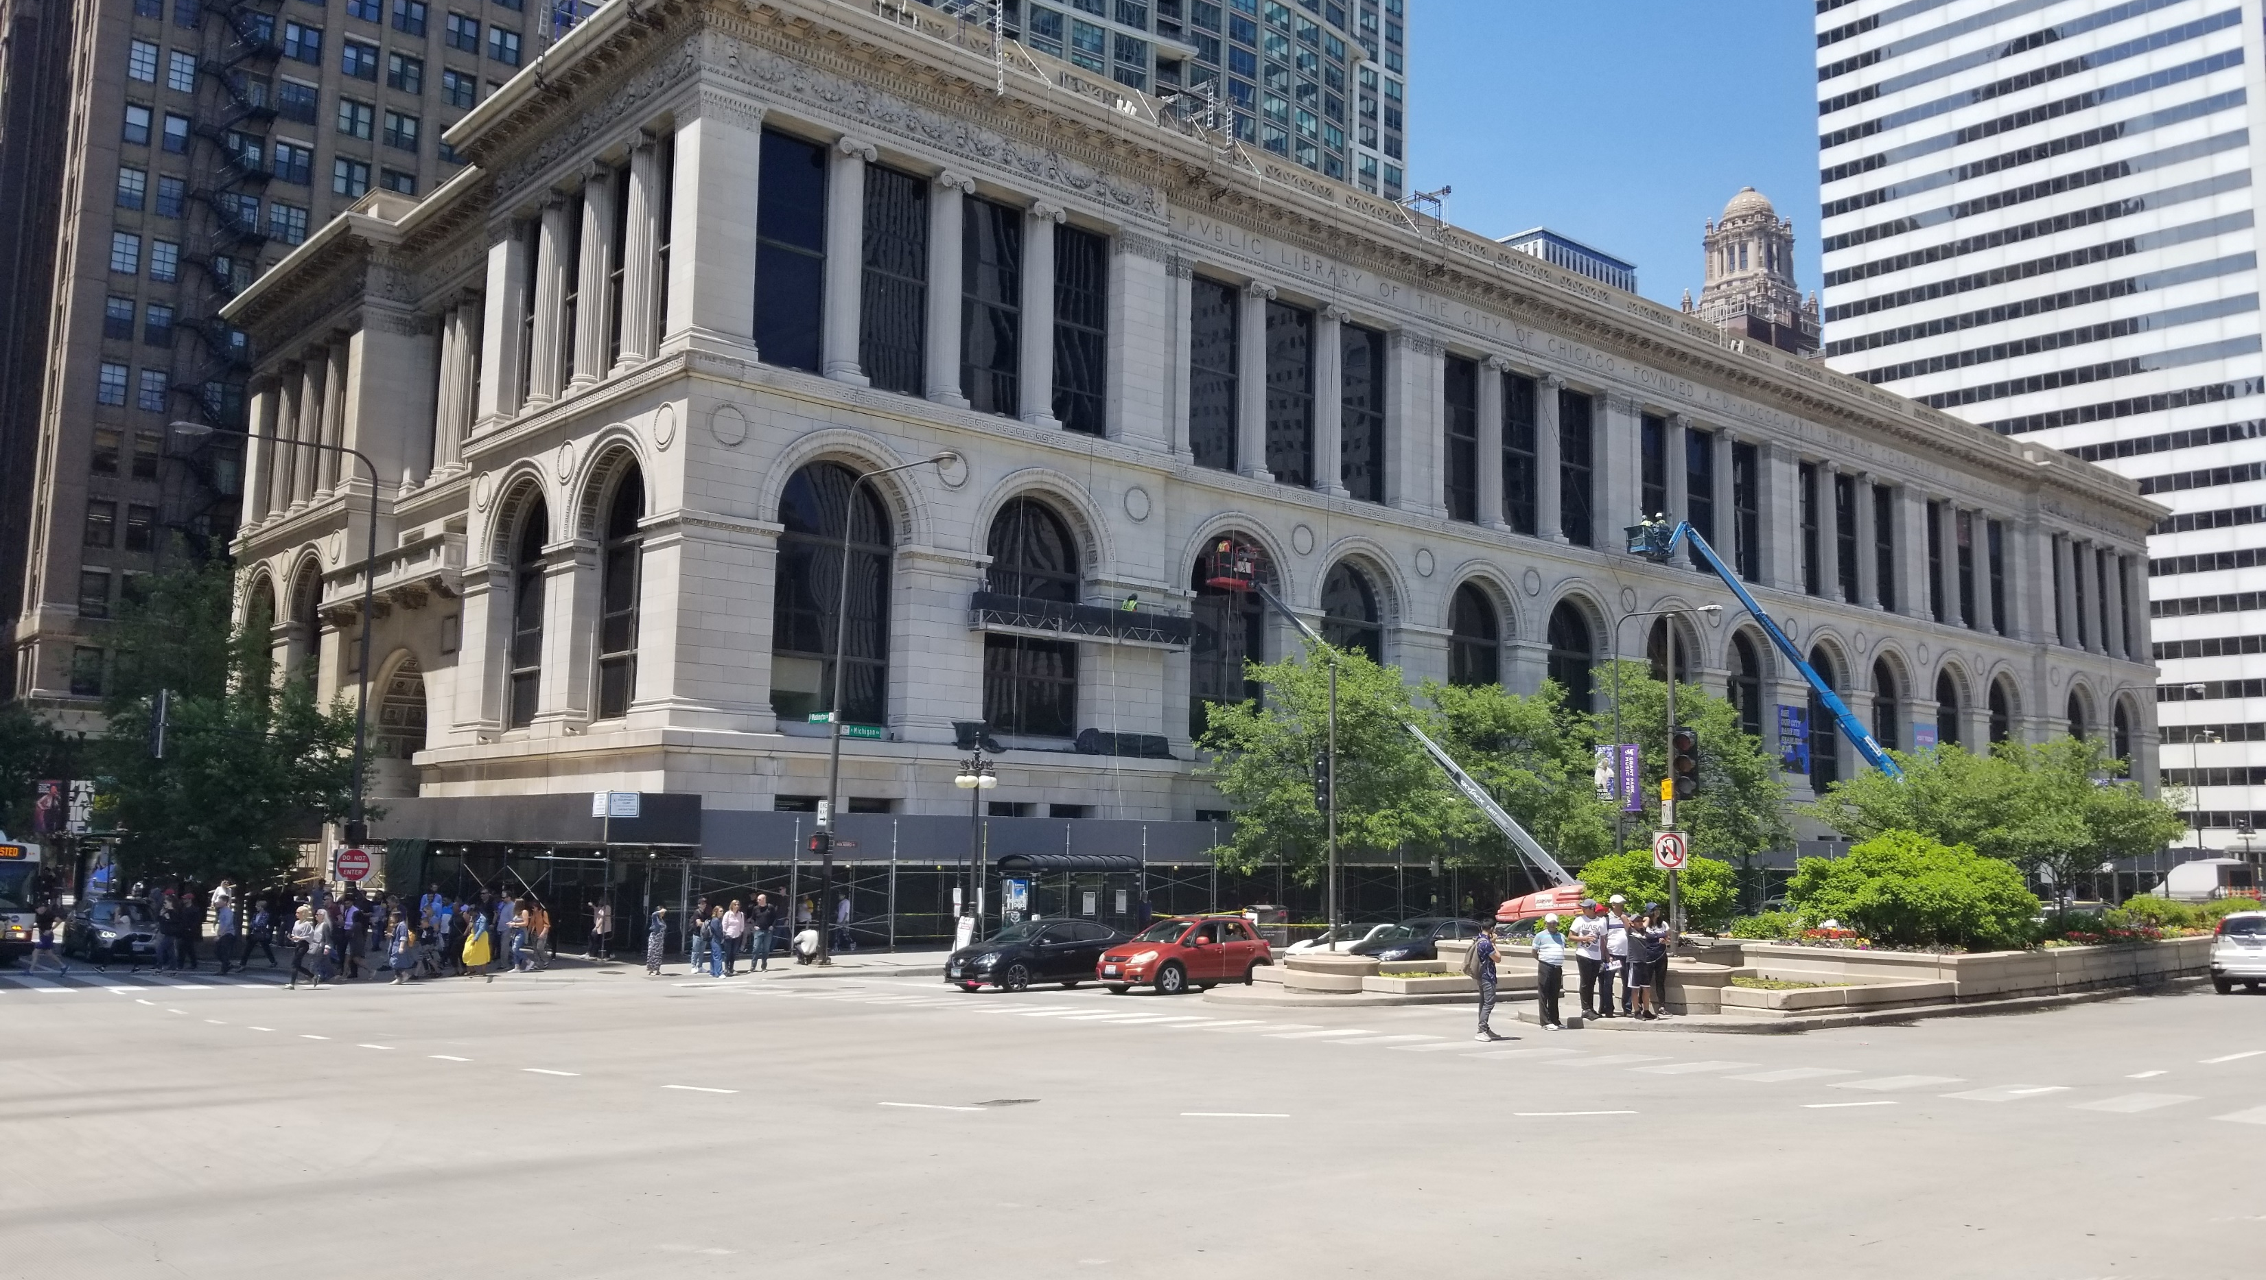
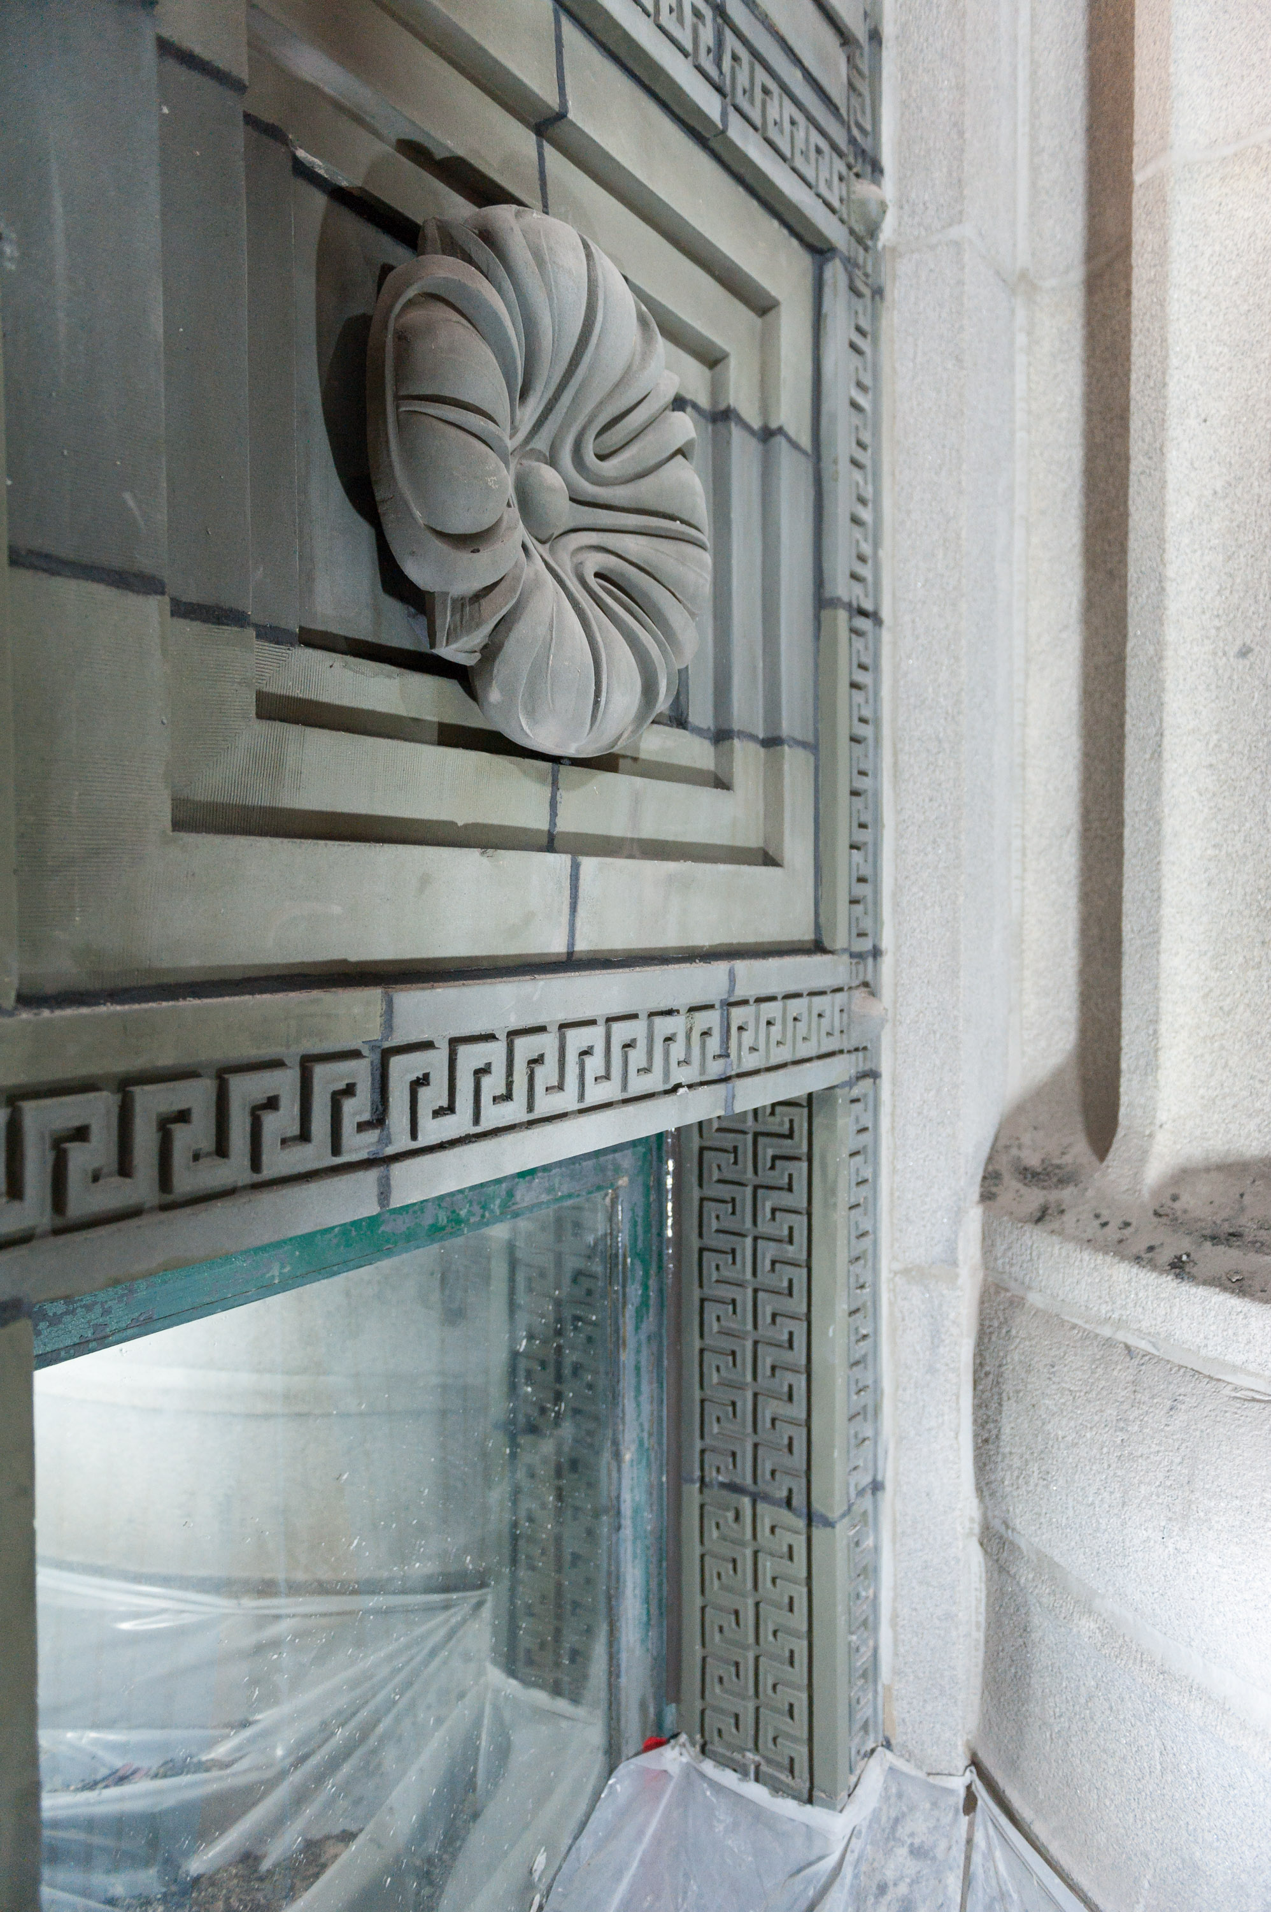
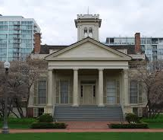
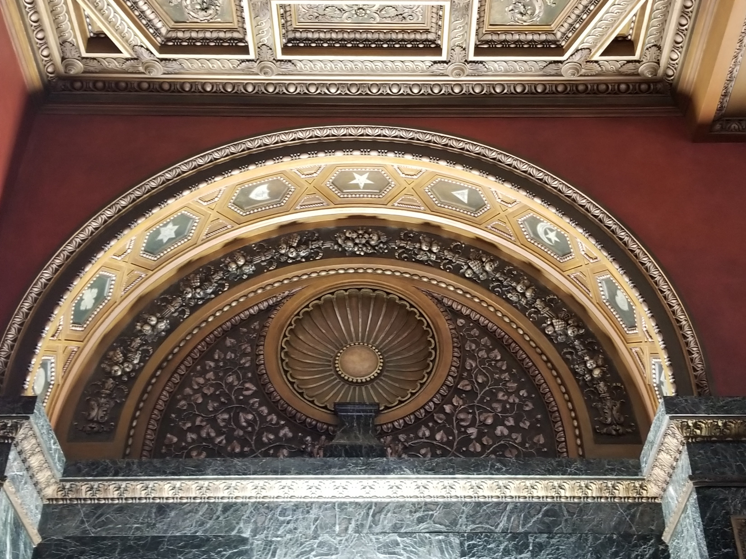
2FM – Construction Operations
Addressing citywide facility needs that impact the end-users, stakeholders, and communities.
Design and Construction projects work in chorus with the Facilities Operations, Environmental Health & Safety, and Finance Administration Bureaus.
Assessing building conditions to determine scope.
Establish and implement design parameters for projects.
Analyzing and designing solutions for identified scope.
Working with end user to determine logistics to minimize operational impacts.
Implementing best construction practices
Delivering projects in a cost and time effective manner
Work closely with alderman, communities, and partner agencies to ensure equitable and inclusive strategies.

Slide 9
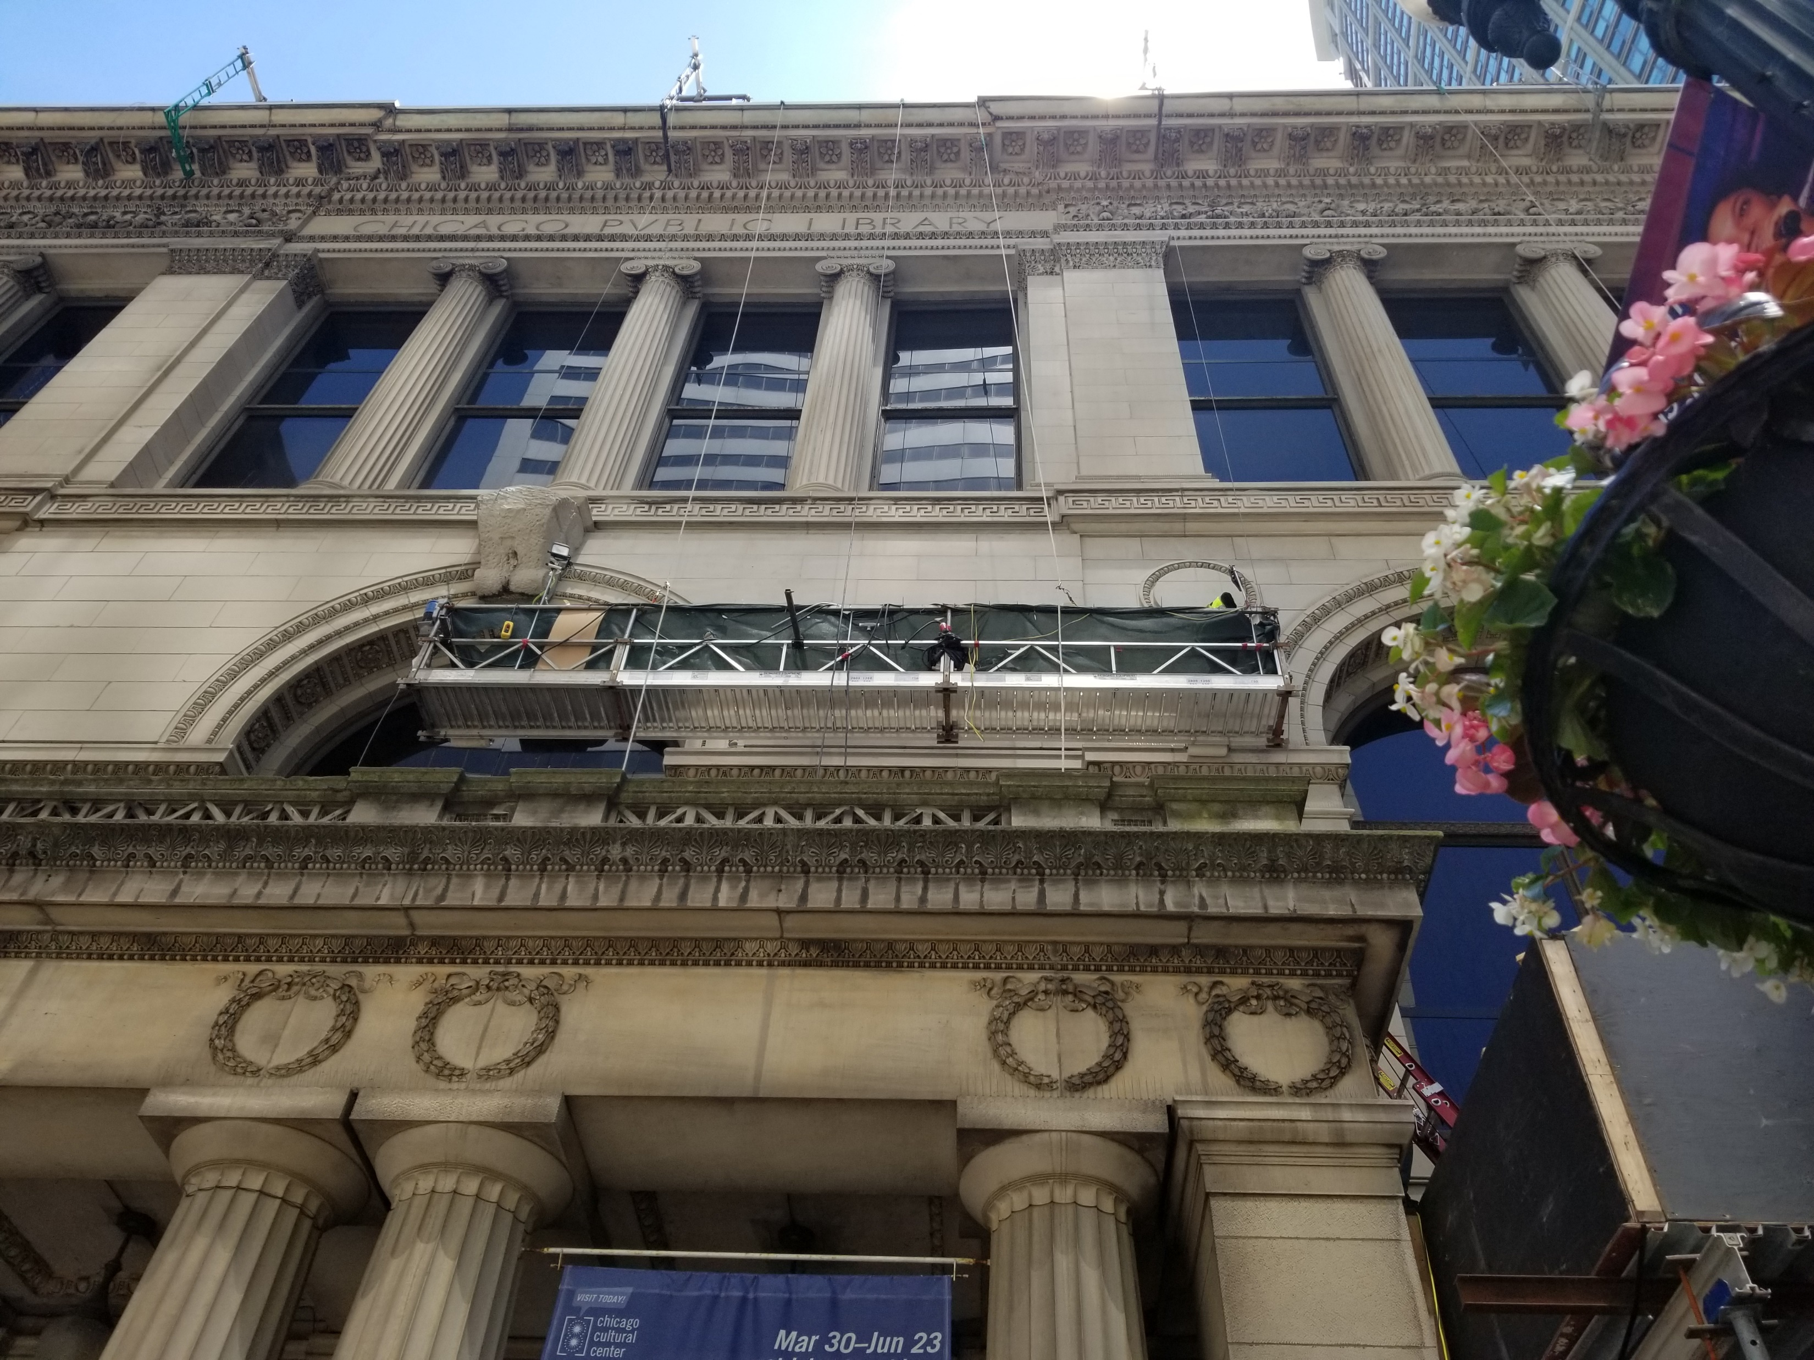
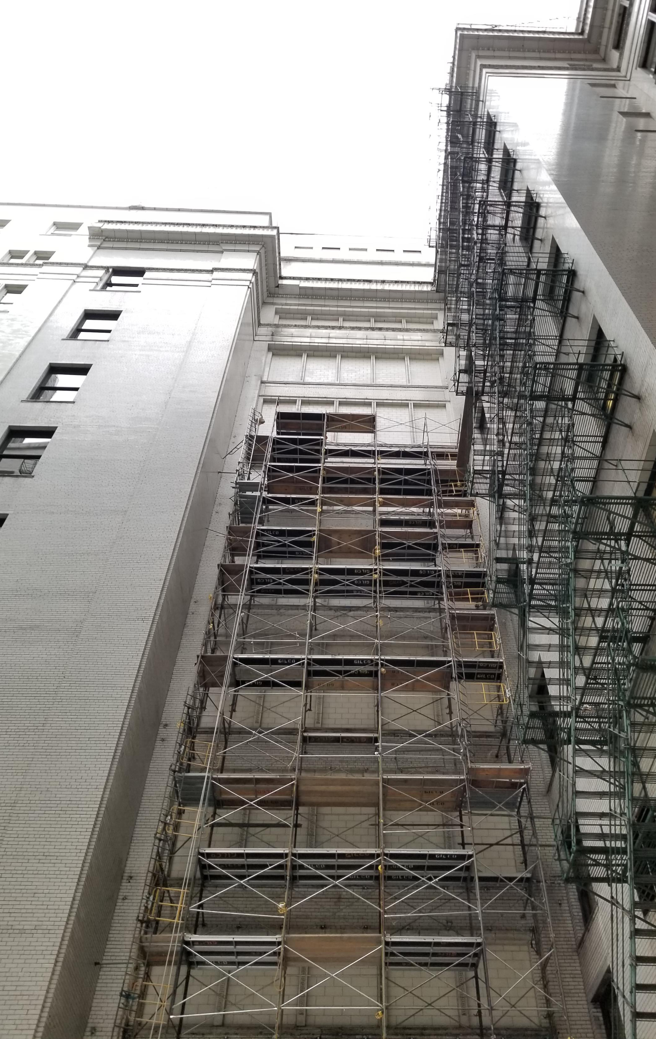
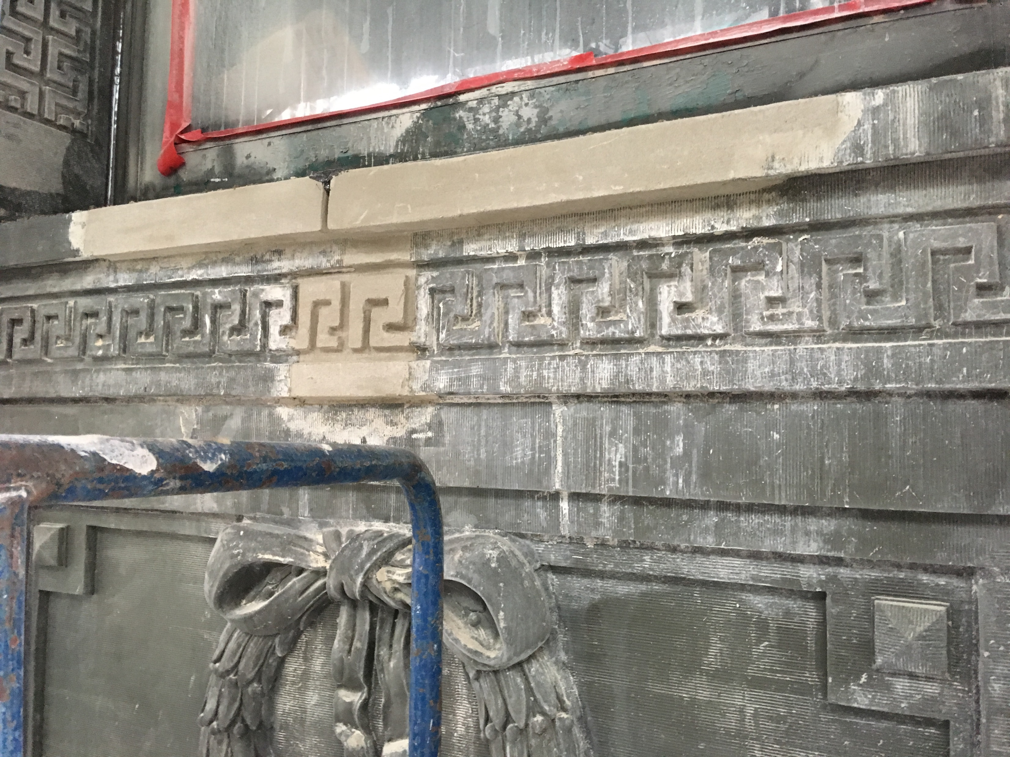
Design & Construction in 2024
What does 2FM have planned?
Leverage capital improvements to spur economic development and job creation across Chicago.
Ongoing Delivery of the capital plan for design and construction projects
Respond to emergency and immediate needs that arise
How will the design and construction work be executed?
We utilize professional services contracts, Job Order Contracts Contractors, Term vendors, traditional bid solicitations, and working partnering agencies like Public Building Commission.

Slide 10
Design & Construction in 2024
Pre-Qualified Professional Services - Projects that require design services
Job Order Contract (JOC) Program - Projects that require immediate and emergency response work
Term Vendor Contracts - Projects that require specialty services
Traditional Solicitations - Requests for Qualifications, Requests for Proposals
Public Building Commission – full-service development of municipal projects

Slide 11
Design & Construction in 2024
Areas of Focus for 2024-2025
ADA Title II Accessibility Assessments
Police Station Hardening and Facility Maintenance
Mechanical, Electrical and Plumbing Efficiency Installations
Space Planning Optimization & Consolidation
Receiving Municipal Facilities
City Buildings
Fire Facilities
Health & Human Service Centers
Library Facilities
Police Facilities
Senior Center Facilities

Slide 12
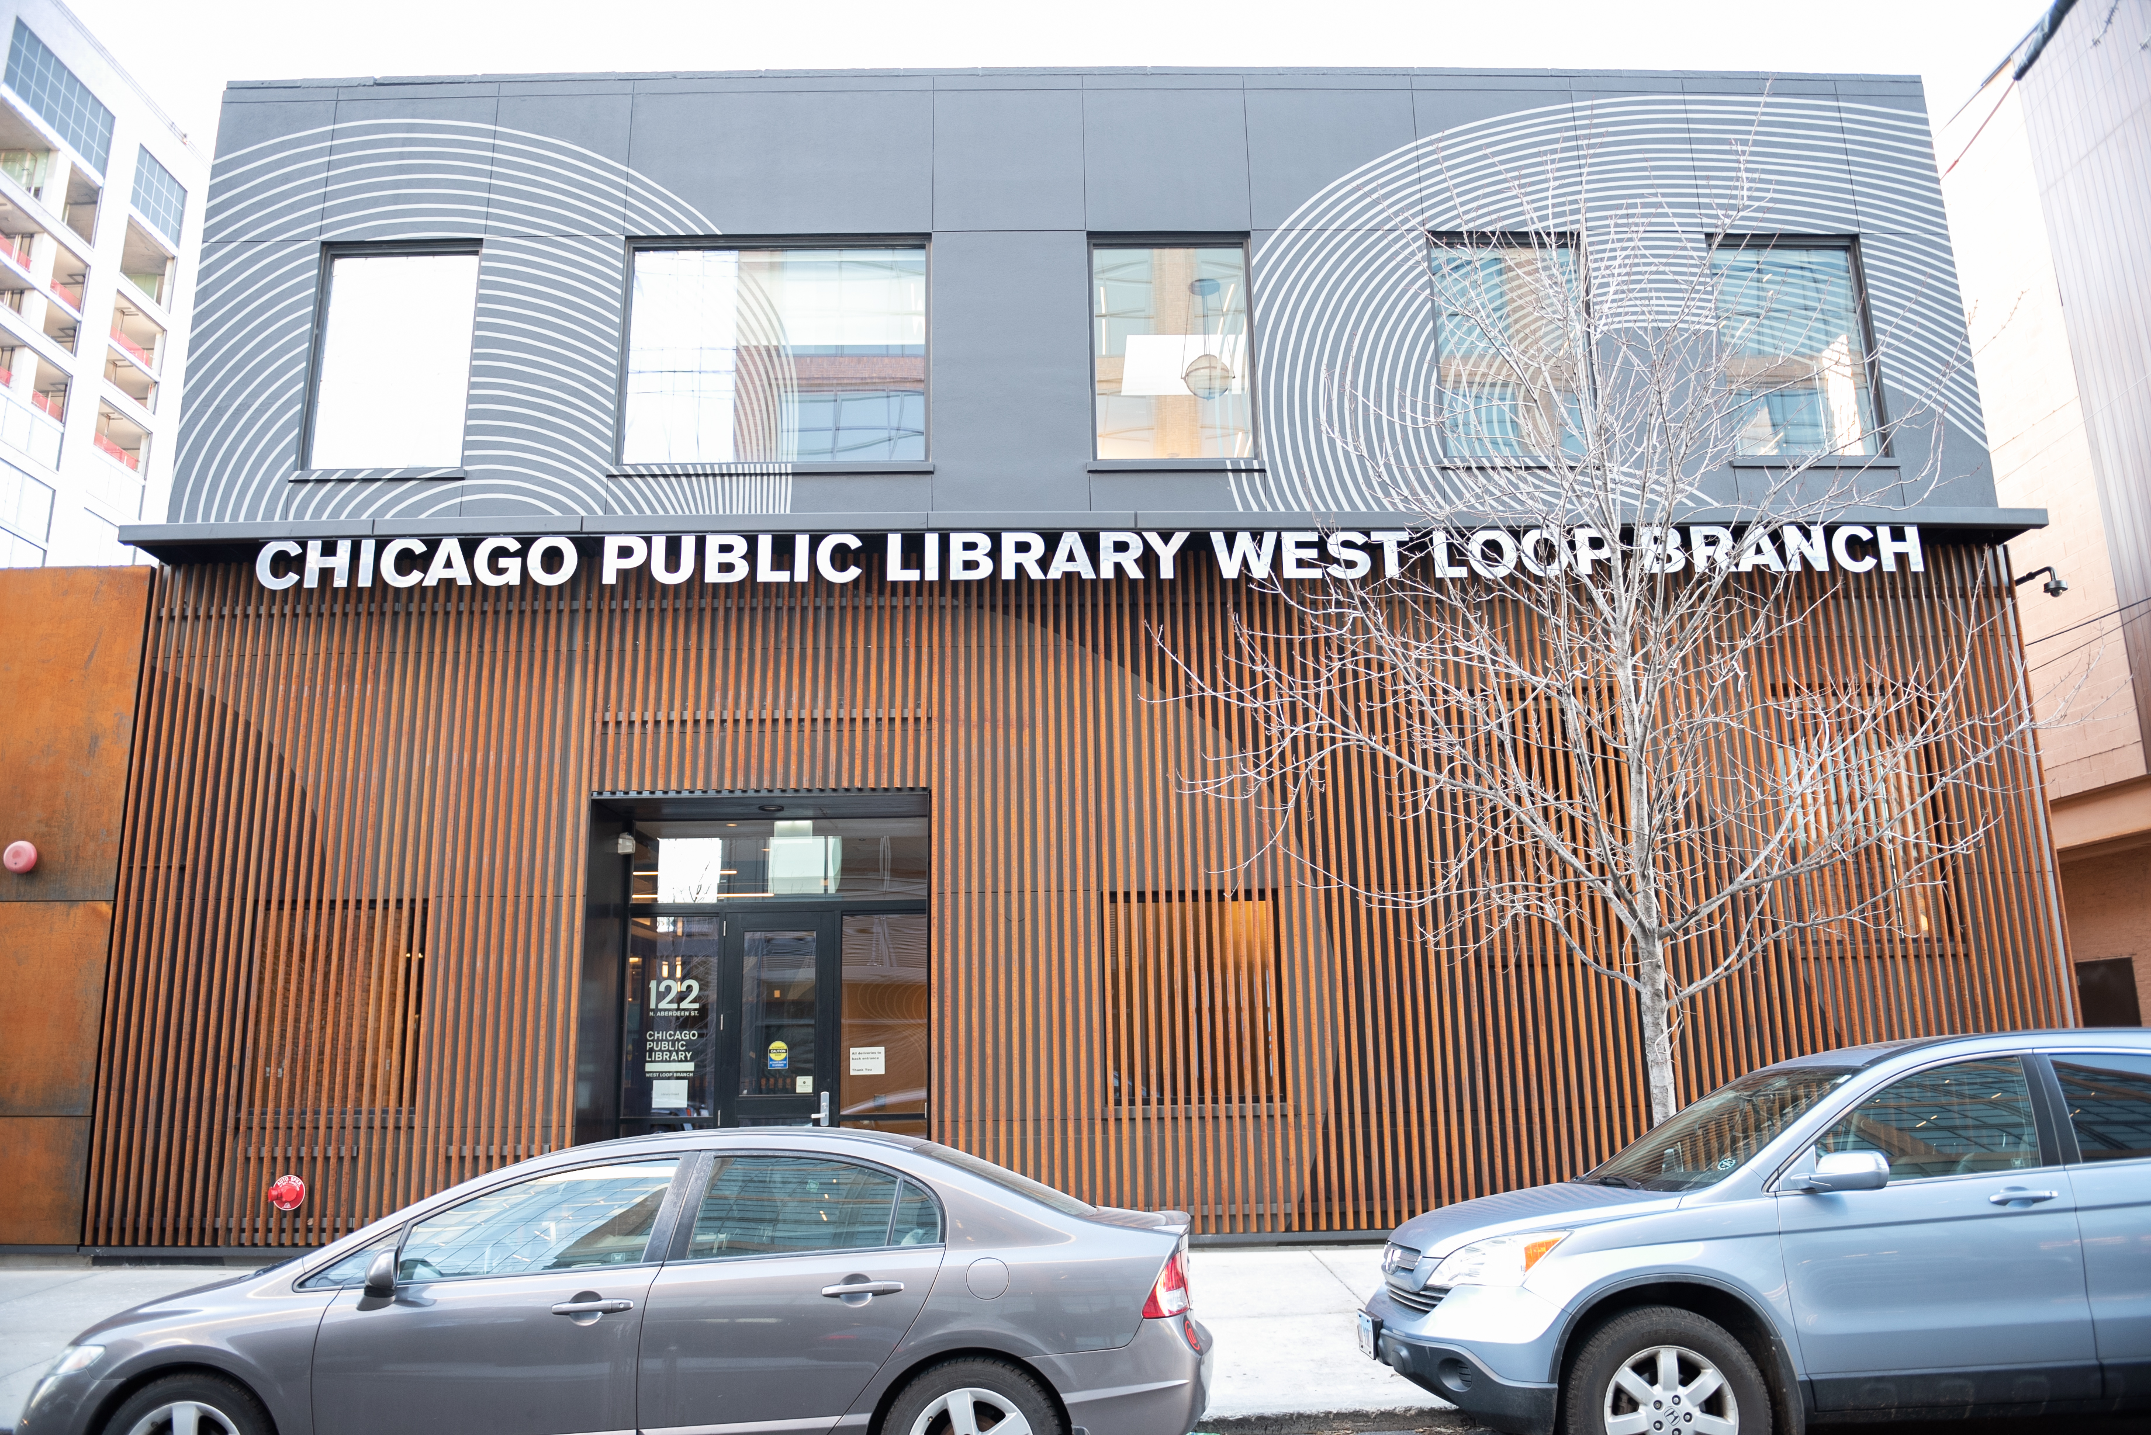
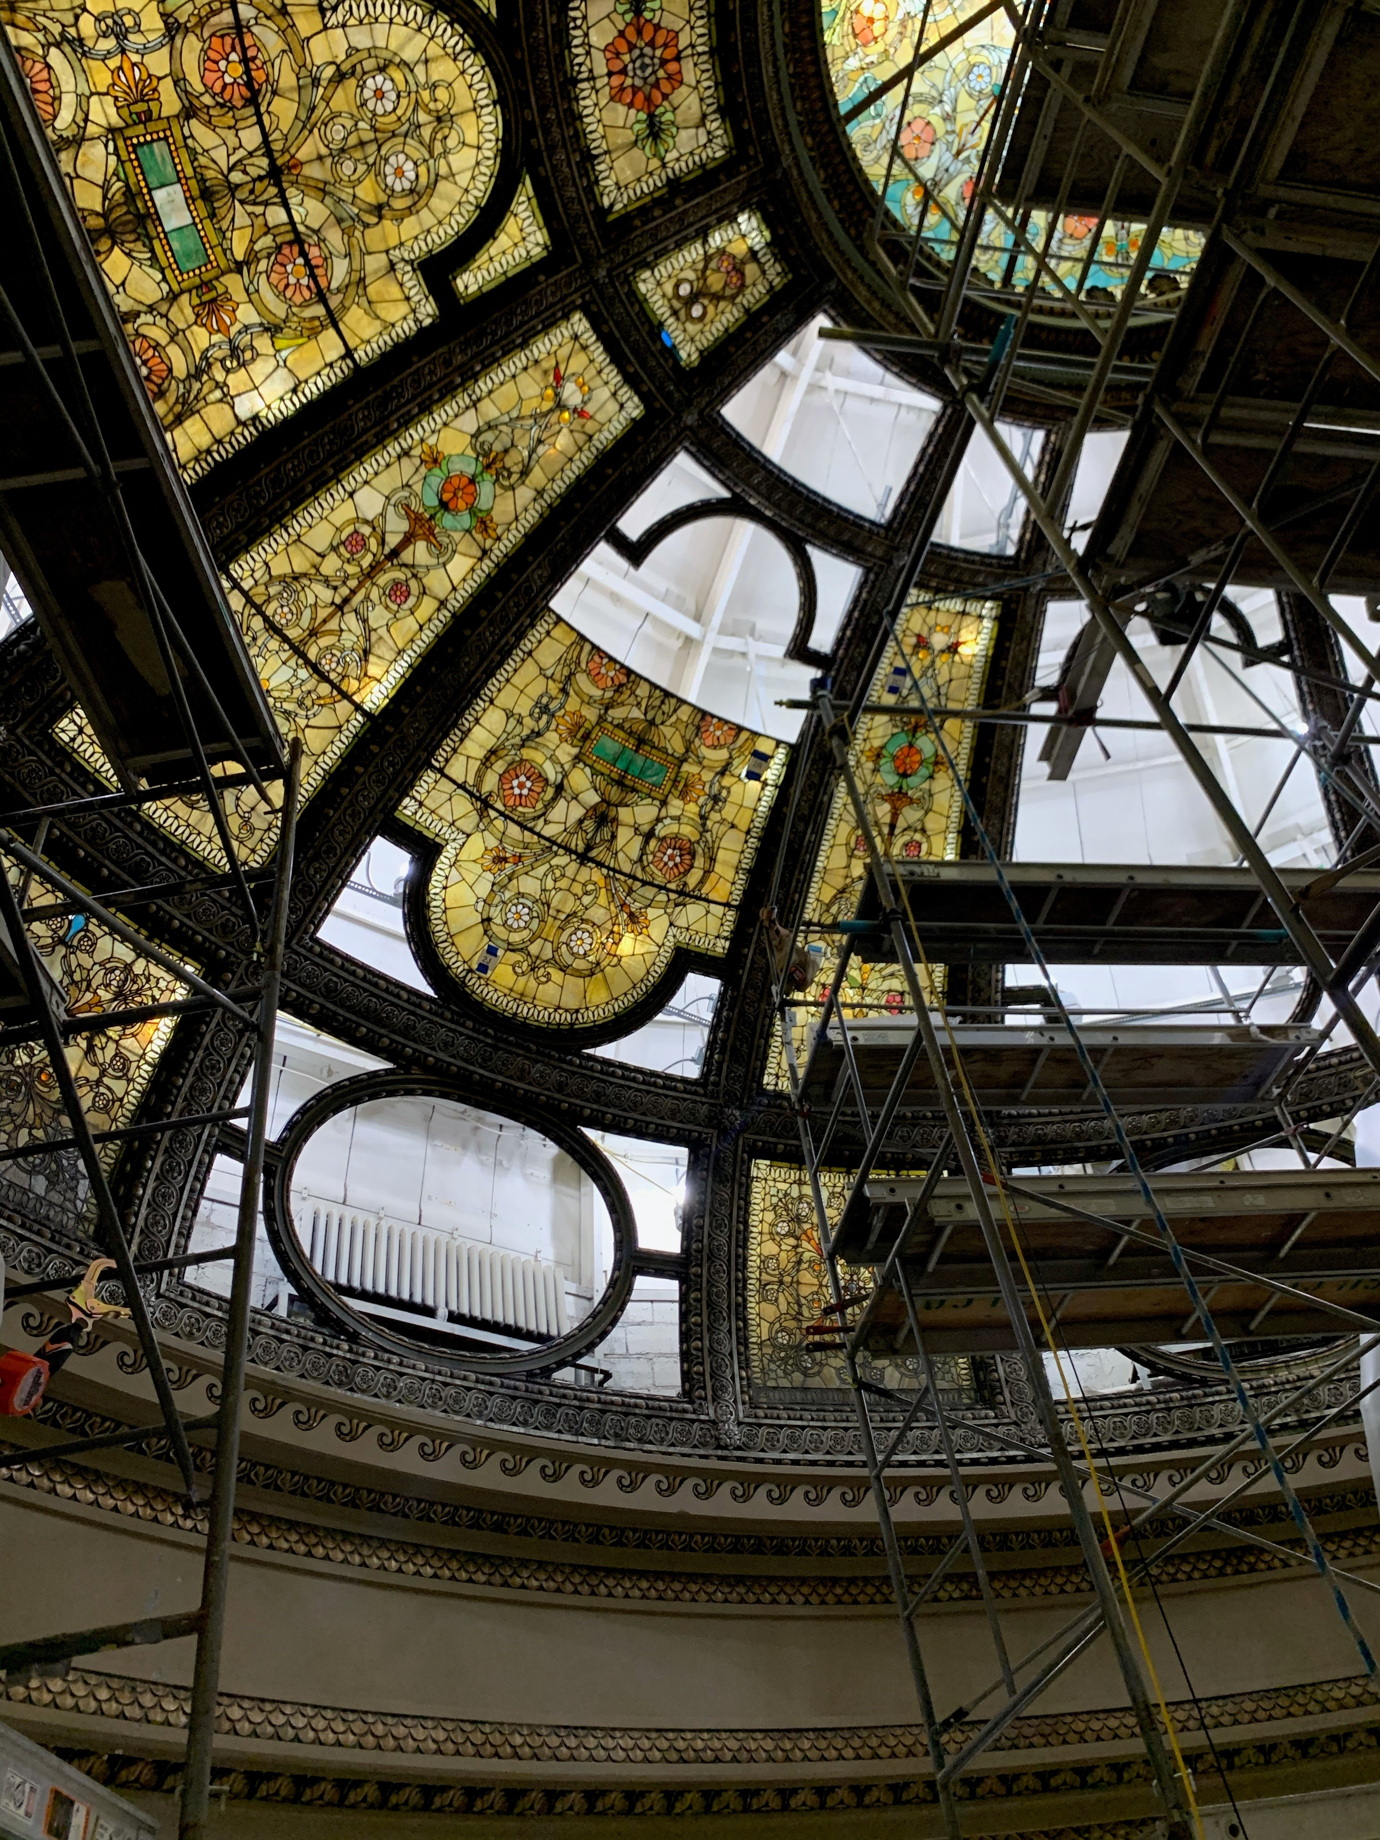
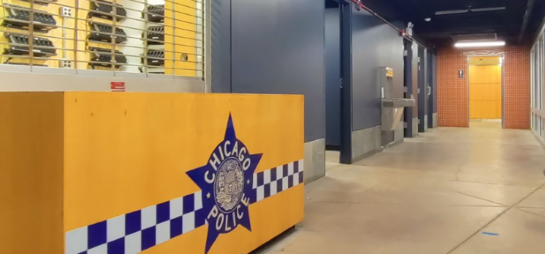
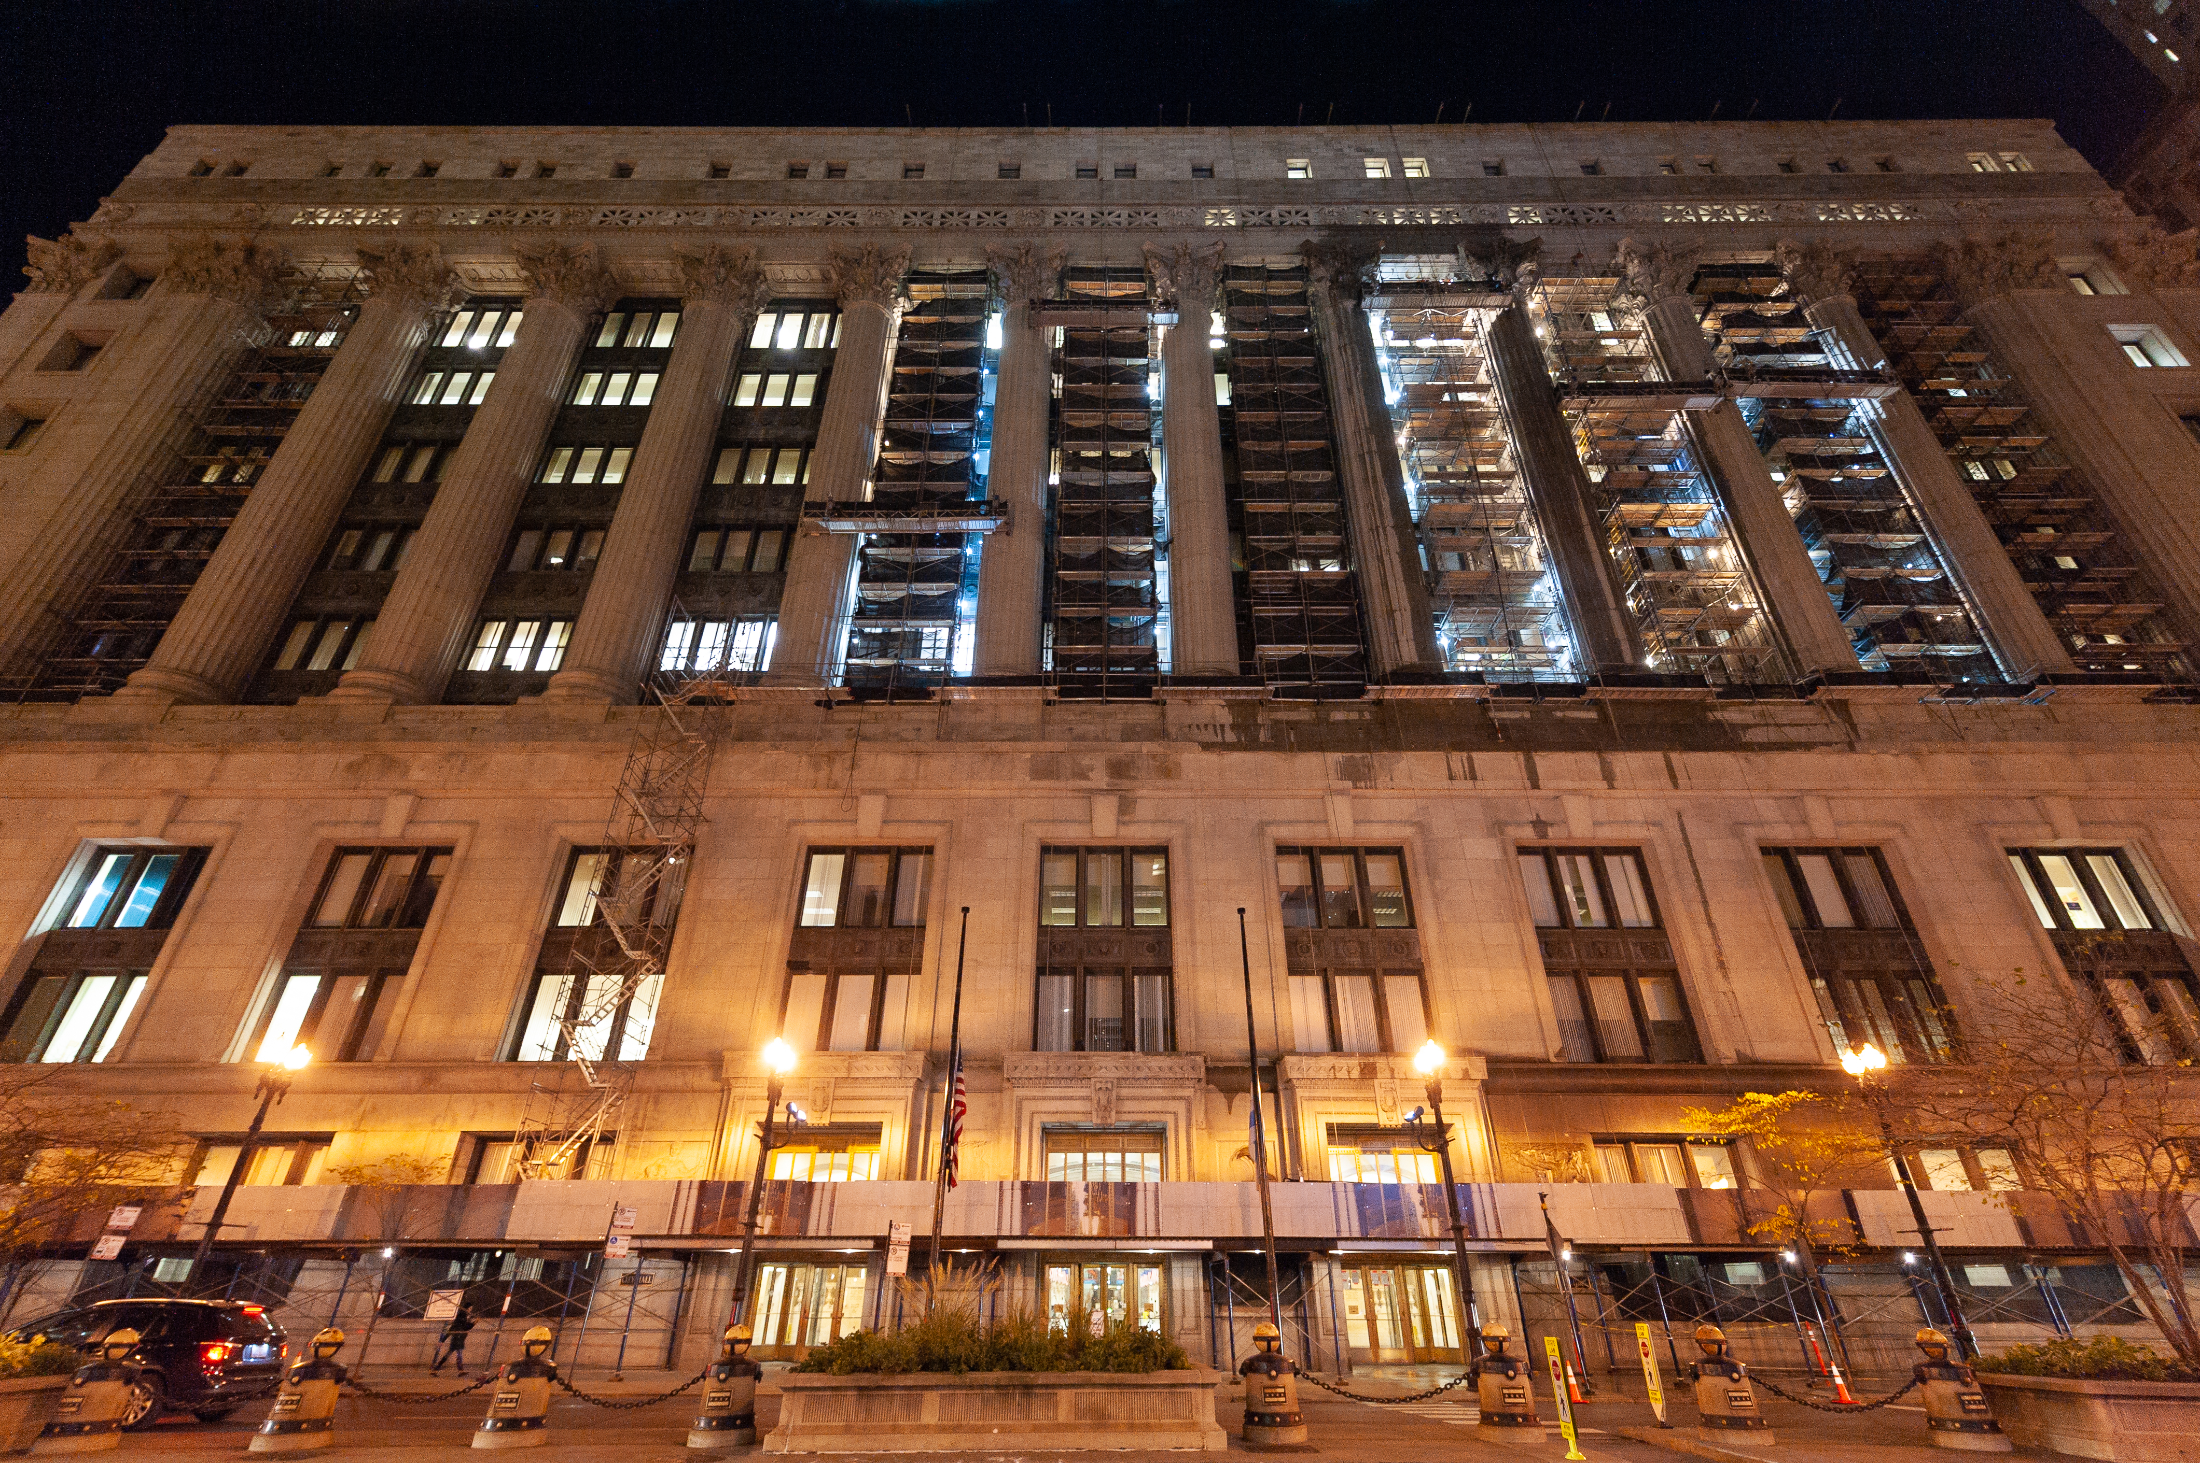
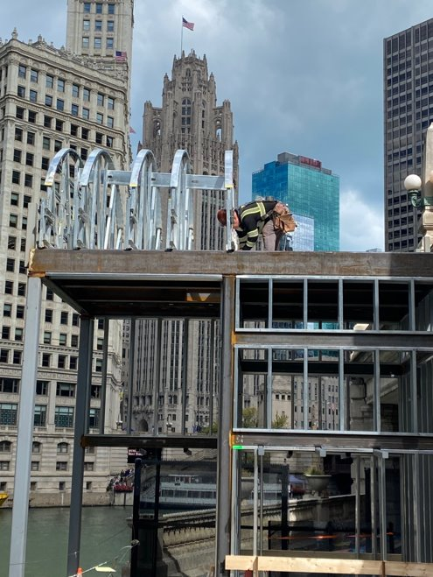
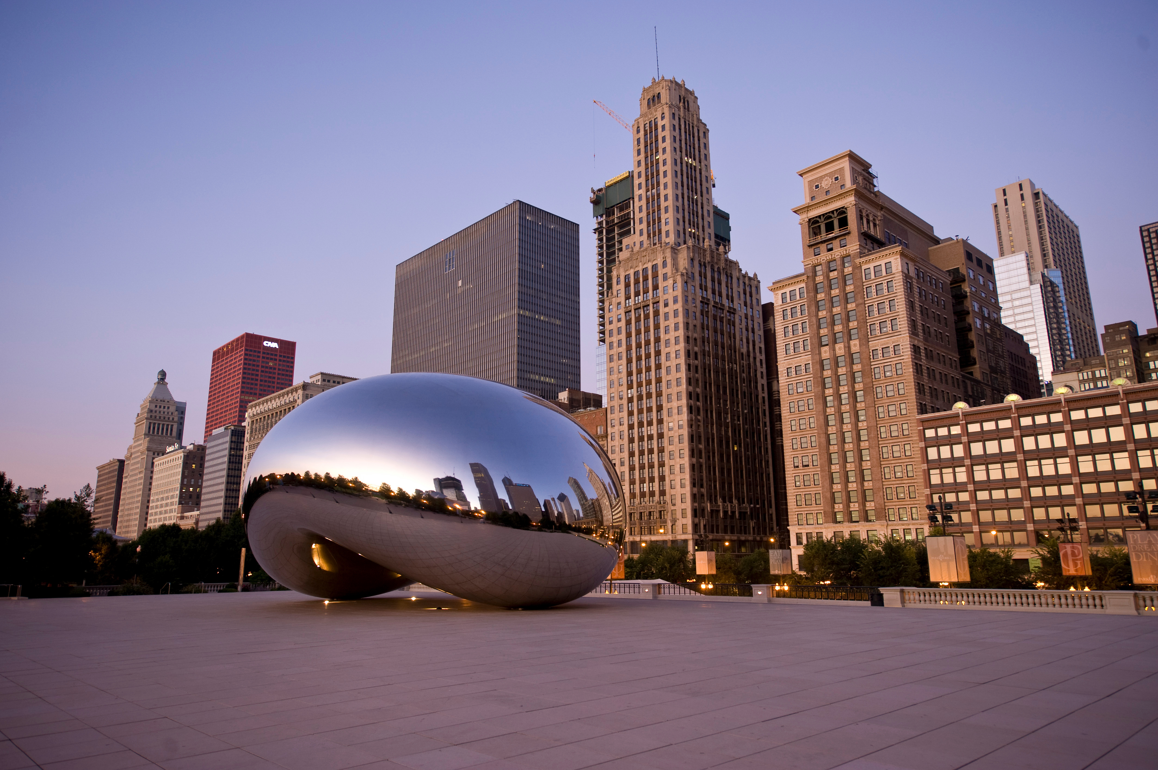
Fleet & Facility Management (2FM)
CPD Cycle Center
Chicago City Hall
Chicago Public Libraries
Millennium Park
Historic Restoration
Chicago Riverwalk
Accessibility Upgrades

Slide 13
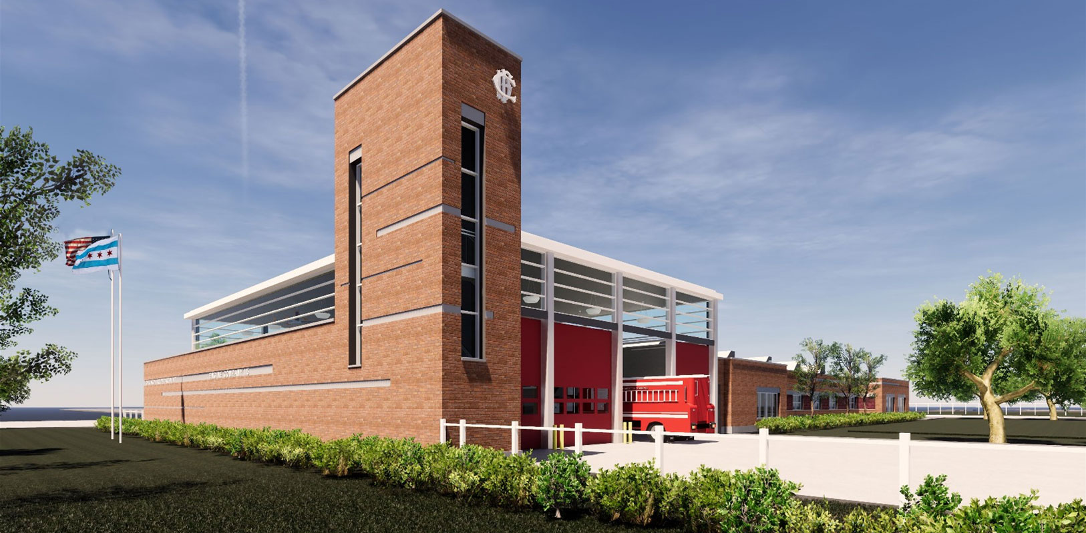
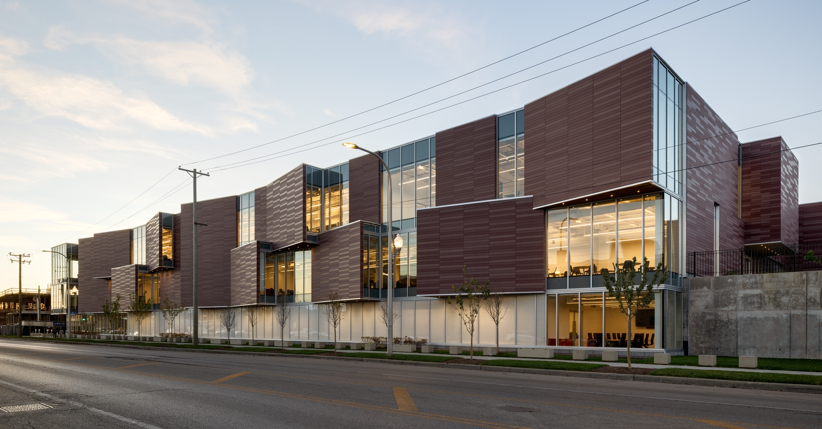
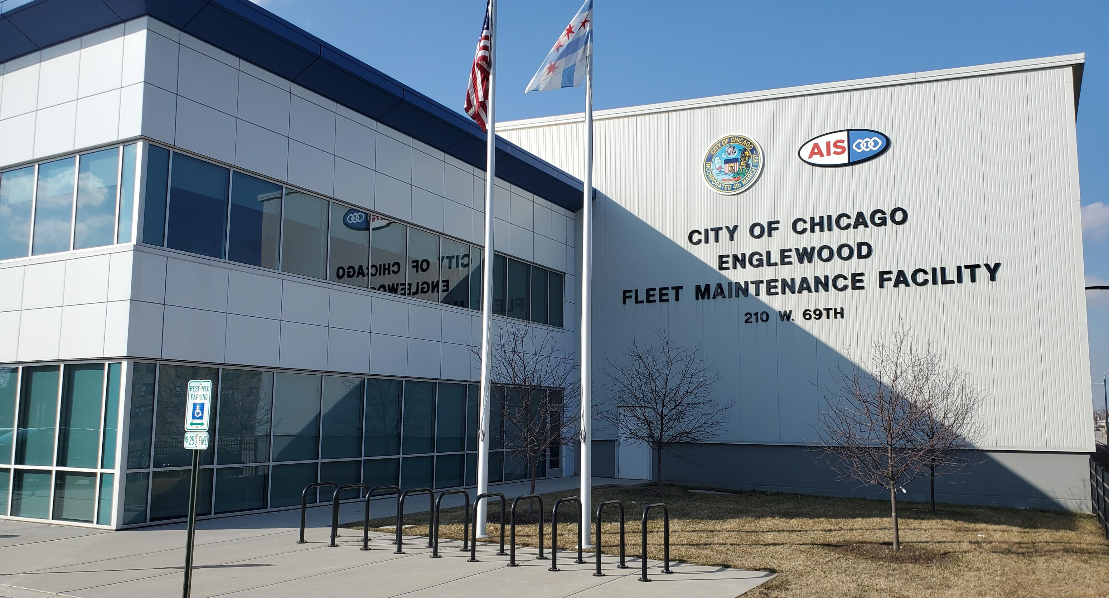
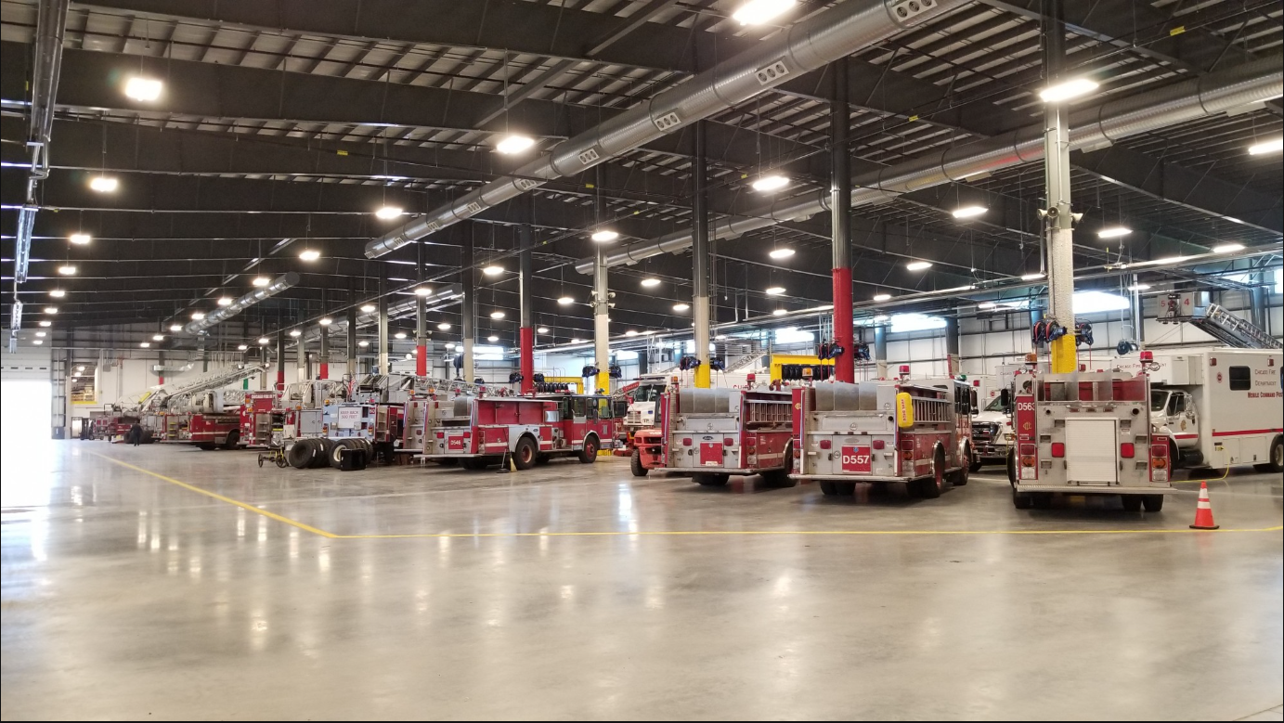
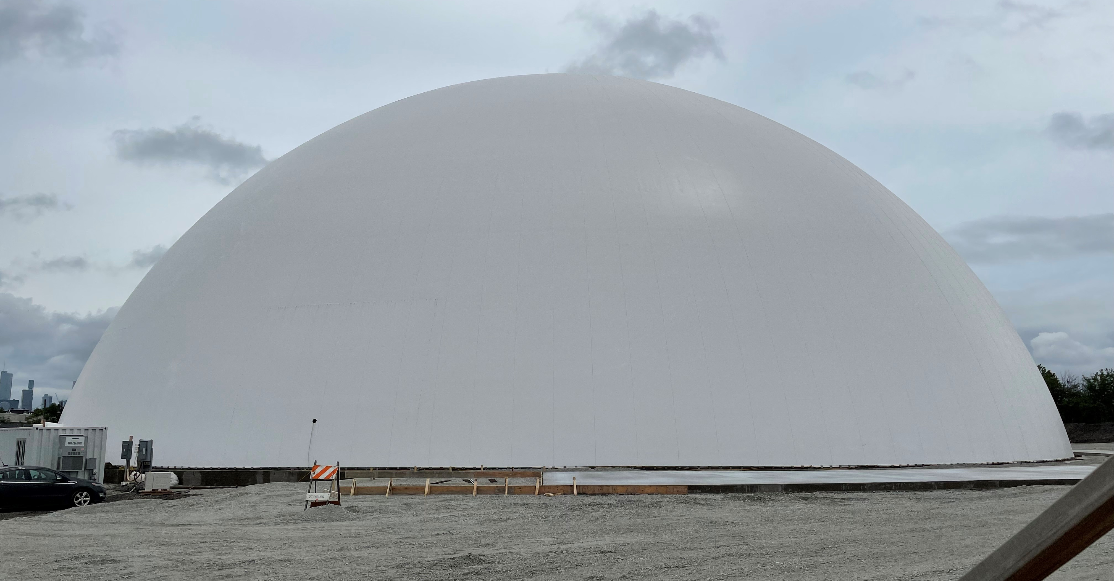
Fleet & Facility Management (2FM)
Fire Engine Company 115
Joint Public Safety Training Campus
Englewood Fleet Maintenance Facility
Grand Avenue Salt Dome

Slide 14
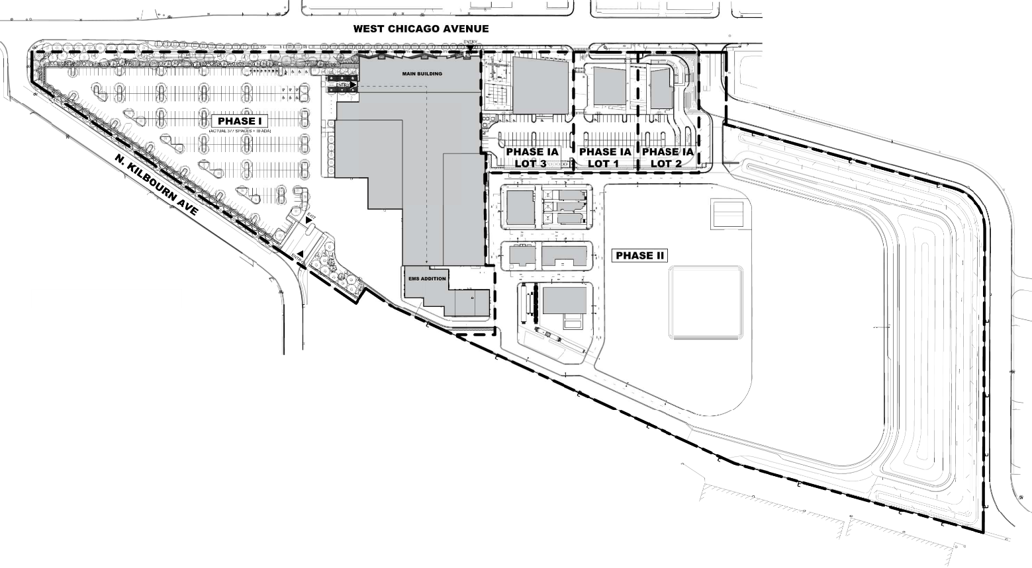
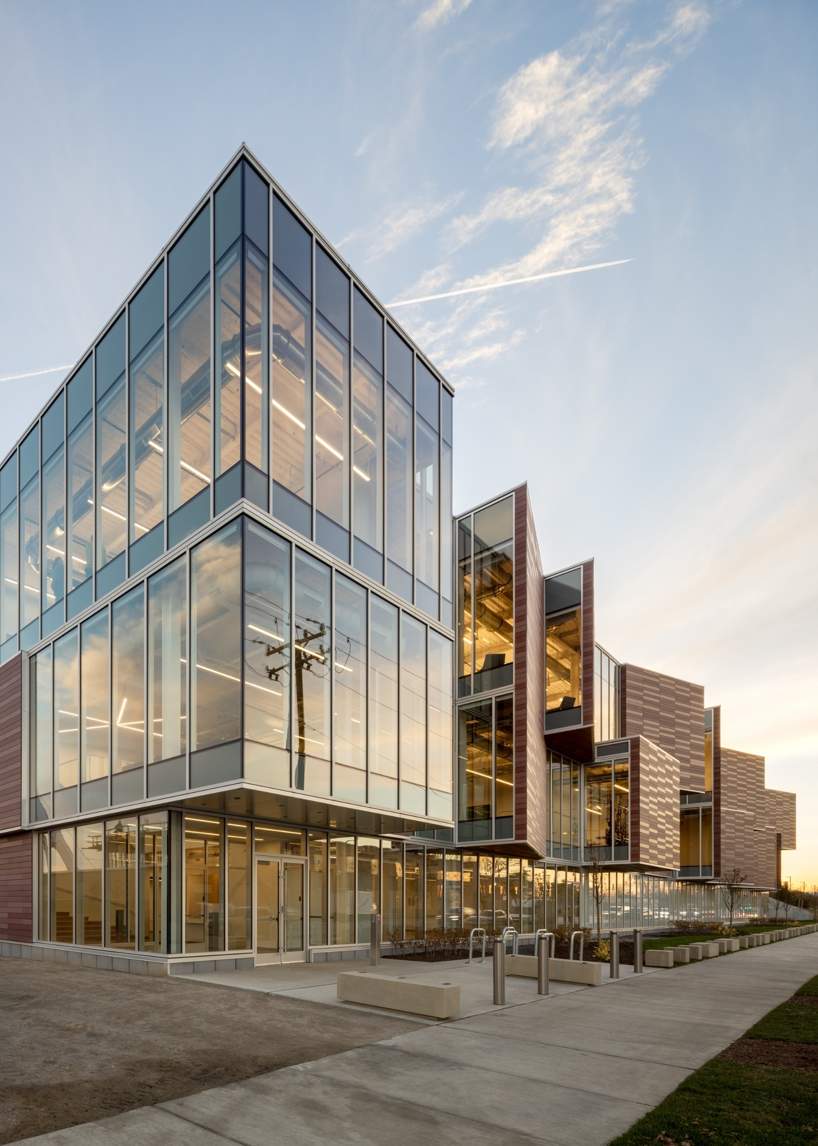
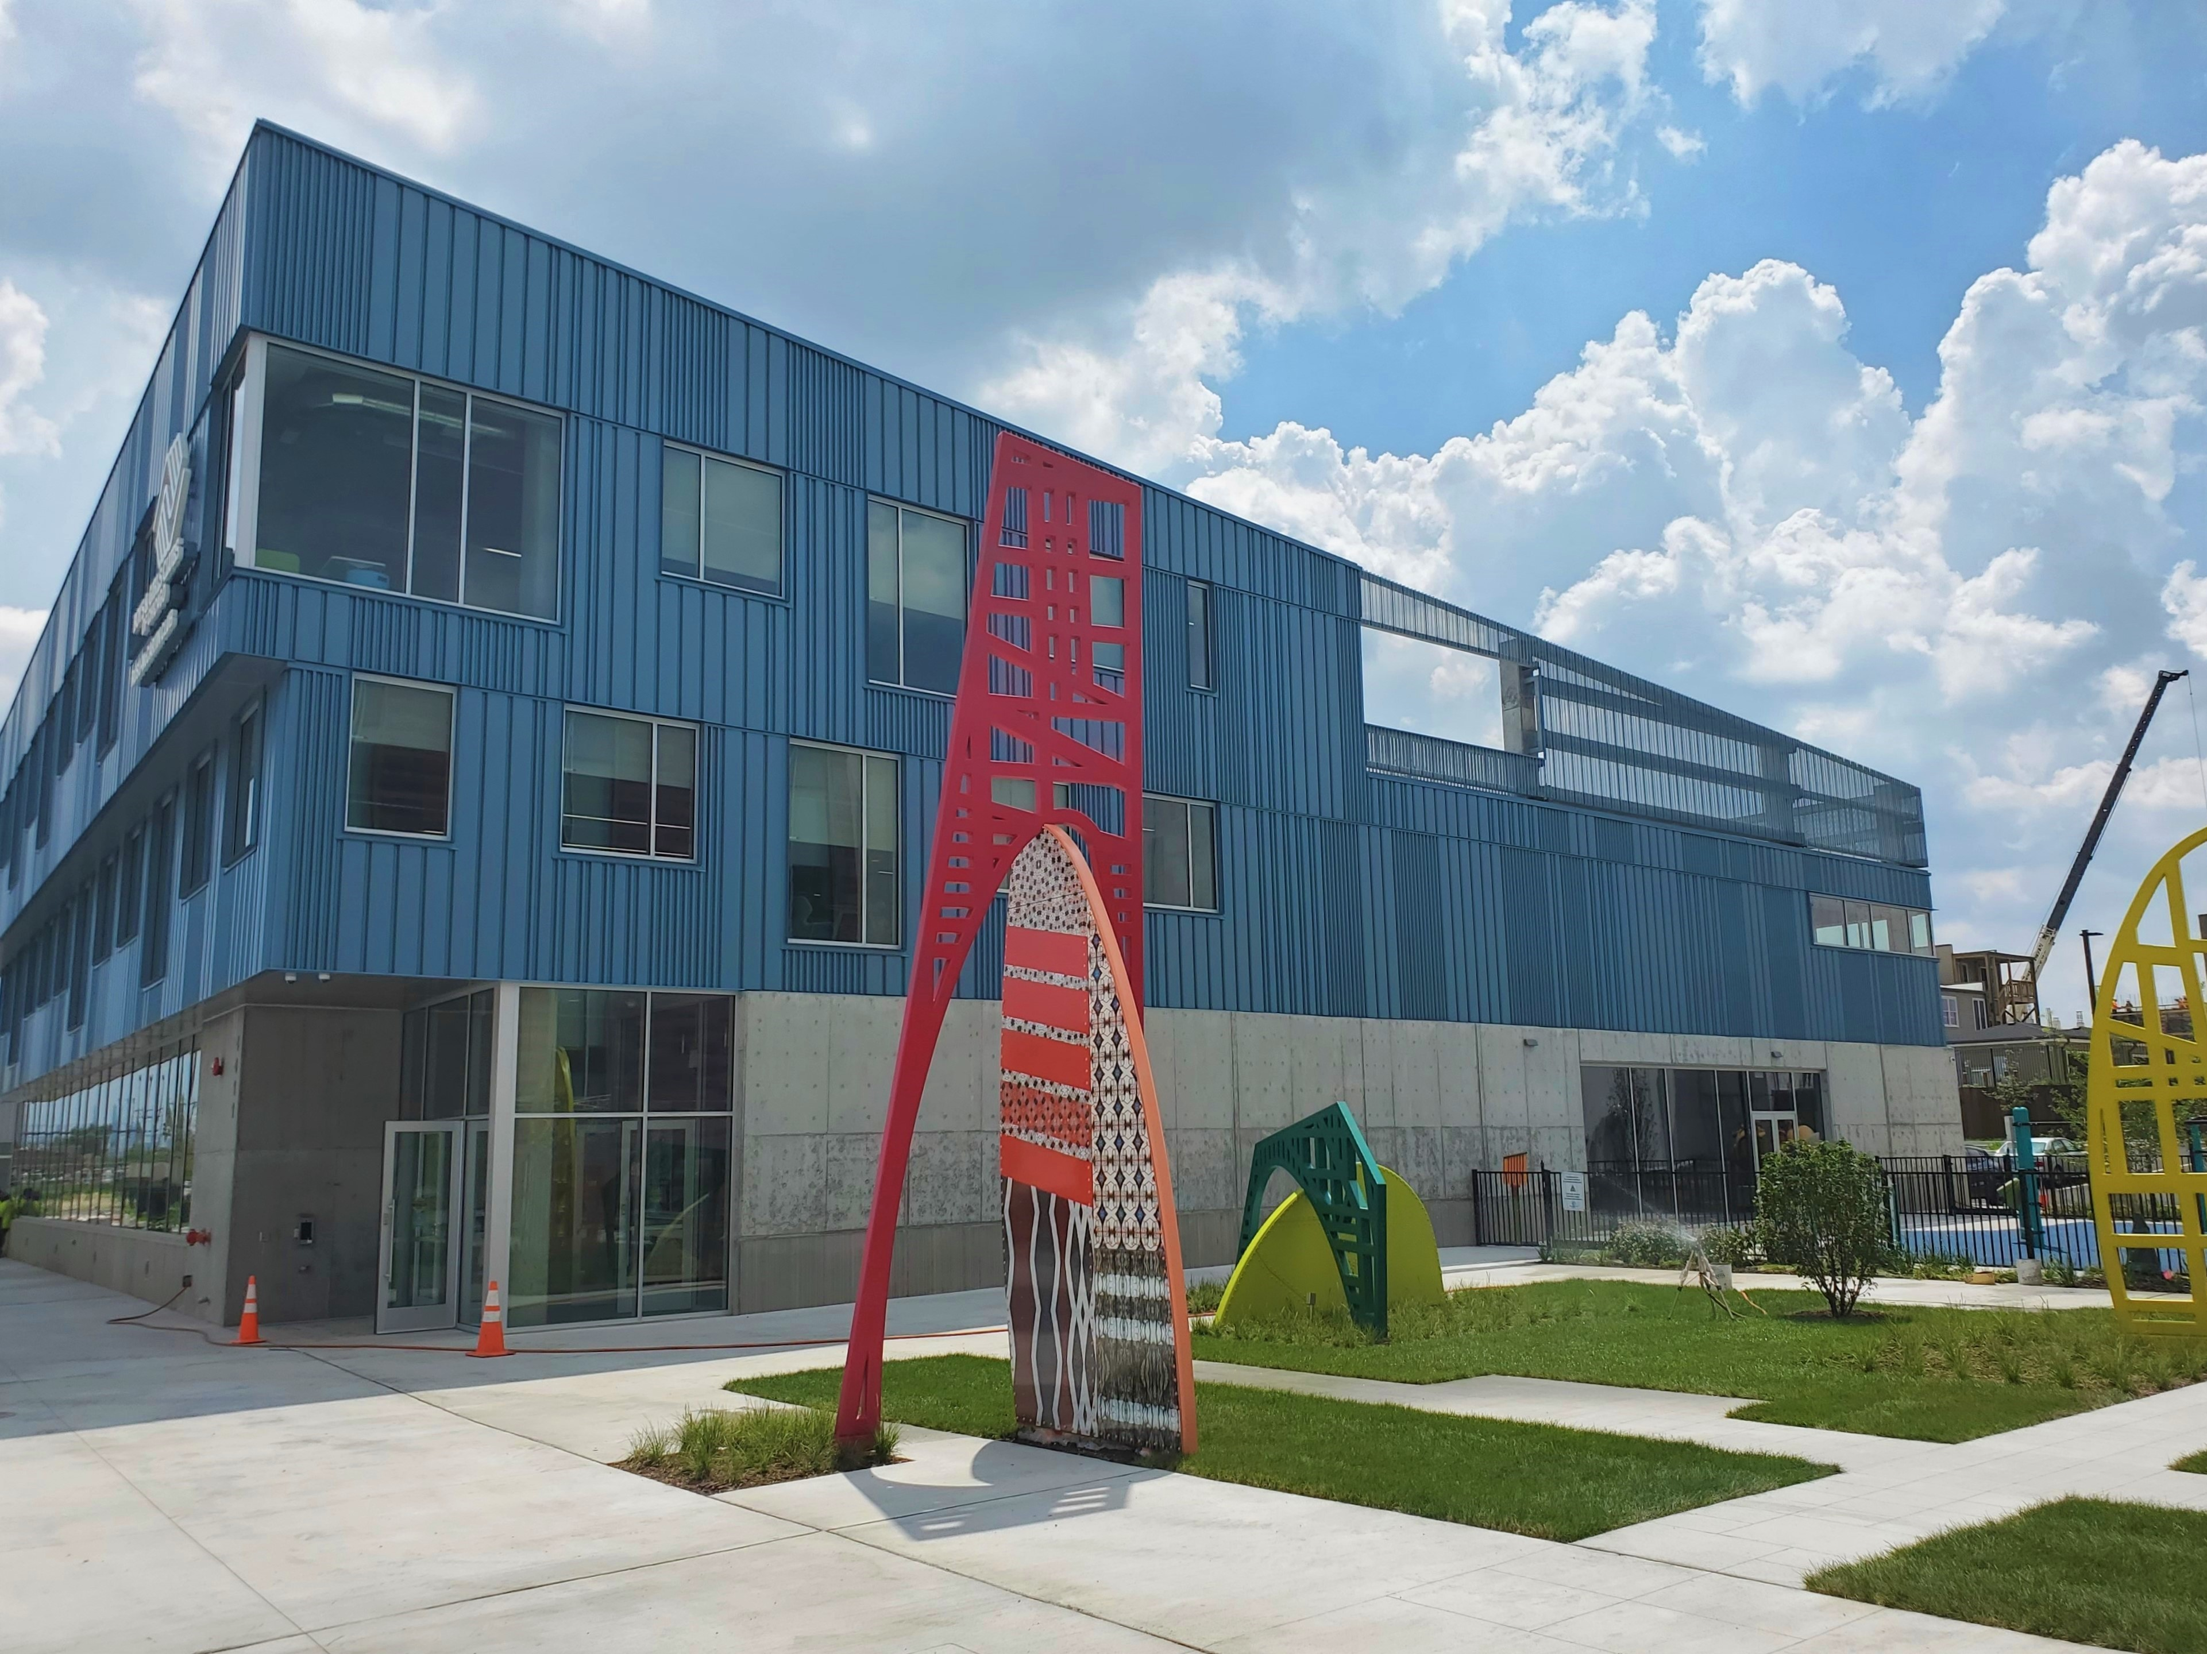
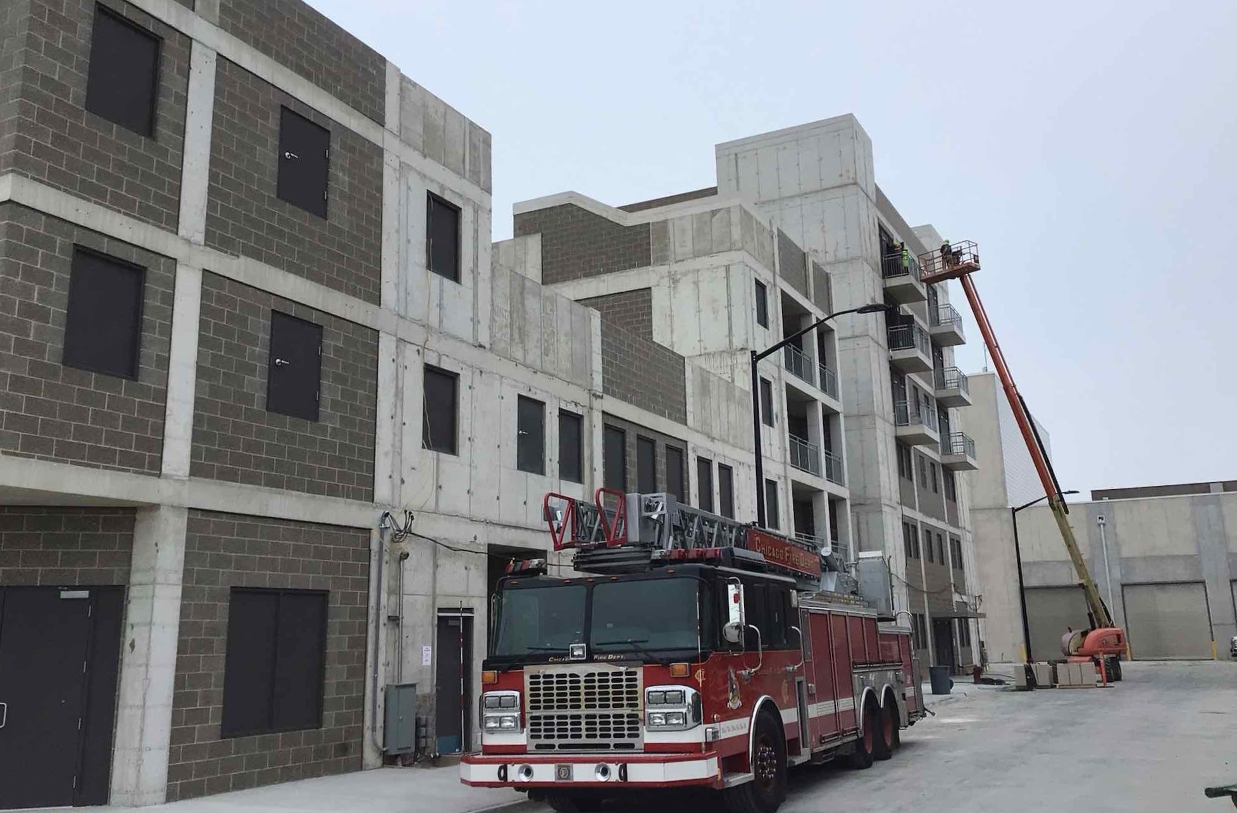
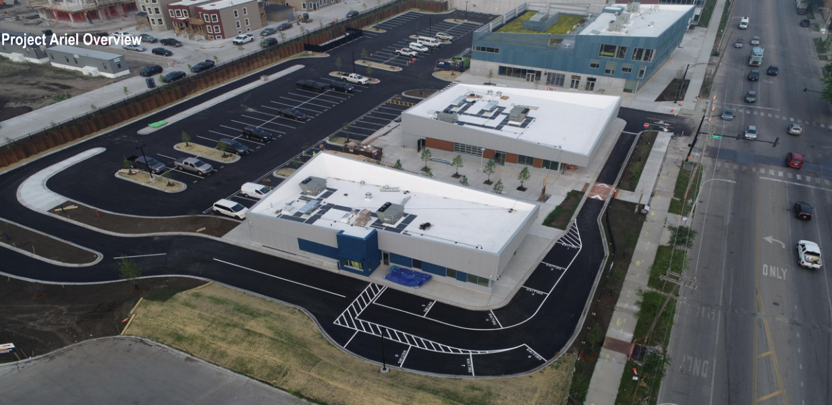
2FM, Joint Public Safety Training Campus
Located on 32 acres of formerly-industrial land in West Humboldt Park
Phase 1 substantially complete Q2 of 2022 and Phase 1A substantially complete Q4 of 2024.
CPD portion of Phase 2 substantially complete and turned over. CFD areas projects for completion in Q2 2024.
Phase 1 includes the 198,000 SF Bauer-Plummer Public Safety Training Center operated by the Office of Public Safety Administration for CFD, CPD and OEMC.
Facilities for state of the art hands-on and scenario-based training exercises.
Rusu-McCartin Boys & Girls Club of Chicago
Phase 1
Bauer-Plummer Public Safety Training Center
Phase 1A
Restaurant Outlots
Phase 2
Outdoor Scenario Village

Slide 15
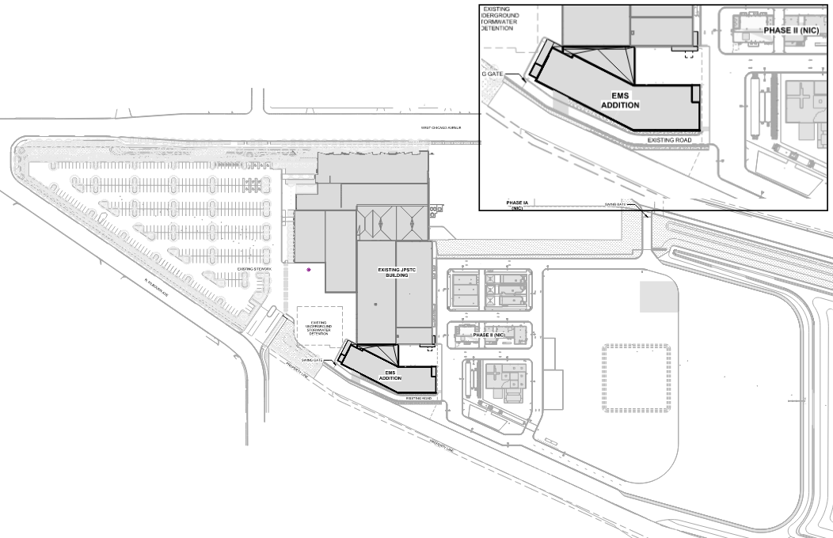
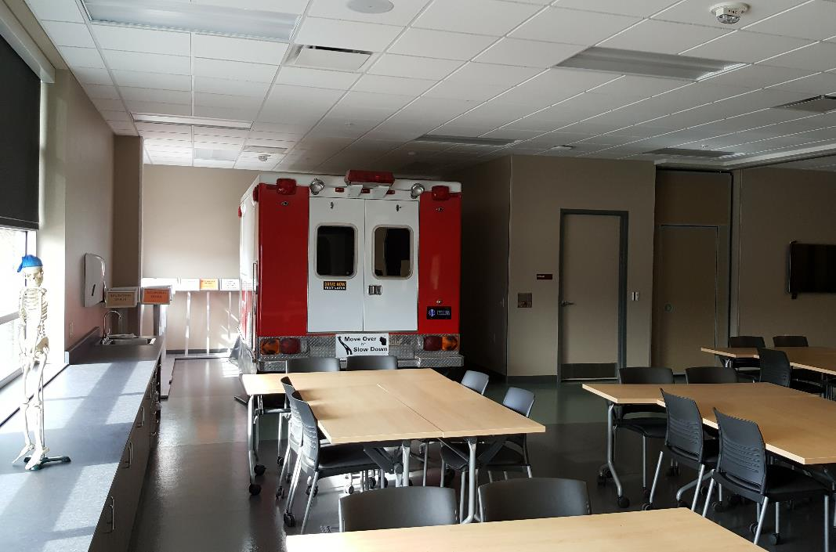
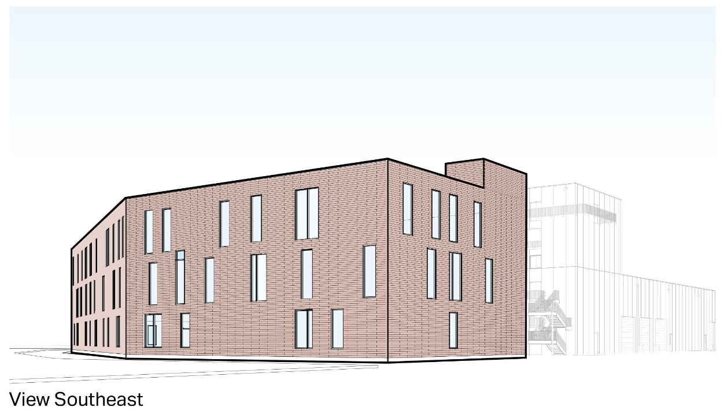
2FM, JPSTC – New EMS Addition
Three-story 52,000 SF building addition to the Bauer-Plummer Public Safety Training Center to house classroom and scenario-based training facilities for CFD’s Emergency Medical Services, as well as additional classroom and office space for CPD.
Design completion projected for Q2 2024
Construction completion projected for Q1 2026

Slide 16
Fleet and Facility Management (2FM)
Finance & Administration Contact:
Carmen Rocha
Carmen.Rocha@cityofchicago.org
Asset Management Contact:
Jaime Viramontes
Jaime.Viramontes@cityofchicago.org
AEC Contact:
Maxwell Riordan
Maxwell.Riordan@cityofchicago.org
Fleet Management Contact:
Kevin Campbell
Kevin.Campbell@cityofchicago.org
Facility Operations Contact:
Julie Bedore
Julie.Bedore@cityofchicago.org
Environmental Health & Safety Contact:
Ram Ramasamy
ram.ramasamy@cityofchicago.org

Slide 17
THANK YOU!

