Slide 1
Department of Family and Support Services Congregate Dining Meal Services RFP
Please stand by, the webinar will begin shortly.
Release Date: June 23rd, 2022
Due Date: July 20th, 2022

Slide 2
House Keeping
Due to the volume of participants, everyone has been placed on mute.
Please submit questions via the question box and we will respond to questions after going through the slides.
Please use the question box to notify us of any technical issues.

Slide 3
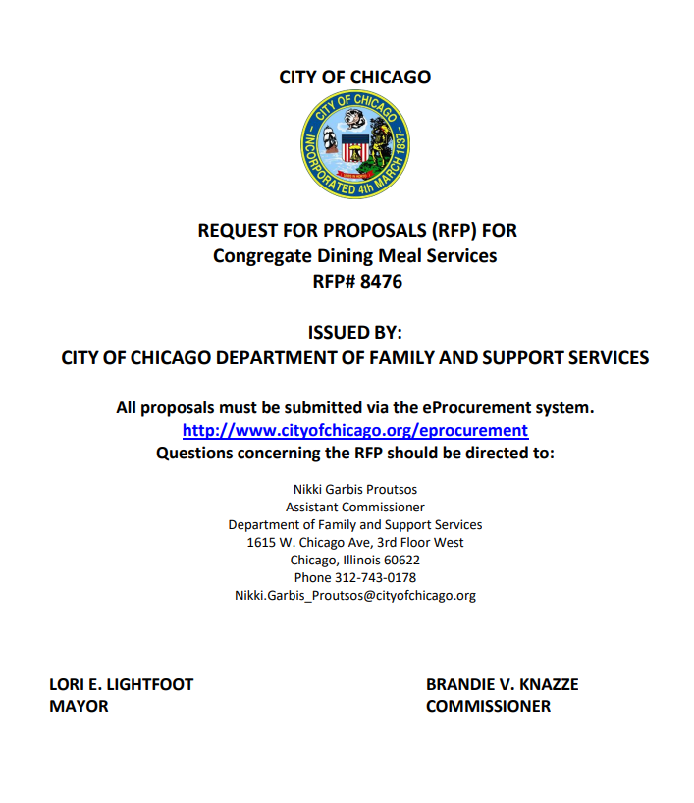
Agenda
Welcome and Introductions
Purpose
Background
Information about the scope/program description
Selection Criteria
Timeline
Technical Assistance for Applicants and eProcurement
Questions

Slide 4
Purpose of the RFP
The Department of Family and Support Services [DFSS] is seeking proposals from qualified agencies for the provision of Congregate Dining Meal Services that are high quality, nutritious, responsive to consumer needs and preferences, and culturally appropriate and cost effective.
The Congregate Dining Program operates two models:
Catered Meals: Meals prepared off-site and delivered to DFSS designated nutrition sites.
44 nutrition sites are located within five (5) geographic regions: Southeast, Southwest, Central West, Northeast, and Northwest (see Attachment 1).
DFSS will award contracts by region.
On-Site Meals: Meals are prepared and served at the same location.
Culturally specific diets: May include Chinese, Korean, Vietnamese, Latinx, Caribbean, Italian, Greek, Lebanese, Kosher, Halal, Indian/Pakistani.
DFSS may award up to five (5) nutrition sites that prepare and serve meals as on-site meal providers as funding allows.
The awarded Congregate Meal Providers will be responsible for the provision of meals and related nutrition supplies and equipment as specified in the RFP.

Slide 5
Background
The City of Chicago’s Department of Family and Support Services[DFSS] is the city’s primary social services provider for vulnerable residents of Chicago.
DFSS’s Mission:
Working with community partners, we connect Chicago residents and families to resources that build stability, support their well-being, and empower them to thrive.
DFSS’s Priorities:
Deliver and support high quality, innovative, and comprehensive services that empower clients to thrive.
Collaborate with community partners, sister agencies, and public officials on programs and policies that improve Chicagoans’ lives and advance systemic change.
Inform the public of resources available to them through DFSS and its community partners.
Steward DFSS’ resources responsibly and effectively.
For more information, please visit: www.cityofchicago/fss

Slide 6
Background
The DFSS Senior Services Division is the Senior Services Area Agency on Aging[AAA] for the City of Chicago as designated by the Illinois Department on Aging[IDoA].
As the Area Agency on Aging [AAA], DFSS- Senior Services provides various programs and services that protect the rights and support the needs of Chicago’s older adult residents.
The Congregate Dining Program (Golden Diners) assists older adults, 60 years and older and their spouses, to live independently by promoting better health through improved nutrition and reducing isolation through program socialization and the provision of additional supportive services.
In accordance with the goals of the Older Americans Act, the Congregate Dining Program works to:
Reduce hunger and food insecurity
Reduce social isolation of older individuals
Promote the health and well-being of older individuals
Delay adverse health conditions

Slide 7
Current State and Priorities for Improvement
Congregate Dining Meal Provision
Before the COVID-19 Pandemic: 800,000 meals were served to over 25,000 older adults annually.
FY 21: 500,000 meals were served to over 13,000 older adults annually. The greater portion of these were meals served as “to go” rather than “dine in”.
Priorities
Improve the provision of culturally appropriate, nutritious, and high-quality meals to help promote the health and well-being of older adults who are experiencing food security.
DFSS encourages submission of service offerings inclusive of and that may be infused with a variety of diverse meals (Latinx, Southern, Caribbean, Italian, Greek, Indian, Halal, etc.)

Slide 8
Target Population
In accordance with the Older Americans Act (OAA) 306(a)(4)(A), service providers must target older adults:
With the greatest economic and social need;
Who are low-income, minority older adults;
With limited English proficiency.
Individuals eligible to receive meals at a Congregate Dining nutrition site includes the following but is not limited to:
Individuals aged 60 years or older and spouses of those individuals, regardless of age, including individuals of same sex who are legally married.
There are no income thresholds or costs to eligible recipients for the meal service; however, clients receiving meals are asked to make a voluntary contribution toward the cost of their meals.

Slide 9
Program Requirements
All Congregate Meal Providers are required to comply with the requirements of the program as specified in Attachment #3 and within this RFP.
All meals must follow the meal pattern developed by the Illinois Department on Aging[IDoA] and all menus must be approved by a registered dietician.
In addition to complying with standards, all meals must provide the following:
(1) serving lean meat or meat alternative
(2) servings vegetables
(1) serving fruit
(2) servings grain, bread, or bread alternative
(1) serving fat free or low-fat milk or milk alternative
Coffee( decaf), tea( as requested), margarine ( when rolls are served) must be offered daily as part of the menu for all meal types.
Meal Unit (Equates to 1 Meal) consists of the following :
The total cost of the specified food, delivery to the site(catered meals), disposable and non-disposable supplies, eating utensils, serving equipment, cleaning supplies(Garbage Bags, Dish Detergent, Vinegar), transport packaging, and other supplies, etc.
Serving Equipment such as steam tables and coffee pots, should be furnished by awarded caterer(s). Please see pgs. 13-14 for more information regarding required food service equipment.

Slide 10
Program Requirements
Please consult the following attachments for applicable information on nutrition sites.
Regional geographic boundaries (Attachment 1: Congregate Dining Program Catered Nutrition Sites)
Nutrition Site Listing (Attachment 2: Nutrition Site Location and Serving Information for Catered Sites) which includes respective site(s):
Meal Serving Days & Times
Diets and Cuisines Served
Daily Number of Meals Served
Sample Menus ( Attachment 4: Menu Samples)
Meal Types
Hot lunch/ Breakfast meal/ Box lunch(Same rate should be proposed for both) (Applicable for catered and on-sites)
Hot or Cold To-Go Boxed Meals (Applicable for catered and on-sites)
Pre-plated meals/ Box lunch (Applicable for catered)
Holiday Meals (Themed- Applicable for catered and on-sites)
Special Citywide Box Lunch Meal (Applicable for catered)
Special Event Hot or Box Meals (Specialty meals- Applicable for catered)
Special Event Breakfast Meals (Specialty meals- Applicable for catered)
Shelf Stable Meals (Applicable for catered and on-sites)

Slide 11
Program Requirements
Cycle Menus (Catered and On-sites):
There are four (4) seasonal cycle menus for the hot lunch, pre-plated, and breakfast meals.
Draft menus are due to DFSS consulting dietician no later than 45 days prior to the next menu cycle and must be approved by the registered dietician.
Menus must be prepared in accordance with:
DFSS Menu Planning Standards (Attachment #5)
DFSS Food Specifications for Cycle Menus ( Attachment #6)
Meal Serving Guide
A meal serving guide must be prepared by the congregate meal provider (catered) and submitted to DFSS consulting dietician for approval when submitting cycle menus.
Meal Orders (Catered):
Submitted by DFSS (1) week in advance.
Changes to meal orders follow timeframe specified in RFP.

Slide 12
Program Requirements
Days of Operation
All sites typically serve meals a minimum of five days per week.
All congregate nutrition sites are closed on (6) major holidays.
Distribution of Required Program Information
Unless otherwise specified, information will be developed by DFSS and distributed via awarded meal providers:
Nutrition Education (On-site meal providers will be responsible for developing materials)
Nutritional Risk Brochure
Food Allergies & Special Diet Information Sheet
SNAP Information
Annual Client Satisfaction Survey

Slide 13
Program Requirements
Service Delivery Specifications for Catered Meal Providers (p.17-18)
Meal packaging must meet regulations approved by the Chicago’s Department of Public Health (CDPH) and be designed to prevent seeping, spilling, dripping, and leaking.
All meal delivery equipment must be food safe, appropriate and capable of maintaining hot and/or cold temperatures.
Hot Food must be delivered hot (no less than 135 F) and cold foods must be delivered cold (no higher than 41F).
In instances of reported shortages/ poorly prepared meals, the meal provider shall make every attempt to replace necessary items prior to serving time or issue a credit to DFSS.
Service Delivery Specifications for On-site Meal Providers (p.18-20)
Food Service Staff Required (flat partial reimbursement rate of $15/ hour)
Adequate Facility Compliance Required ( Attachment #9: Program Self Evaluation Check List)
Outreach, socialization, participant registrations, and collection of voluntary contributions.

Slide 14
Program Requirements
Quality Control
For cook-chill-heat production systems or any production system that includes prepared food storage, awardee will be required to submit food samples to laboratory for pathogenic organism analysis quarterly.
Awardee must have clearly written sanitation, safety, and monitoring policies and procedures.
Invoices
Invoices and support documentation will be required to be submitted by the appropriate deadlines:
Catered meal provider (weekly)
On-Site meal provider (monthly)
Good Food Purchasing Policy (GFPP)
The Congregate Dining Meal Service Providers will be required to participate in the Good Food Purchasing Program (GFPP) and work with the GFPP Team to record and report purchases and/or pledge to participate in the Good Food Purchasing goals.
Please see the following attachments for more information:
Attachment #7a: Good Food Purchasing Program Standards for Food Service Institution.
Attachment #7b: GFPP Tracking Form
Attachment #7c: Good Food Purchasing Pledge

Slide 15
Performance Goals and Outcomes
DFSS seeks respondents with evidence of strong past performance against desired outcome goals.
Performance Indicators
80% or more of the seniors indicate that they receive quality meals.
80% or more of the seniors indicate that their nutritional needs are being met by participating in the program.
Completion of baseline assessment and active engagement in annual updates to its Good Food Purchasing Plan.
Output Metrics
Food Service Quality
# of instances that food items and condiments provided are not specified on the menus.
# of food service issues (shortages, unauthorized substitutions) are less than 5% of the number of deliveries made.
100% of food service issues involving more than 3 servings of an entrée or side dish results in redeliveries for catered meal providers.
Timeliness of submission of quarterly menus and laboratory analysis from submitted food samples will also be tracked to ensure they are submitted by due dates.
Responses to food service issues or concerns are addressed within 24 hrs. of receiving complaint.

Slide 16
Performance Goals and Outcomes Continued
DFSS seeks respondents with evidence of strong past performance against desired outcome goals.
Food Safety
# of incidents of food borne illnesses.
# of quarterly pathogenic organism analyses of food samples reporting positive for Shigella, Salmonella, and Listeria.
A minimum average of 30 seniors per day will be maintained in the program for on-site meal providers.
GFPP Implementation
The agency strives to meet at least the minimum baseline purchasing thresholds in each value category in the Good Food Purchasing Program over the life of the contract, with improvements demonstrated year over year through ongoing reporting and assessment.

Slide 17
Selection Criteria-Basis of Award
Each proposal will be evaluated on the strengths of the proposal and responsiveness to the selection criteria.
Awards for Congregate Catered Meal Services will be made by region.
Awards for Congregate On-site Meal Service will be based on score and funding availability.
DFSS may consider additional factors in selection to ensure systems-level needs are met such as: geography/location across the city, capacity, experience, community needs, costs, and provision of culturally appropriate meals.
Successful respondent(s) must be ready to proceed with the proposed program by October 1st, 2022.
Failure to submit a complete proposal with all required documentation may result in the proposal being deemed unresponsive and therefore, subject to rejection.

Slide 18
Selection Criteria - Organizational Capacity
This section is worth: 30 points
DFSS seeks respondents that demonstrate:
Qualified staff responsible for program oversight and management as indicated by its staffing pattern, job descriptions and resumes, and if relevant, a discussion of its sub-contactors.
Organizational expertise and capacity specific to the target population.
Adequate systems and processes to support monitoring program expenditures and fiscal controls.
Adequate Human Resources capacity to hire and manage staff.
A commitment to reflecting and engaging the diverse people in the communities it serves.

Slide 19
Selection Criteria - Organizational Capacity Continued
This section is worth: 30 points
DFSS seeks respondents that demonstrate:
That they have a plan to become more inclusive in its partnerships and operations.
That they conduct regular training/continuing education and has a consistent method to on-board new staff.
That they have a facility and equipment to support program operations both routinely and during variety of emergencies including but not limited to public health, weather, power failures, vehicular breakdowns, and employee absences.
The number and type of meals it intends to serve daily and annually.

Slide 20
Selection Criteria – Strength of Proposed Program
This section is worth: 30 points
DFSS seeks Respondents that demonstrate:
A clearly defined meal service program including a description of its facility, the meal preparation model, quantity and quality of the equipment used, and storage. If relevant transportation and delivery protocols will also be described.
An estimate of how many individuals will be served by this program.
An outreach and retention plan that demonstrates an understanding of the target population, their needs and challenges.
A mechanism for developing, disseminating, collecting, compiling and analyzing client customer satisfaction surveys and ability to make programmatic adjustments as a result of this feedback.

Slide 21
Selection Criteria – Strength of Proposed Program Continued
This section is worth: 30 points
DFSS seeks Respondents that demonstrate:
Their ability to support the City of Chicago’s Good Food Purchasing Program goals by 1) submitting the Good Food Purchasing Program Implementation Plan and 2) affirms compliance to meeting the contract’s data reporting compliance requirements.
Appropriate expertise, knowledge, and experience in providing nutrition education.
A plan for returning to in-person dining and socialization (on-site only) or for meal re-delivery/re-routing.
A nutritional analysis software program it intends to use or outlined another method of performing nutritional analysis.

Slide 22
Selection Criteria – Performance Management and Outcomes
This section is worth: 25 points
DFSS seeks Respondents that demonstrate:
Evidence of strong past performance against desired outcome goals and performance metrics and/or other notable accomplishments in providing services to the target population.
Experience using data to inform/improve its services or practices.
The relevant systems and processes needed to collect and store key participant and performance data, including client contributions, as relevant.
Having established, effective quality control standards and procedures around food handling, processing, packaging sorting and delivery.
The Relevant systems and processes needed to track, manage, and report data used to determine performance on program outcomes.

Slide 23
Selection Criteria – Reasonable costs, Budget justification, and Leverage of funds
This section is worth: 15 points
DFSS seeks Respondents that demonstrate:
The fiscal capacity to implement the proposed program.
Reasonable implementation costs and funding requests relative to its financial and human resources.
A cost proposal supports the proposed scope of work or work plan.
That it engages in a regular auditing process.

Slide 24
Selection Criteria- Attachments for Catered Meal Applicants
For Catered Meal Service Applicants, please be sure to include the following:
Congregate Catered Meal Cost Proposal (Attachment #8A)
Resumes, Certifications, and any special licenses for staff involved in the Congregate Dining Program.
Staffing chart that provides the number of line staff, supervisors, and other staff assigned to the project.
Copy of the most current full Public Health Inspection Report for agencies currently providing meals to the public.
Respondents applying to provide both catered and on-site meal services, must complete separate applications for each service model.

Slide 25
Selection Criteria- Attachments for On-site Meal Applicants
For On-site Meal Applicants, please be sure to complete and include the following:
Congregate On-Site Cost Proposal (Attachment #8B)
Self Evaluation Form (Attachment #9: Program Accessibility Self-Evaluation)
Resumes, certifications, and any special licenses for staff involved in the Congregate Dining Program.
Staffing chart that provides the number of line staff, supervisors, and other staff assigned to the project.
Copy of the most current full Public Health Inspection Report for agencies currently providing meals to the public.

Slide 26
Contract Term & Respondent Eligibility
Term of Contract
Funding is subject to the availability of funds from the City of Chicago, Illinois Department on Aging [IDoA], and the Older American’s Act.
Delegate agency agreement awards will be made for a three-year period, October 1st, 2022- September 30, 2024, for an amount not to exceed $3,200,000.00 for the first budget year. DFSS reserves the option to extend the delegate agency agreement(s) for one additional year.
Eligible Respondents
Respondents for both catered and on-site services must be licensed and inspected food service establishments.
Respondents for on-site meal services must have program facilities that are accessible to persons with disabilities and in full compliance with the Americans with Disabilities Act of 1990 (ADA).
This is a competitive process open to all entities: non-profit, for-profit, faith based, private and public, all units of government and sister agencies.

Slide 27
Selection and Transition Timeline
Pre-proposal webinar – June 30th, 2022, 10:30 a.m. -12:00 noon
Due date to submit pre-proposal questions – July 8th, 2022
Applications due – July 20th, 2022 by noon
Program period begins – October 1st, 2022

Slide 28
Deadline
Applications are due
on July 20th, 2022
at 12:00, Noon

Slide 29
Application Tips
Start Early!!
If you have never done business with the City of Chicago, register into iSupplier/eProcurement ASAP.
Review RFP narratives and application questions closely. Remember they align with the scope and selection criteria. Use the information in the RFP for guidance in formulating your answers.
Carefully review the selection criteria.
There is a 4,000 character limit which includes punctuation and spaces. Each response is allotted 4,000 characters.
Do not use the back button on your browser.
Save Often!!

Slide 30
Tips for Working in eProcurement
You can “submit” your application and later amend it up until the due date July 20th, 2022 at 12:00 noon.
Avoid the rush and possible mishaps by submitting early. Plan on submission taking 30-60 minutes.
Late applications will not be accepted.
Make use of the eProcurement hotline for help at 312-744-4357 (HELP).
Please note that the hotline operates during business hours only, Monday-Friday 9-5.
Save often, submit early!

Slide 31
Technical Assistance!
On the DFSS web page is a link to the RFP of interest and training documents. See “Alerts” Section on our website.
For Questions on Registration and eProcurement Technical Assistance for Delegate Agencies –
CustomerSupport@cityofchicago.org or call 312-744-HELP (4357)
Training Materials (Documents and Videos) – https://www.cityofchicago.org/city/en/depts/dps/isupplier/online-training-materials.html

Slide 32
How to accept an amendment

Slide 33
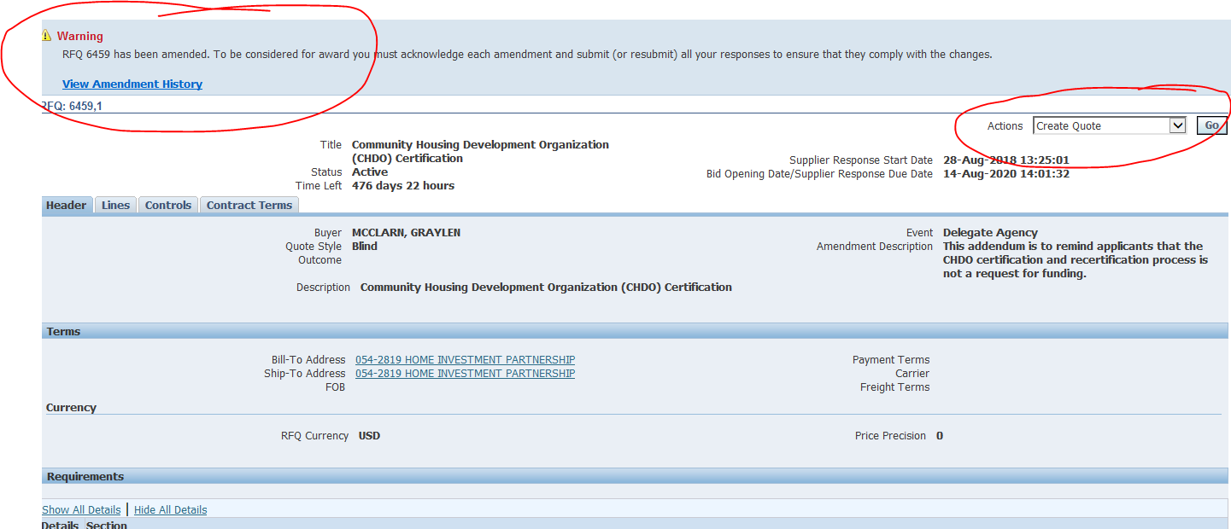
How to accept an amendment – Step 1
The RFP you are interested in has been amended. In order to start an application , you will need to acknowledge and accept the amendment first in order to start your application. (Please not that the RFP shown in this and subsequent slides is an example). To accept the amendment, click on “View Amendment History”.
If the RFP has not been amended (yet), select “Create Quote” from the drop-down menu in the “Actions” box and click on “Go”. This will take you to the application page, where you can get started.

Slide 34
How to accept an amendment – Step 2
To begin the acceptance and acknowledgment process, to open the RFP in view only, click on the Document number (1) To review the amended changes to the RFP, click on the infinity or eyeglass icon (2) To acknowledge receipt and understanding of these changes and proceed, click on the “Acknowledge Amendments” button (3).
By acknowledging the amendment, you are indicating that you are aware of the changes made to the RFP in the amendment.

Slide 35
How to accept an amendment – Step 3
When you get to this screen, click on the “I accept…” check box and then click on “Acknowledge”

Slide 36
How to accept an amendment – Step 4
Click on “Yes” to indicate that you confirm your acknowledgement of the amendment.

Slide 37
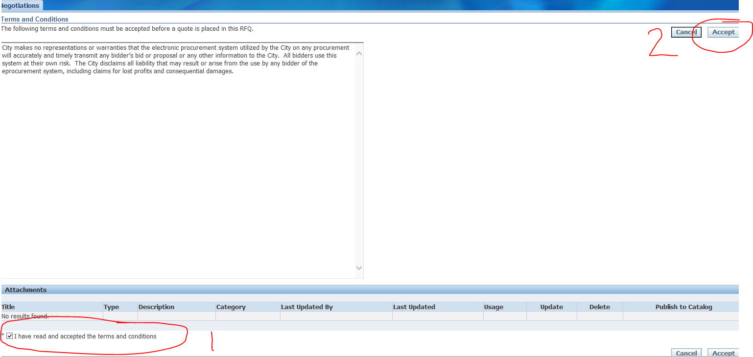
How to accept an amendment – Step 5
Finally, (1) click on the checkbox that you accept the terms and conditions and then (2) click on “Accept” to accept them.
This is the final step in acknowledging and accepting the amendment.

Slide 38
How to submit an application

Slide 39
How to submit an application - Step 1
When you are ready to submit, start by saving your draft one last time. Then click Continue.

Slide 40
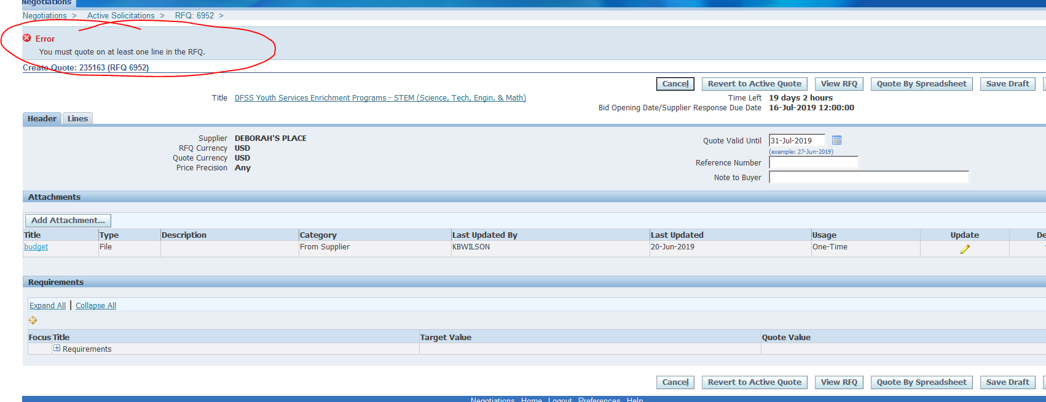
How to submit an application - Step 2
If you are missing information, you will be given an error message on the top of the page.

Slide 41
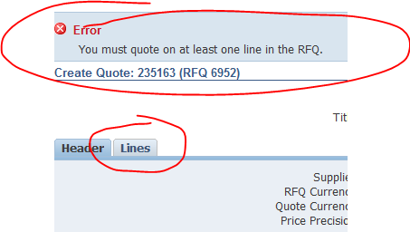
How to submit an application - Step 3
Usually the error messages direct to something left undone in the application.
In the last example, the error message indicated that the lines (found under the lines tab) had not been filled out.

Slide 42
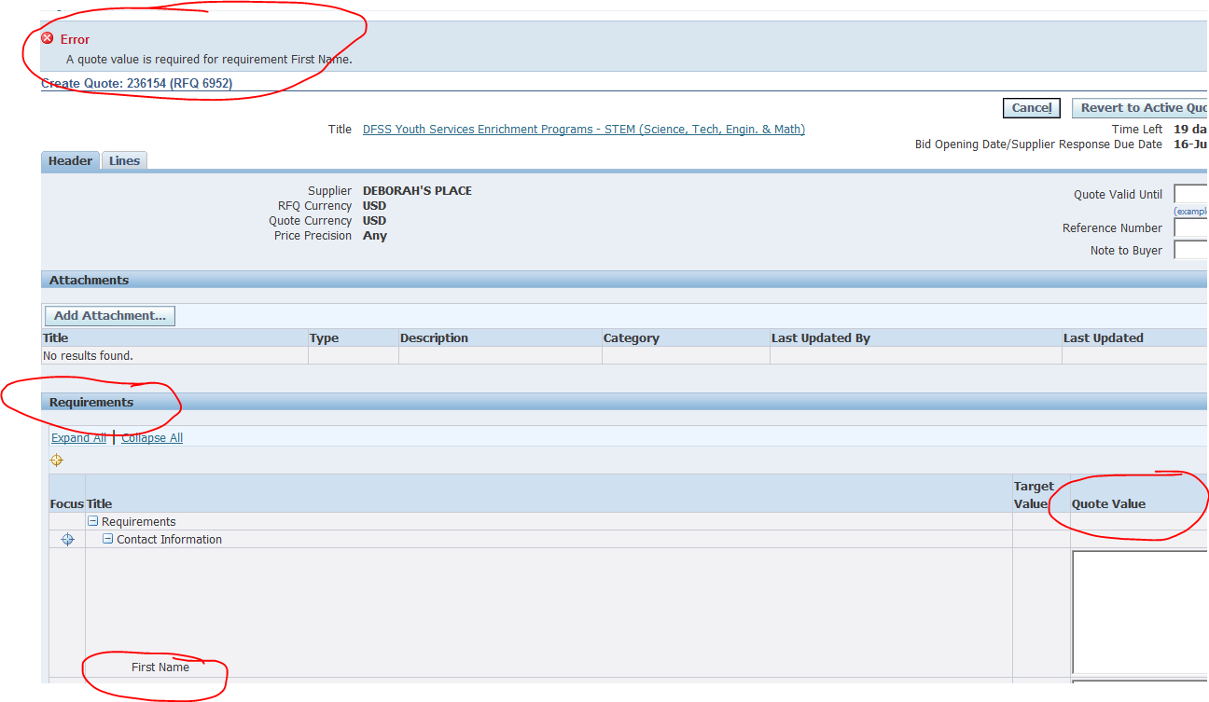
How to submit an application - Step 4
In this example, the error is about an unanswered question in the application (or Requirements section). The Quote Value refers to your (in this case, missing) answer.

Slide 43
How to submit an application - Step 5
Once your application is free from errors, you are ready to proceed and submit! At this point, clicking “Continue” should put your application into the “Review and Submit” phase.

Slide 44
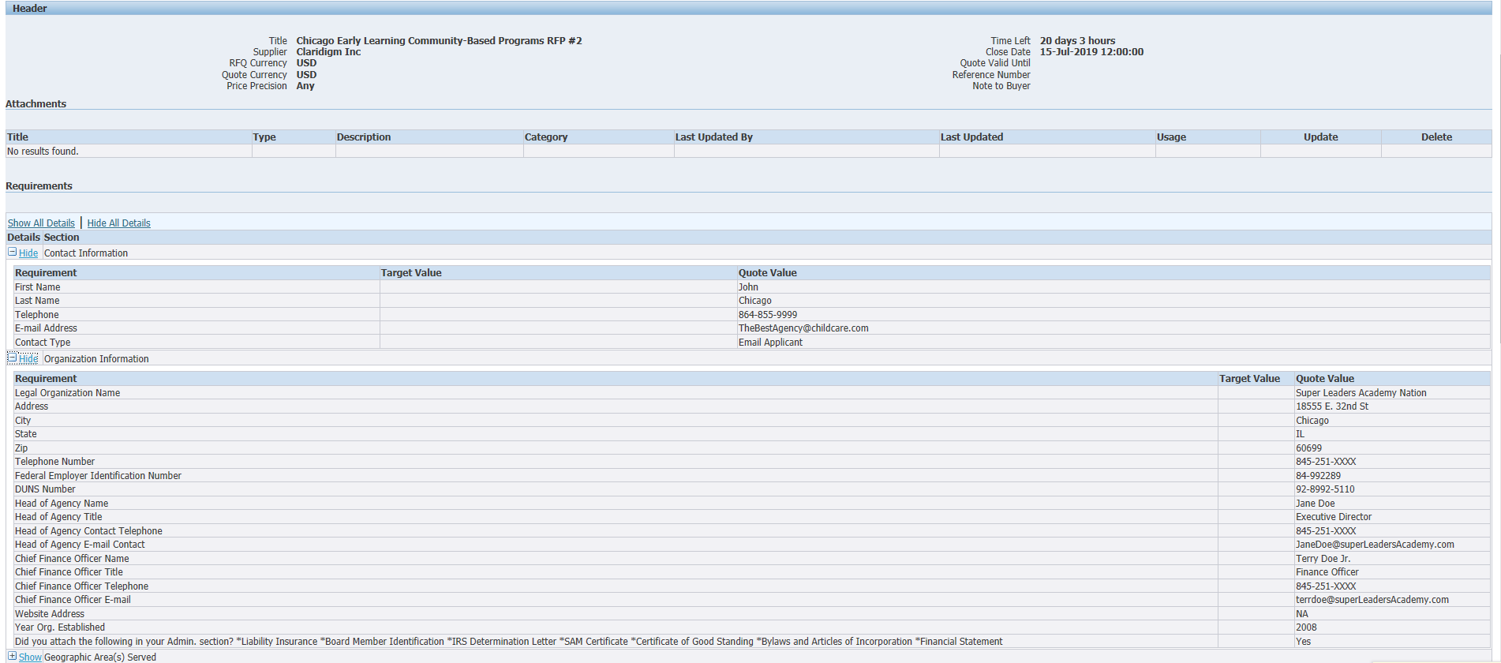
How to submit an application - Step 6
This is your last chance to review all your data and confirm that it is accurate. Check your attachments and scroll to the bottom of the screen to see all your responses.

Slide 45
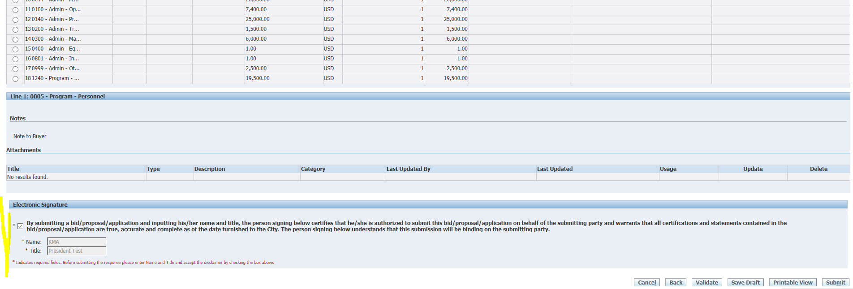
How to submit an application - Step 7
At the bottom of the screen you will be asked to provide an electronic signature. Be sure to fill in the signature before checking the box!

Slide 46
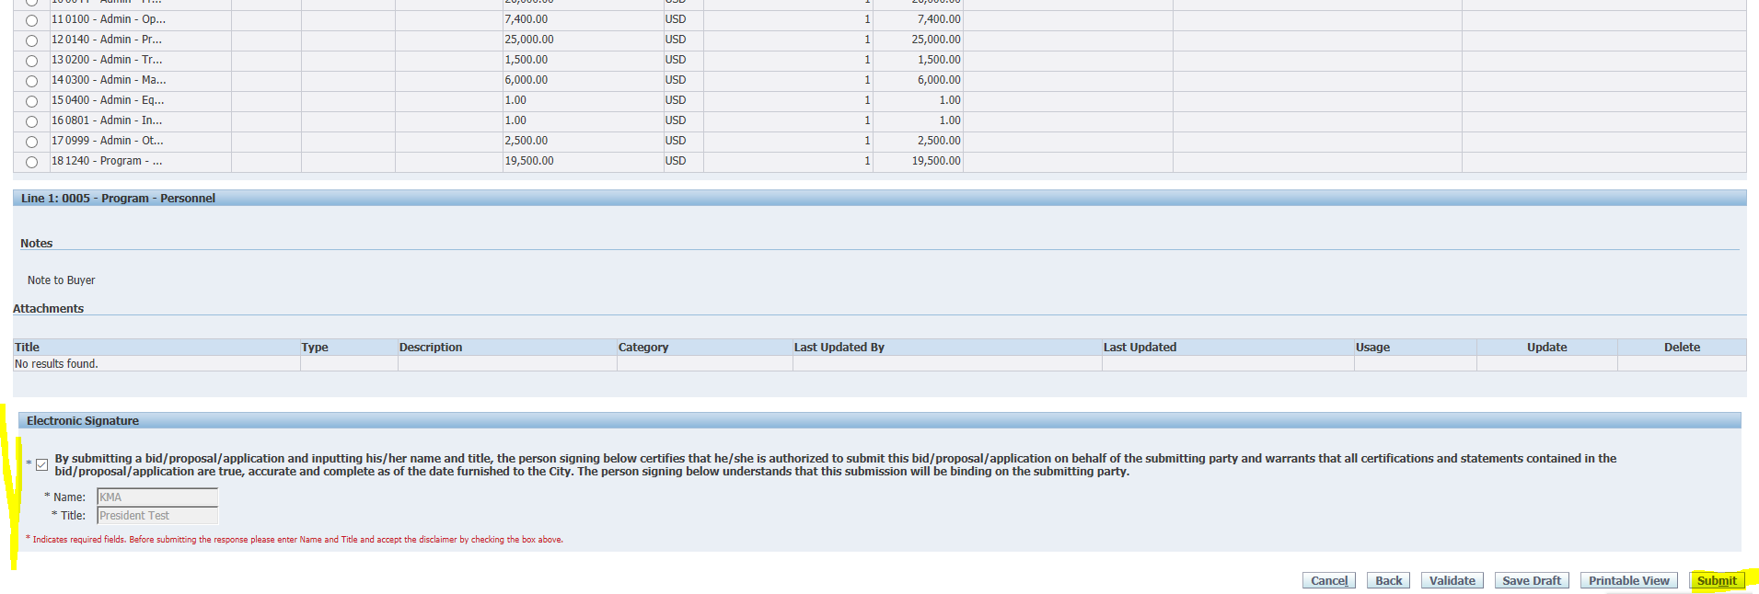
How to submit an application - Step 8
Then click “Submit”.

Slide 47
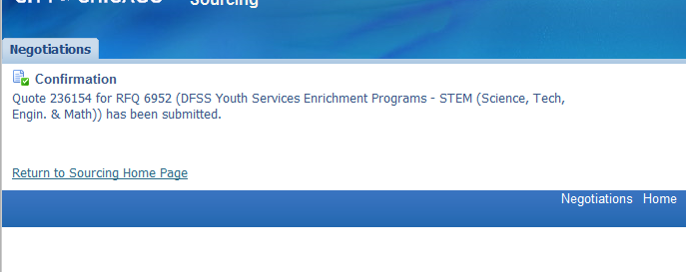
How to submit an application - Step 9
Make sure that you see this submittal confirmation screen. The eProcurement system will send a confirmation email within 24 hours of your submission. Please call or email me if you desire confirmation prior to then.

Slide 48
Questions?

Slide 49
Program Questions?
Nikki Garbis Proutsos
312-743-0178 Nikki.Garbis_Proutsos@cityofchicago.org
For non-programmatic questions contact:
Julia Talbot
(312)-743-1679
Julia.Talbot@cityofchicago.org

