Slide 1
WORKING WITH ASSIST AGENCIES
Presented By:
Chicago Minority Supplier Development Council
U. S. Minority Contractors Association
The AeroStar Avion Institute

Slide 2
Welcome
The Department of Procurement Services is committed to Communications and Outreach, which is key to keeping citizens informed of bid opportunities, new programs, and innovations.
Also ensure that you download a copy of our most recent Consolidated Buying Plan. This is a 15-month forecast including hundreds of upcoming opportunities for 12 city agencies. To download go to: www.chicago.gov/dps
We encourage you to follow on our website www.chicago.gov/dps for the latest news, updates, and our calendar of events. Go online www.chicago.gov/DPS and click on the letter icon and sign-up for our Email Newsletter: DPS Alerts. News that you can use.
Follow us on social media to stay informed:
Facebook: www.facebook.com/ChicagoDPS
Twitter: www.twitter.com/ChicagoDPS
LinkedIn: www.linkedin.com/company/chicagodps
Youtube: www.YouTube.com/ChicagoDPS
NOTE: Legal advertisements for the City of Chicago Department of Procurement Services (DPS) appear in the Chicago Tribune. Information about DPS contracting opportunities will be available at www.chicago.gov/bids.

Slide 3
RESOURCE GUIDES
DPS has published a four-volume set of Resource Guides, expanding on the guiding principle of transparency.
The Resource Guides were divided into key areas of the procurement process:
Contract Administration
Incentives and Programs
Certification
Compliance
Download now at www.chicago.gov/dpsguides
@CHICAGODPS

Slide 4
Today’s Workshop
Everyone is muted upon entry for the presentation portion of the workshop
We ask that you hold your questions to the end of the presentation. You can use the chat feature to type out your question and the speaker will answer the questions at the end of the presentation.
To Send a Question: Use only the Q & A panel to ask your question. Do not use the chat panel
Use the Q & A panel on the right side of your screen.
In the Send to or To drop-down list, select the recipient of the message.
Enter your message in the chat text box, then press Enter on your keyboard.
Note: If you join a meeting, session, or event in progress, you can see only the Q & A that participants send after you join.

Slide 5
Chicago Minority Supplier Development Council
The Chicago Minority Supplier Development Council, Inc. (ChicagoMSDC) is a premier organization for increasing business opportunities between major buying organizations and minority-owned businesses.
For the minority entrepreneur, ChicagoMSDC's programs and resources are avenues for increasing sales to private- and public-sector buying organizations. For the buyer, ChicagoMSDC serves as a credible resource for locating qualified minority suppliers. To both the entrepreneur and the buyer, ChicagoMSDC is the central network where supplier diversity lives and business alliances flourish.
The ChicagoMSDC partnership includes over 250 private-and public-sector buying organizations and nearly 1,000 minority businesses.

Slide 6
WORKING WITH ASSIST AGENCIES
Presented By:
J. Vincent Williams
Chicago Minority Supplier Development Council
Notes:
Ve

Slide 7
Your Partner in Sustainable Economic Growth

Slide 8
Who we are?
History
Mission
Highlights
Founded in 1967
Network includes a National Minority Supplier Development Council (NMSDC)and 23 regional councils across the country – ChicagoMSDC
Private 501(c)3 supported by contributions from corporations
To certify, develop, connect, and advocate for minority suppliers
To be the premier organization for increasing value added business opportunities between major buying organizations and minority- owned businesses
Approximately $18B in MBE
contracts in 2019
Over 1000 certified MBE’s locally and 12,000 Nationwide
Supplier Diversity Economic Impact Tracking Tool
Operates Programs to assist with developing MBEs. Technical Assistance, Bidding assistance, Access to Capital Workshops, Corporate Readiness

Slide 9
Members and Affiliates
Nearly 100 local corporate members 250 national corporate members
Serving the public and private sector across all industries
Access to a local database that includes all diverse suppliers
Twenty Three Regional National Minority Supplier Development Council (NMSDC founding Affiliate)

Slide 10
Membership Options
Local and National
Eighty percent of national corporate membership dues are used to support the 23 NMSDC affiliate councils.
National corporate members receive the following benefits from affiliate councils:
Local Office National Office
Supplier Diversity Program Development Support • Members may receive service
from any of NMSDC’s 23 Affiliate Council areas.
Identify and certify minority business enterprises (MBEs)
MBE referral and/or introductions
Standardized platform for delivery of services
More solutions to connect with the right MBE for your business
Registration discounts for Affiliate minority supplier development training
Programs and learning opportunities
Registration discounts for Affiliate seminars and special events
NMSDC Central: our go-to technology platform for certification, search and retrieval of MBE information
Access to networking and communication opportunities
Access to Affiliate Information Center materials
Assistance and support in RFP/bid distribution

Slide 11
Services/Benefits:
Bridging the Gap in your Procurement Process
☑ Cost Savings and Increases in revenues as much as 15%
☑ ChicagoMSDC serves as a resource center and diversity partner which is solely dedicated to the growth and sustainabilty of minority businesses
☑ Supplier Diversity Program Support and/or Development
Supplier Diversity Consulting Services Available with partners
☑ Software Solution - access to the local database of certified MBE’s with standard membership
☑Access to a comprehensive diverse sourcing database that includes all diverse categories with sponsorship membership options

Slide 12
Services/Benefits:
Bridging the Gap in your Procurement Process
☑ Multiple Networking Opportunities
Annual Signature Networking Events
CBOF – ChicagoMSDC Scholarship Classic – MBE2MBE Exchange
☑Assistance and support in RFP/Bid distribution
☑ Event and Webinars Participation/Workshops
☑ Educational Program and Training for your procurement staff
Procurement Lunch & Learn
Corporate Supplier Diversity Training Classes
☑ Supplier Diversity Sourcing and Compliance Management Support throught NMSDC

Slide 13
Services/Benefits:
Bridging the Gap in your Procurement Process
Access to ChicagoMSDC database of qualified suppliers
Diversity education and training
Growth of our corporate diversity program(s)
Support of ChicagoMSDC programs and services
Meet our business obligations and requirements
Network with local minority businesses
Network with other corporations - Locally & Nationally
Network with government agencies
Become a part of the National NMSDC network

Slide 14
Onboarding Diverse Suppliers:
Bridging the Gap in your Procurement Process
Work with you to Identify Diverse Suppliers
Start with your existing database - Identify Gaps
Look at spend, determine where you have the most opportunity
Understand your current spend
What you do not have
What you would like to have
Review upcoming opportunities
Work with ChicagoMSDC to assist with opportunities to meet new diverse suppliers
Procurement Lunch & Learn
Host an Informational Webinar

Slide 15
Diversity Partnership
Bridging the Gap in your Procurement Process
WE ASK OUR CORPORATE PARTNERS TO AGREE TO THE FOLLOWING:
Continually share information about new and upcoming opportunities to share with minority suppliers. (news updates)
Provide ChicagoMSDC with an evergreen 10 -15 minute
"How to do Business with Us."
Instructional video that will be featured on ChicagoMSDC's You Tube channel.
Utilize the local database and the ChicagoMSDC staff to seek
qualified, certified minority suppliers.
Report the number of ChicagoMSDC certified MBEs your organization utilizes year over year
Continually review and consider sponsorship opportunities with ChicagoMSDC and minority suppliers

Slide 16
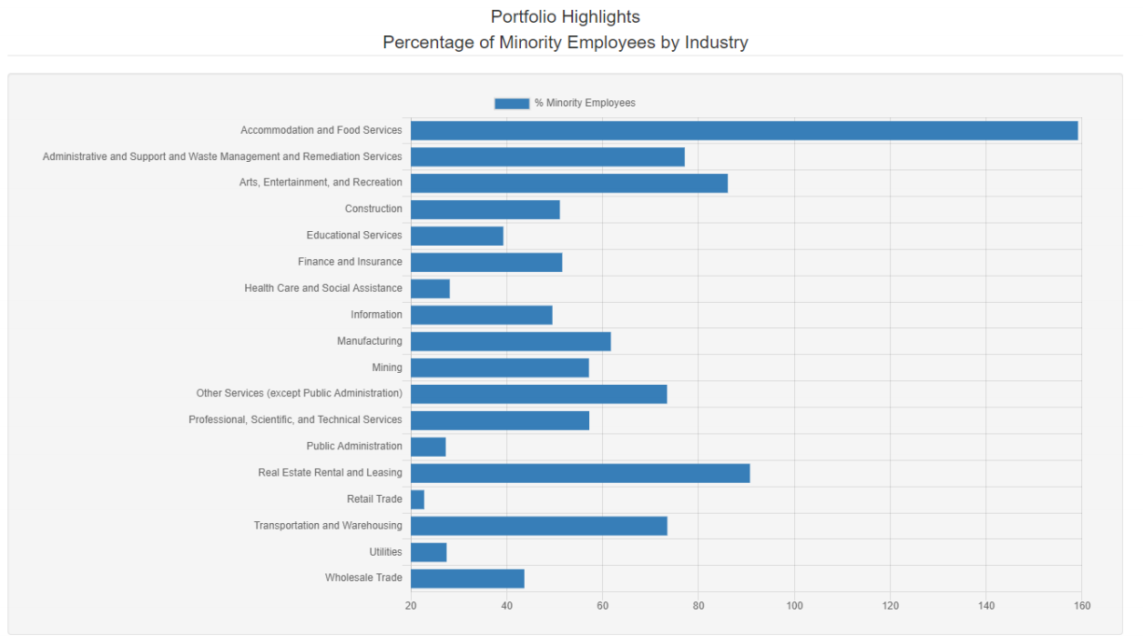

Slide 17
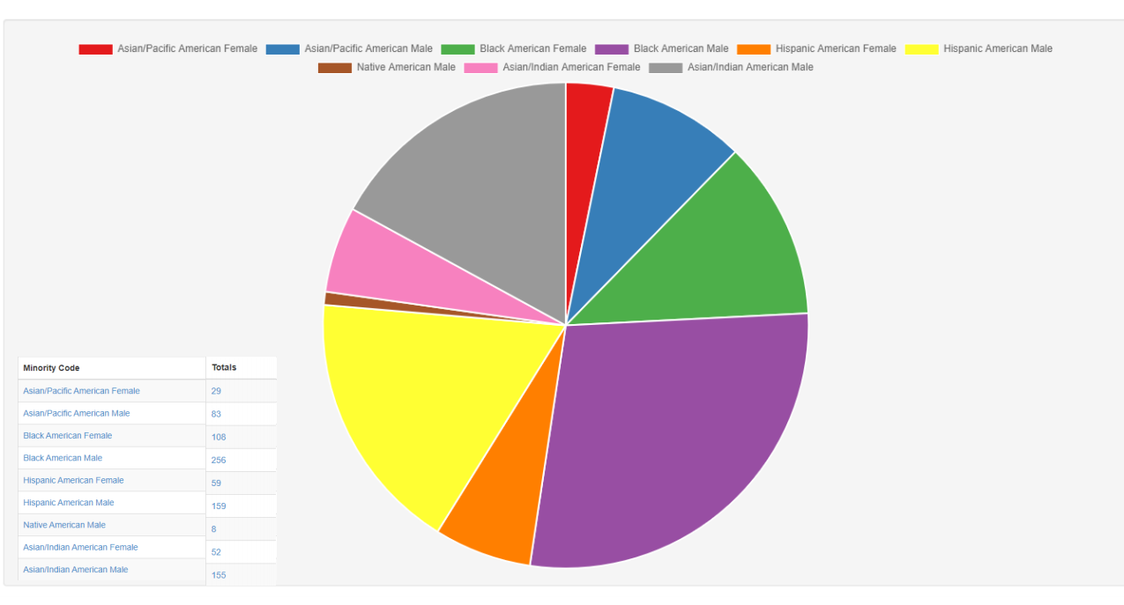

Slide 18
Become a Part of Our Ecosystem…
New Initiative exclusively with ChicagoMSDC & WGN Radio
(The Voice of Chicago) 1 Million Listeners

Slide 19
Strategic Partners and MBEs
I

Slide 20
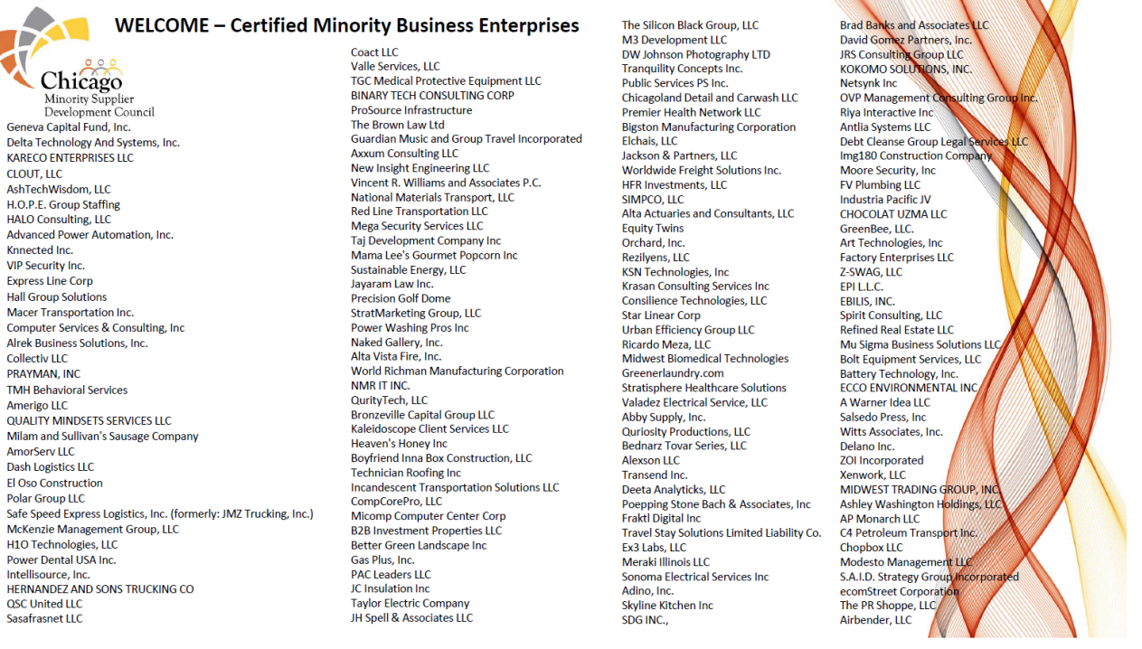
2020 Welcomed 168 New MBEs

Slide 21
Your Supplier Diversity Sustainability Partner
12

Slide 22
CONTACTS
Vincent Williams
President & CEO vwilliams@chicagomsdc.org
David Thomas
Director, Chicago MBDA Business Center dthomas@chicagombdacenter.com (312) 755-2563
Jose Robles Michelena
Executive Vice President
jrobles-michelena@chicagomsdc.org (312) 755-2550
Neda Sharp
Program Manager, Illinois Tollway T.A.P. nsharp@chicagomsdc.org
(312) 755-2554
Barbara Lumpkim
Interim Development Officer blumpkin@chicagomsdc.org
(312) 755-8880
Linda Robinson - Director of Events
lrobinson@chicagomsdc.org
(312) 755-2555
ChicagoMSDC – 216 W. Jackson Suite 600 – Chicago, IL 60606
(312) 755-8880 – www.chicagomsdc.org
13

Slide 23
U. S. Minority Contractors Association
U. S. Minority Contractors Association provides unique professional, educational, technical, and consultative services to both the membership and the community at large. We endeavor to provide the best consultative services possible in the construction, environmental, building maintenance, architectural - engineering design, hospitality training and general service industries. We serve as the premier advocacy and assistance agency in the nation for minority contractors, subcontractors, general contractors, and professional service firms in the broader build community nationwide. Our strategic partners are some of the largest firms in America as non-minority firms in Construction, Architecture, Technology and Financial services who are committed to the advancement of diversity, equity and inclusion.

Slide 24
WORKING WITH ASSIST AGENCIES
Presented By:
Teresa Hollingbird-Jackson
U. S. Minority Contractors Association

Slide 25
U.S. Minority contractor's association
Success through excellence

Slide 26
THE U.S. HUB OF MINORITY CONTRACTORS, SUBCONTRACTORS, AND SERVICE PROVIDERS.
The United States Minority Contractors Association (USMCA) is a non-profit [501C3] professional trade association of minority owned, and operated businesses (MBE/WBE/DBE/VBE) located in Illinois, Indiana, Metro-Atlanta- Georgia communities and over all within fourteen other states throughout America.
We encourage and support the development of manpower, employee training, apprentice programs, as well as notifying members of existing employment opportunities for minority, female, veterans and other designated protective class individuals consistent with Federal, State and municipal guidelines . We provide access to architectural drawings/specifications for public and private projects, while also affording educational, technical, and consultative assistance to the membership. Insurance, bonding, bidding/estimating, financing, and contract administration are just a few of the membership services available. We identify bidding and contracting opportunities for non-minority, minority firms, strategic partners [nonminority] in the construction industry and encourage the sharing of best business practices among the entire membership. We have an inhouse proprietary automated software that allows members to retrieve bid documents, plans and specifications, in our designated bid plan room electronically and on site. Individuals are eligible to receive two free hours of bid estimating advice and assistance utilizing cutting edge software and techniques. Service available to members only. Driven by our global strategic partner -Procore-discount features exist for construction management training as well.
Learn more about becoming a member with USMCA by visiting our website listed below.
www.usminoritycontractors.org

Slide 27
Key Membership Benefits
Identify Procurement Opportunities
Business Consulting/
Technical Support
Networking
Bi-weekly bids & opportunities
Word of mouth referrals
“In- house” projects & ventures
One–on-One business coaching & consultation
Certification assistance & advocacy
FREE Website Built with Consultation
Monthly meetings bringing you Non-Minority GC’s, Government agencies, private sector contacts and many more
Connect with someone who could potentially grow your business!

Slide 29
Programs we are offering
Minority Certification Mentoring Program - Assisting minority contractors in achieving MBE/DBE/WBE status
ETI Training Institute of USMCA - Assisting small businesses in business startup, growth and technical assistance
Advanced business development training with long-term coaching and mentoring assistance-Getting Certified and expanding MBE Certifications
Placement services for unemployed/under-employed minority residents - career resume development

Slide 30
Thank you
PLEASE CONTACT INFO@USMINORITYCONTRACTORS.ORG FOR MORE INFORMATION ON HOW TO BECOME A MEMBER!

Slide 31
The AeroStar Avion Institute
The AeroStar Avion Institute is a Woman, and Minority Owned Business Enterprise that delivers programs that teach skills necessary to not just participate, but LEAD in the next generation of STEM innovation. Students are immersed in inquiry-based learning, engineering design projects, they operate flight simulators, remote controlled helicopters, drones, RC airplanes and VR headsets. They also build model airplanes and rockets to specifications. They study and demonstrate extensive knowledge on flight theory, aviation weather, aircraft radio operation, aircraft cockpit instrumentation and STEM careers. We soar above other programs because we provide years of ongoing support to students interested in pursuing pathways in Aviation/STEM.

Slide 32
WORKING WITH ASSIST AGENCIES
Presented By:
Tammera L. Holmes
The AeroStar Avion Institute
Notes:
Ve

Slide 33
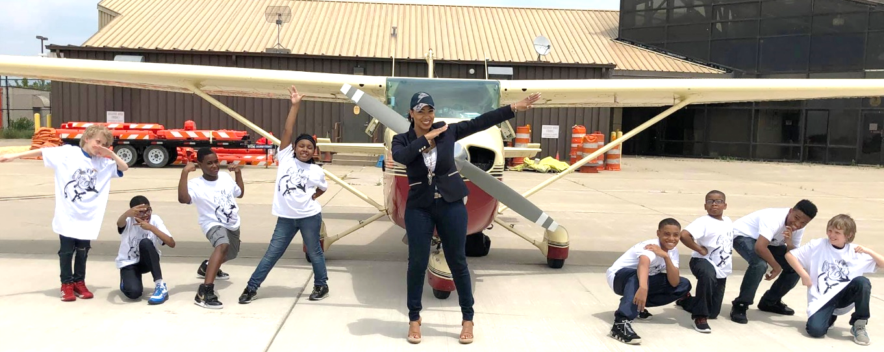
Tammera L. Holmes Founder & CEO

Slide 34
ABOUT US
“GIVING WINGS TO DREAMS”
WHO WE ARE | WHAT WE DO | WHY WE DO IT

Slide 35
Our 3 Objectives
1. Increase public understanding of the importance of aviation and support aerospace education initiatives at the local, state, national and global levels, especially among students from diverse backgrounds.
2. Maximize academic achievement among young men and women by providing strong, innovative academic tools that enhance their aptitude for learning both inside and outside of the classroom. (STEM focus)
3. Provide training and support for individuals interested in pursuing careers in the areas of Science, Technology, Engineering and Mathematics, particularly aerospace.

Slide 36
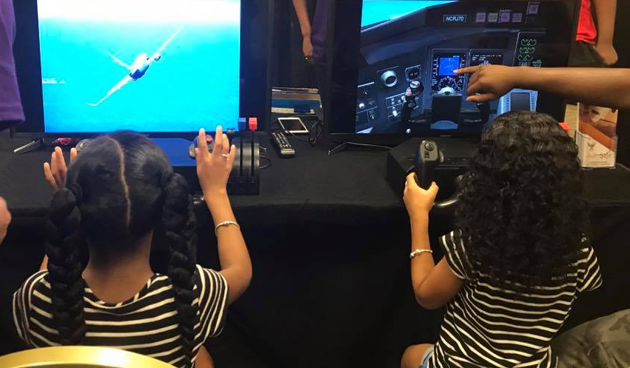
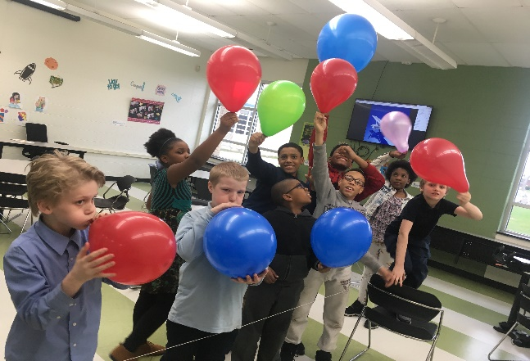
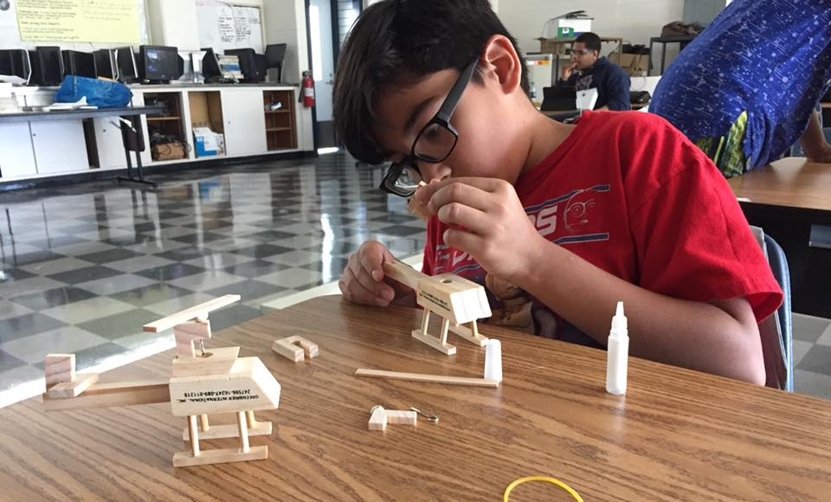
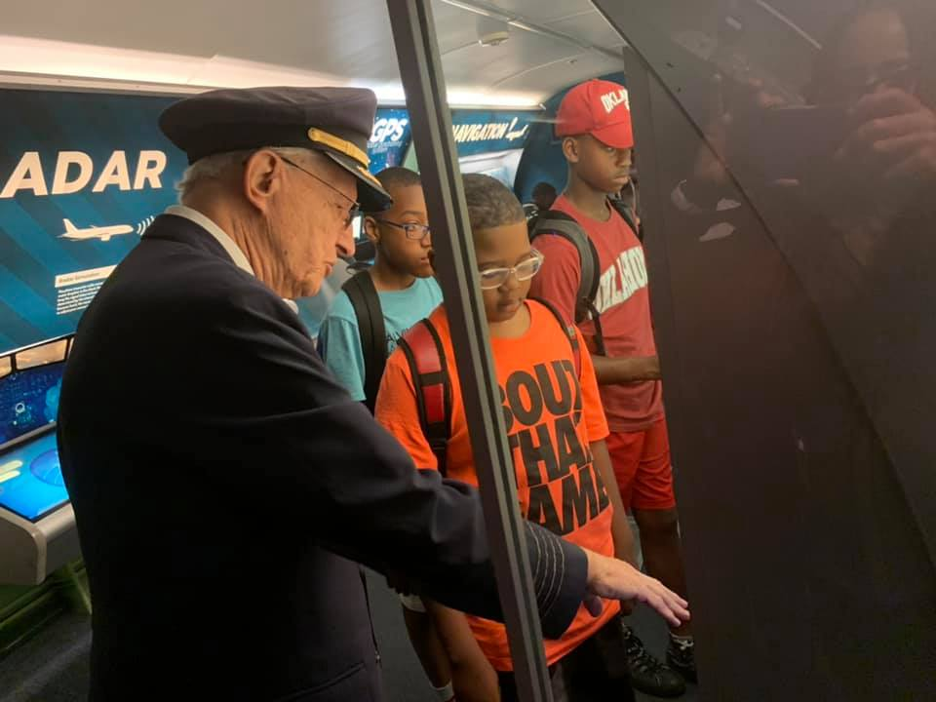
Our 4 Propellers
1. Expose
2. Educate
3. Empower
4. Employ

Slide 37
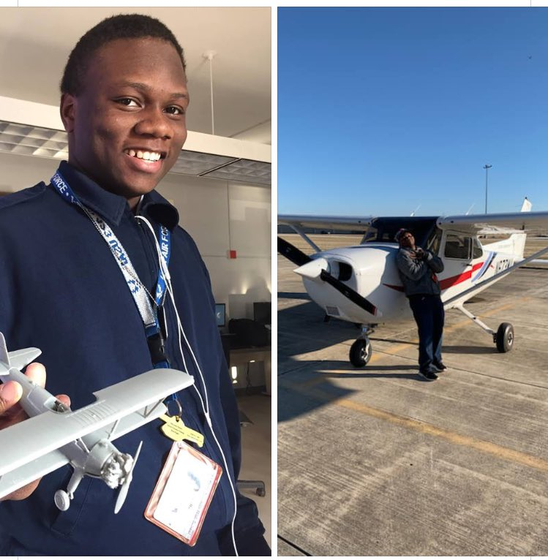
Organization Description
Served nearly 10K students in Chicagoland and Northwest Indiana since 2008
Launched the first Aviation High School in CPS History at Air Force Academy
Has launched 3 Aviation CTE programs in the last 4 years.
Nationally recognized leader for Aviation Talent Pipeline Development & Diversity
The only Kindergarten - Career Aviation education and training org in the nation
Year-round programming for all ages
Rigorous curriculum for exposure, exploration and licensing and certification
Aviation Career Exploration, Career Mapping and scholarship support
Airport facility tours
Corporate facility tours
Professional Development
Job Shadows, Internship and Mentor placements
Aviation outreach events for 1000+ students annually
Robust Online Aviation E-Learning Academy – The AeroVerse
Field Trips, guest speakers, capstone projects, and industry
Formal partnerships for flight training and aircraft maintenance technician training
Notes:
* Fee percentage based on industry averages - https://www.topechelon.com/blog/placement-process/typical-placement-recruitment-fees-average/

Slide 38
Program Overview
Aviation/Aerospace focused
STEM enrichment
Skill building
certified content
Rigorous curriculum
Project-based learning
Career exploration
Apprenticeship placement

Slide 39
THE PITCH
PROBLEM | SOLUTION

Slide 40
The problem
EDUCATION
WORKFORCE
Poor math & science scores in the US
Lack of real-world application of basic academic principles
Low college acceptance/completion rates for minority and underserved students
Lack of resources for STEM learning
Absence of female/minority mentors & instructors in STEM subjects
Skilled labor shortage
Lack of candidates with certifications, licenses & credentials
Plenty of candidates with degrees but no experience
Aging workforce, baby boomer retirement crisis
Lack of diversity in STEM & Aviation sectors
Unemployment/underemployment high for low-skilled workers
Notes:
* Fee percentage based on industry averages - https://www.topechelon.com/blog/placement-process/typical-placement-recruitment-fees-average/

Slide 41
The Solution
EDUCATION
WORKFORCE
Increase student interest in STEM through project-based learning
Enhance classroom learning through infusing aviation concepts
Use industry certified curriculum to ensure skills acquisition and workforce readiness
Provide minority and female role models and advocates to increase matriculation
Provide college application and selection support
Provide career exploration and career mapping
Provide job search and placement support
Create robust and diverse talent pool for employers
Create highly skilled talent pool for employers
Provide professional mentors
Meet aviation industry need for critical shortages of pilots, technicians and STEM workers
Provide apprenticeship platform for skills and knowledge transfer from retirees to next generation
Notes:
* Fee percentage based on industry averages - https://www.topechelon.com/blog/placement-process/typical-placement-recruitment-fees-average/

Slide 42
THE MARKET
OVERVIEW | CUSTOMERS

Slide 43
Market overview
WHERE
Current
Chicago Metropolitan Area
Northwest Indiana
Outlook 5-10 years
Houston, Texas
Atlanta, Georgia
Washington, DC
New York, New York
Charleston, SC
WHO
Academia
Public Schools
Private Schools
Charter Schools
Trade Schools
Community Colleges
Universities
Community
Workforce Organizations
Youth guidance organizations
Civic engagement organizations
Industry
Aircraft Manufacturers
Airlines
Airports
Industry service suppliers
Regulatory agencies
Engineering
Trades & Utilities
Notes:
* Fee percentage based on industry averages - https://www.topechelon.com/blog/placement-process/typical-placement-recruitment-fees-average/

Slide 44
Market overview
EDUCATION
WORKFORCE
K-4 STEM Exploration
5-8 Aviation Career Exploration
9-12 Aviation Pre-Apprenticeships, Apprenticeships and Advanced Apprenticeships
Age18+ AeroStar Ambassador Alliance for Collegiate Support, Professional Development and Career Mapping
Licensing & Certifications for 17-25 focus
Public Private Partnership Apprenticeship programs for high school grads seeking a skilled trade as a Pilot, Aircraft Technician, or STEM worker in Aviation
College students seeking meaningful internships
Industry employers seeking diverse talent
Industry employers seeking highly skilled talent
Industry partners seeking to invest in CSR initiatives directly in line with their revenue goals and social justice commitment.

Slide 45
CUSTOMERS: MARKET SEGMENT
Target
Parents seeking supplemental education opportunities in underserved, minority communities
Corporations seeking to foster impact in community and invest in future talent pipeline
Organizations looking to build apprenticeships and training program capacity
Long Term FUNDING
Aerospace talent pipeline project - The Boeing Company
Aviation youth engagement initiatives - United Airlines, Chicago Housing Authority, Elizabeth Morse Charitable Trust
Chicago Area Apprenticeship program - Chicago Department of Aviation (Pending)
Aviation Careers and Technical Education development – State & Federal Grants (future)
Cost
Donor Funded
Grant funded
Programs and classes are free or significantly reduced
Notes:
* Fee percentage based on industry averages - https://www.topechelon.com/blog/placement-process/typical-placement-recruitment-fees-average/

Slide 46
CUSTOMERS: MARKET SEGMENT
Funders
Boeing
United Airlines
Chicago Housing Authority
JetBlue
Milhouse Charities
Boy’s and Girls Club of Northwest Indiana
Partners
Chicago Tuskegee Airmen
Tuskegee NEXT
Illinois Institute of Technology
Olive Harvey College
Chicago Public Schools
Organization of Black Aerospace Professionals
Collaborators
University of Chicago
Federal Aviation Administration Great Lakes Region
Chicago Community Trust
NASA Out of School time Learning
Chicago Department of Aviation
Obama Foundation
After School Alliance
AAR
Gary Area Career Center
Gary Chicago International Airport
Museum of Science & Industry
B. Coleman Aviation
Southern Illinois University
Lewis University
Notes:
* Fee percentage based on industry averages - https://www.topechelon.com/blog/placement-process/typical-placement-recruitment-fees-average/

Slide 47
AEROSTAR AVION INSTITUTE
Facebook
Instagram @AeroStarAvion
Twitter @AAIPipeline
TAMMERA L. HOLMES
(312) 883-6383
PROGRAMS@AVIONINSTITUTE.ORG

Slide 48
Questions?

Slide 49
TRAINING • OUTREACH • COMMUNICATIONS

Slide 50
Thank You for Attending…
FAIRNESS • TRANSPARENCY • DIVERSITY • INCLUSION
Department of Procurement Services
121 North LaSalle, City Hall Room 806, Chicago, IL 60602
City Hall Bid & Bond Room 103 ● 11th Floor Room 1103
www.chicago.gov/dps ● dpsevents@chicago.gov
facebook.com/ChicagoDPS ● @ChicagoDPS ● youtube.com/ChicagoDPS

