Slide 1
HOW TO BECOME CERTIFIED

Slide 2
Welcome
The Department of Procurement Services is committed to Communications and Outreach, which is key to keeping citizens informed of bid opportunities, new programs, and innovations.
Also, ensure that you download a copy of our most recent Consolidated Buying Plan. This is a 15-month forecast including hundreds of upcoming opportunities for 12 city agencies. To download, go to: www.chicago.gov/dps.
We encourage you to follow us on our website www.chicago.gov/dps for the latest news, updates, and our calendar of events. Go online, www.chicago.gov/DPS and click on the letter icon and sign-up for our Email Newsletter: DPS Alerts full of news that you can use.
Follow us on social media to stay informed:
Facebook: www.facebook.com/ChicagoDPS
LinkedIn: www.linkedin.com/company/chicagodps
Youtube: www.YouTube.com/ChicagoDPS
NOTE: Legal advertisements for the City of Chicago Department of Procurement Services (DPS) appear in the Chicago Tribune. Information about DPS contracting opportunities will be available at www.chicago.gov/bids.

Slide 3
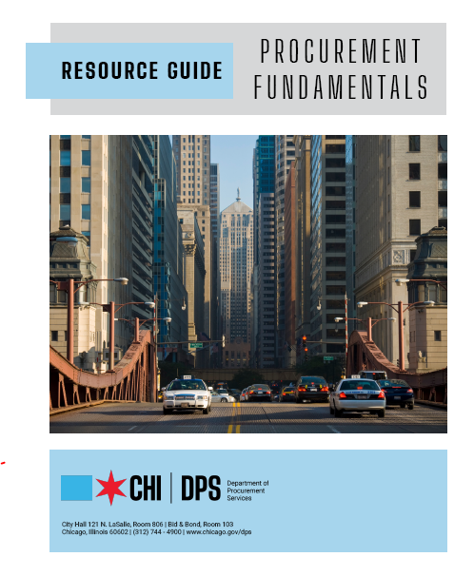
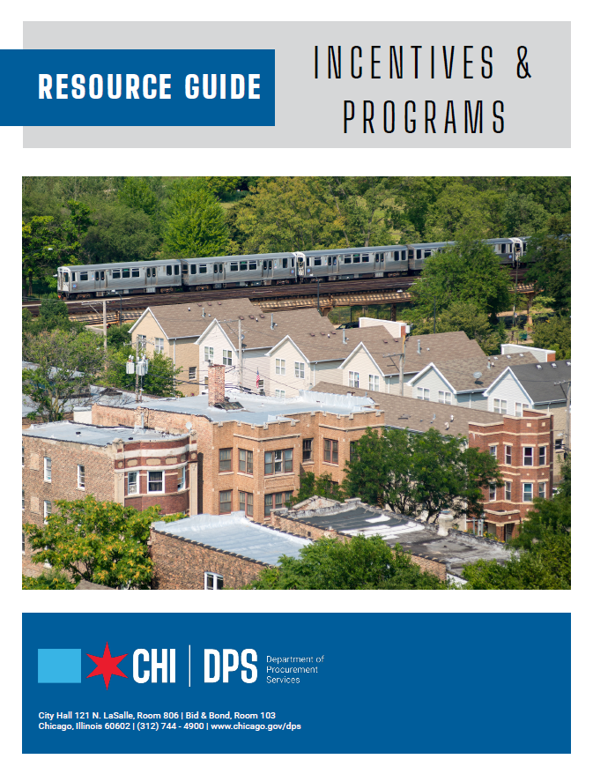
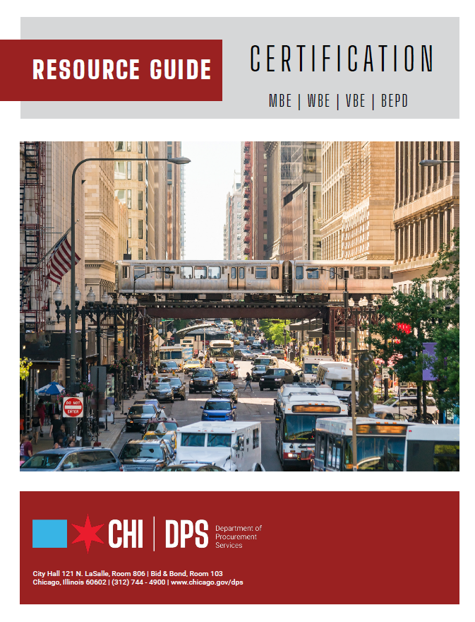
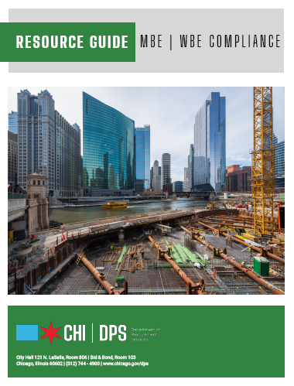
RESOURCE GUIDES
DPS has published a four-volume set of Resource Guides, expanding on the guiding principle of transparency.
The Resource Guides were divided into key areas of the procurement process:
Contract Administration
Incentives and Programs
Certification
Compliance
Download now at www.chicago.gov/dpsguides
@CHICAGODPS

Slide 4
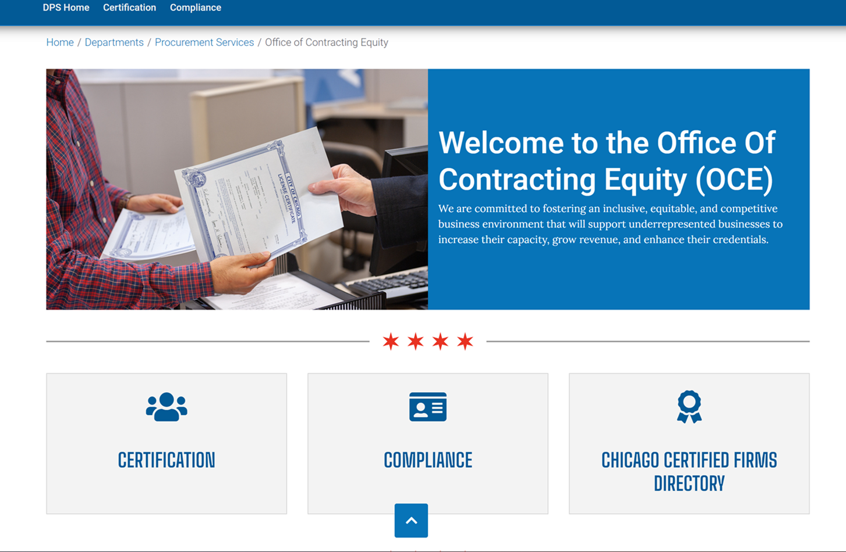
Office of Contracting Equity
DPS has a new contracting equity website to assist vendors in the search for information regarding certification, compliance and more.
The webpage highlights key areas of the procurement process:
Certification Overview
Compliance Information
Chicago Certified Firms Directory
Core Workshop Offerings
Visit this webpage at www.chicago.gov/oce

Slide 5
DPS is the contracting authority for the procurement of goods and services for the City of Chicago. Through its Office of Contracting Equity, the Department is responsible for the administration of incentives and programs designed to promote the inclusion of minorities, women, and other eligible small businesses in contracting opportunities offered by the City of Chicago.
DEPARTMENT OVERVIEW

Slide 6
OUR GOALS AT A GLANCE
Benefits of Certification
Who Qualifies for Certification
Certification Requirements
The Application Process
Required Information/Documents
After Applications are Submitted

Slide 7
City of Chicago Certification Programs
MBE – Minority-Owned Business Enterprise
WBE – Women Owned Business Enterprise
VBE – Veteran-Owned Business Enterprise
BEPD – Business Enterprise for People with Disabilities
DBE – Disadvantaged Business Enterprise
ACDBE – Airport Concessions Disadvantaged Business Enterprise

Slide 8
Benefits of Certification

Slide 9
The Benefits
Provides visibility – Once Certified your firm is listed in a directory which is accessible to the general public and all Prime Contractors.
There are minority, women, veteran and disadvantaged business participation goals on City of Chicago projects and sister agencies.
There are businesses in the private sector that seek out certified firms for products and/or services.

Slide 10
The Benefits
The City of Chicago has a Target Market program which provides exclusive bidding to certified minority and women owned business enterprises. This allows certified businesses to take 100% of the contract because there are no subcontractor goals associated with the project.

Slide 11
Qualifying Groups
African American/Black
Hispanic
Asian
Asian-Indian
Women
Veterans
Persons with Disabilities
Other Individuals who can prove social and economic disadvantage

Slide 12
Veteran-Owned Business Enterprises
VBE – Veteran-Owned Business Enterprise
“Veteran” means a person who has served in the United States armed forces and was discharged or separated under honorable conditions.
DD214 or DD215 needed as supporting evidence. (Required)
If vendor does not have their DD214 or DD215, the applicant should contact the Veterans Administration (VA).

Slide 13
Certification Requirements

Slide 14
What’s Required
Local Business: principal place of business should be in the counties of Cook, DuPage, Kane, Lake, McHenry or Will (Applies to MBE/WBE/VBE/BEPD)
DBE/ACDBE – Can be located anywhere in Illinois
Must be 51% owned, controlled, and managed by a minority, woman, veteran and/or person(s) with a disability. For DBE/ACDBE, owners must be socially or economically disadvantaged individuals

Slide 15
What’s Required
Personal Net Worth Standard
MBE/WBE/VBE: The threshold only applies to construction companies. The PNW is currently $2,767,082.23. This is evaluated annually by the City of Chicago.
DBE/ACDBE: The threshold applies to all people seeking certification and is currently at $1,320,000. This is adjusted periodically by the U.S. Department of Transportation.
The calculation of personal net worth excludes the value of your primary residence and interest in the certified firm. For MBE/WBE Construction, the value of retirement savings, pensions/401 (k), and real estate are also excluded.

Slide 16
What’s Required
Business Size Standard
MBE/WBE/VBE: Gross Receipts must not exceed $48,681,024.12 averaged over 3 years for non-construction firms. Construction firms are subject to 150% of SBA* size standards averaged over 7 years.
DBE: The firm’s 5-year average annual gross receipts must not exceed the SBA size limit for the firm’s primary line of business or the three-year average maximum of $30.40 million for Federal Highway Administration/Federal Transit Administration (FHWA/FTA) assisted contracts. Federal Aviation Administration (FAA) assisted contracts must not exceed the SBA* size limit for the firm’s primary line of business.
ACDBE: Not to exceed $56.42M averaged over 3 years for most firms – some exceptions do exist.
*Ref: https://www.sba.gov/document/support--table-size-standards

Slide 17
Business Structures that Qualify
Sole Proprietor – Typically owned by only one person, has no legal existence apart from the person him/herself
Owner must submit Assumed Name Certificate if operating in name other than owner
General Partnership – Two or more people go into business together without any formalities
Partnership Agreement required

Slide 18
Business Structures that Qualify
Corporations
A corporation is treated as an entity that is completely separate from its shareholders. It allows others to invest in the business without being liable for the debts of that business.
The firm must be in Good Standing with the State
Must have Articles of Incorporation
Must have a Certificate of Incorporation
Must have By-laws of Corporation
Must have copies of all stock certificates (front/back)
Must have Meeting Minutes

Slide 19
Business Structures that Qualify
Limited Partnership
The limited partners are more like stakeholders in a corporation. They are not liable for the debts beyond their own ownership.
Assumed Name Certification or Certificate of Limited Partnership
Limited Liability Company (LLC)
Partnerships that have a Managing Member/Partner
Must have an Operating Agreement
Must have Articles of Organization

Slide 20
Suppliers Distributors Brokers
Suppliers
A supplier must be a regular dealer which is a firm that owns, operates or maintains a store, warehouse or other establishment in which materials, supplies, articles or equipment are bought, kept in stock and regularly sold or leased to the public in the usual course of business.
Distributors
Firms operating as a Distributor are identified as having a direct relationship with a manufacturer to distribute its goods and products within a specified territory, or region. The goods and/or products are not available or sold to the general public.

Slide 21
Suppliers Distributors Brokers
Brokers
Firms acting as a Broker are not eligible for certification as a MBE/WBE/VBE/BEPD but can be eligible for certification as a DBE.
A person or entity that fills orders by purchasing or receiving supplies from a third-party supplier rather than out of its own existing inventory and provides no substantial service other than acting as a conduit between his or her supplier and his or her customer is considered a broker.

Slide 22
Online Application Process

Slide 23
The Process Online
Submit applications online at:
www.Chicago.mwdbe.com
The Application Fee is $250.
(No Fee for DBE/ACDBE or BEPD)
After Submission
You will receive an emailed invoice.
We will not review your application until you pay the $250 application fee.
You can pay the $250 at any of the City’s Payment Centers. You must bring the invoice when paying at the payment centers.
* 2nd page of invoice has website address to make an online payment.

Slide 24
Information Needed
Contact Information
Type of Certification You Are Seeking
MBE/WBE/VBE/BEPD/DBE/ACDBE
BEPD requires Schedule G Form
VBE requires DD214 or DD215
Ownership Information
Employee Information
Facility Information
Financial Information
Licenses (for applicant and business)

Slide 25
Information Needed
Proof of Eligibility Documents
Resume(s) Owners, Key Management
Evidence of Executed Contracts and/or invoices
Driver’s License and Birth Certificate or Passport
Proof of Equity Contribution/Investment
Business Bank Account Signatory Card
Organization Chart
Equipment List
Loan Information

Slide 26
Information Needed
Financial Documents
Federal Business and Individual Tax Returns
Three Years for Non-construction Firms MBE/WBE/VBE/BEPD
Seven Years for Construction Firms MBE/WBE/VBE/BEPD
Five Years for DBE/ACDBE Firms
W-2s/1099s (Owner, Key Managers)
Personal Net Worth Statement (construction firms, all new DBE/ACDBE)

Slide 27
After Applications are Submitted
Your application is checked to make sure we have all documentation
The process can take approximately 90 days from the day we receive “all” documents.
Documents are thoroughly reviewed.
You may receive a site visit. All DBE/ACDBE applications and MBE/WBE/VBE/BEPD applicants in the areas of construction, and supplier/ distributors will receive a site-visit.

Slide 28
Maintaining Certification
There is no Expiration to Certification
However…..
All Vendors must submit an Annual “No Change Affidavit.”
You must notify the Certification Division of the Department of Procurement Services regarding organization changes, business name changes, and ownership changes within 10 business days of the change. You can report material changes online in the portal via the Expansion application with a follow-up email to dps.certification@cityofchicago.org

Slide 29
Maintaining Certification
Expansion of Services:
Submit your request in writing online in the portal via the Expansion application.
Where possible, include the added category NAICS code(s), description of the service to be performed and supporting documentation evidencing the owner’s experience.
You must include:
Required Licenses
Copies of past or present contracts
Any needed insurance
Current resume

Slide 30
What you Need To Know
Top 10 Reasons Applications are Denied
Unsubstantiated or questionable ownership/control.
Unclear description of critical functions and who is responsible.
Company cannot substantiate where and/or how start-up funds/expansion capital was initiated.
Outside secondary employment takes the majority of the MBE/WBE/VBE/BEPD/DBE Enterprise’s time each day.
The company is not located in one of the six county regions (MBE/WBE/VBE/BEPD).
Point of Contact did not respond to requests for information in a timely manner.
Inconsistencies with the Applicant firm name among various documents.
Problems with contracts: missing, incomplete, not signed & executed by qualifying owners, or have no corresponding proof of payments.
Required documents are not attached or no explanation is given as to why the documents are not available.
Three/Five/Seven years of tax returns were not submitted (signed) as required.

Slide 31
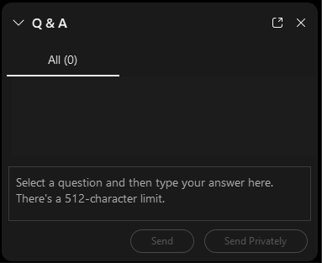
QUESTIONS?
Do you have a question? Please use the WebEx Q&A feature as shown.

Slide 32
FOLLOW US ON SOCIAL MEDIA
@CHICAGODPS
Did you find this workshop helpful? Share it on social media using #DPSWorkshops and spread the word to help the City business community learn about the programs and initiatives available at the City of Chicago.

